Slide 1
Postmodernism | Douglas Jacoby

Slide 2
Post-modernism
A mood
Movement
Methodology

Slide 3
Post-modernism
A mood
Movement
Methodology

Slide 4
Post-modernism
A mood
Movement

Slide 5
Post-modernism
A mood
Movement
Methodology

Slide 6
Ideas and ideologies are powerful, and affect us all

Slide 7
Ideas and ideologies are powerful, and affect us all
—whether we understand them or not!

Slide 10
Postmodernism (PM) is a curious blend of relativism (denying absolute truth) and strong, often strident, truth claims of its own.

Slide 11
PM is the dominant philosophy of our age:

Slide 12
PM is the dominant philosophy of our age:
Universities Film Television
Literature Music Advertising
Jurisprudence Schools Government
Seminaries Sculpture Churches

Slide 13
PM = reaction to modernism.

Slide 14
PM = reaction to modernism.
19th century optimism

Slide 15
PM = reaction to modernism.
19th century optimism
Cosmos as a machine, completely intelligible through science
Science as savior
Technology improving life
Education bringing peaceful coexistence
Utopian political programs
We’ve learned nearly everything there is to learn.

Slide 16
PM = reaction to modernism.
19th century optimism
Cosmos as a machine, completely intelligible through science
Science as savior
Technology improving life
Education bringing peaceful coexistence
Utopian political programs
We’ve learned nearly everything there is to learn.
Progress!

Slide 17
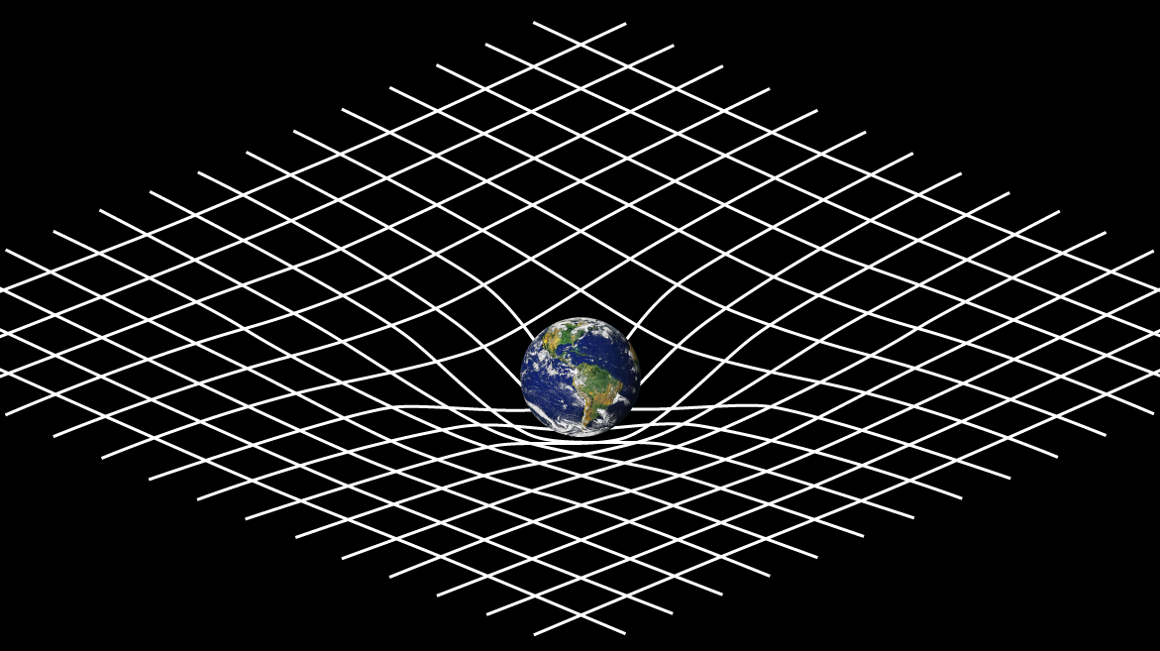

Slide 20
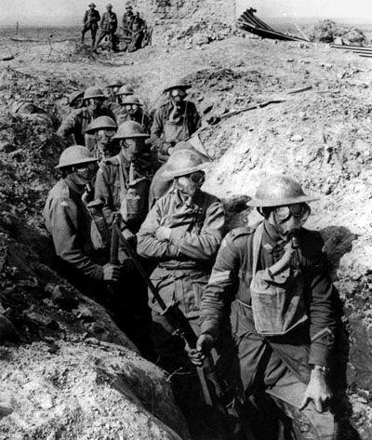

Slide 21
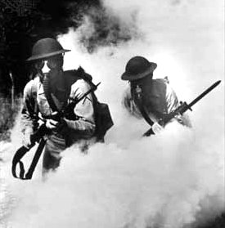

Slide 22
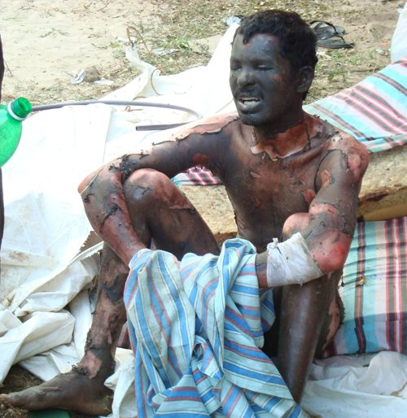

Slide 24
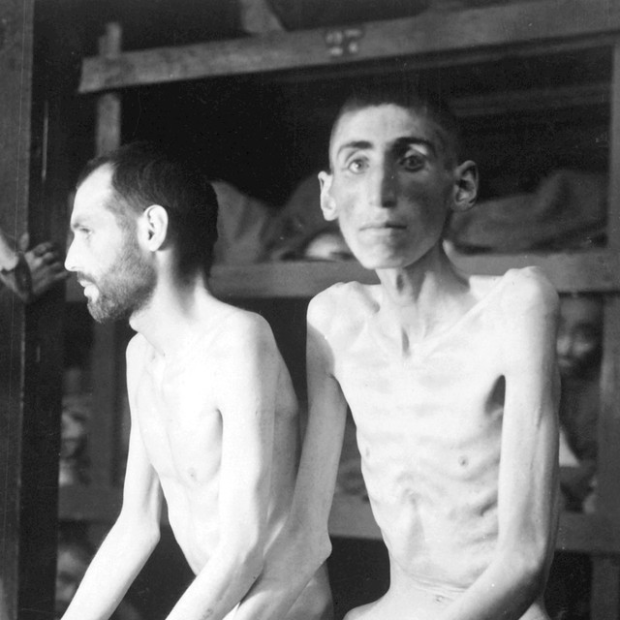

Slide 26
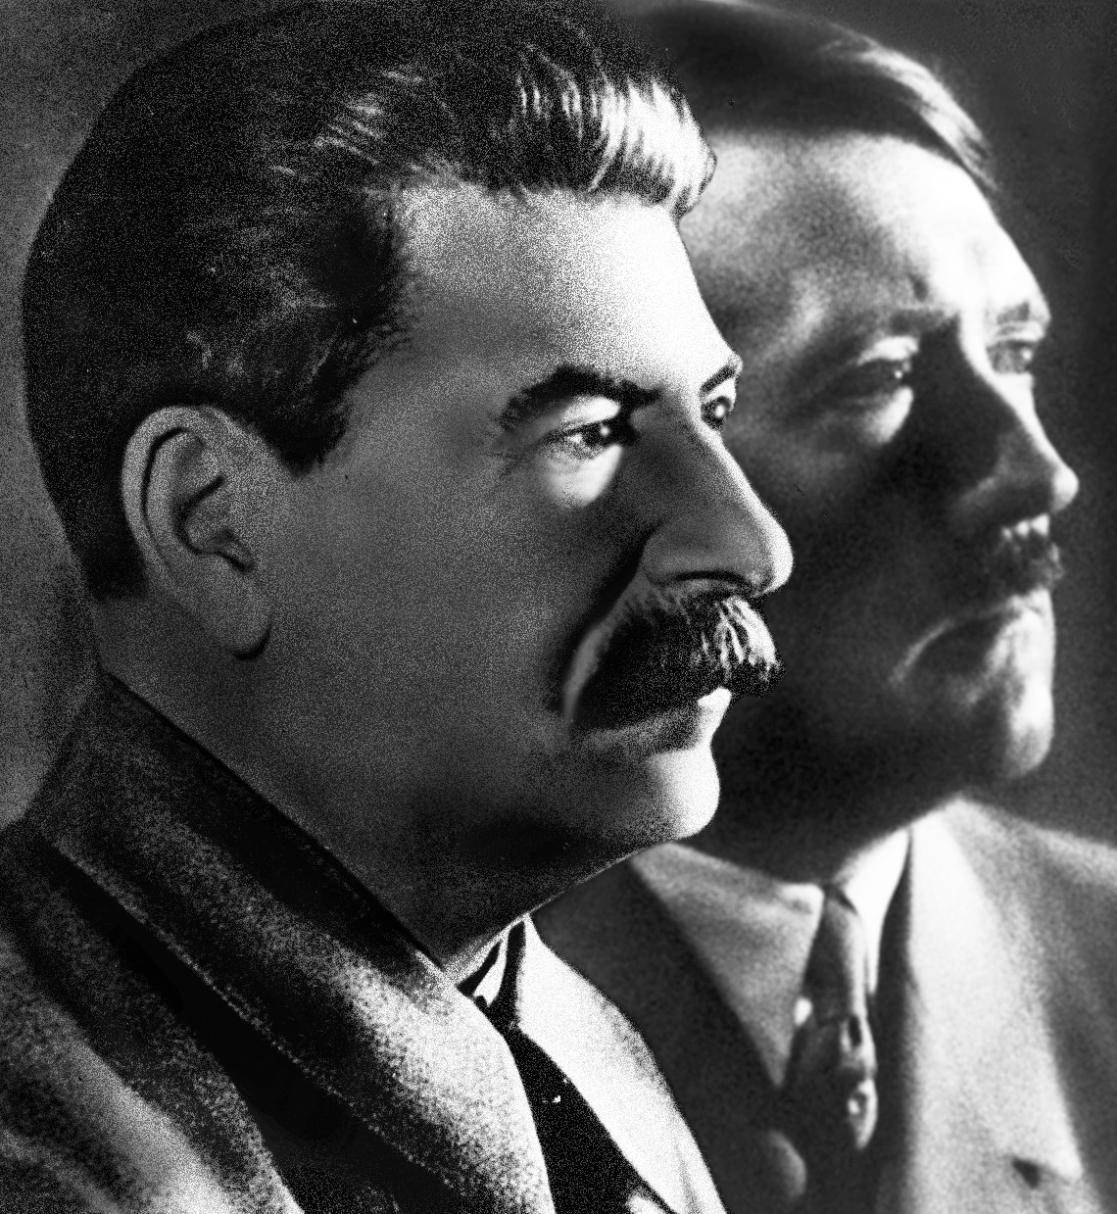

Slide 27
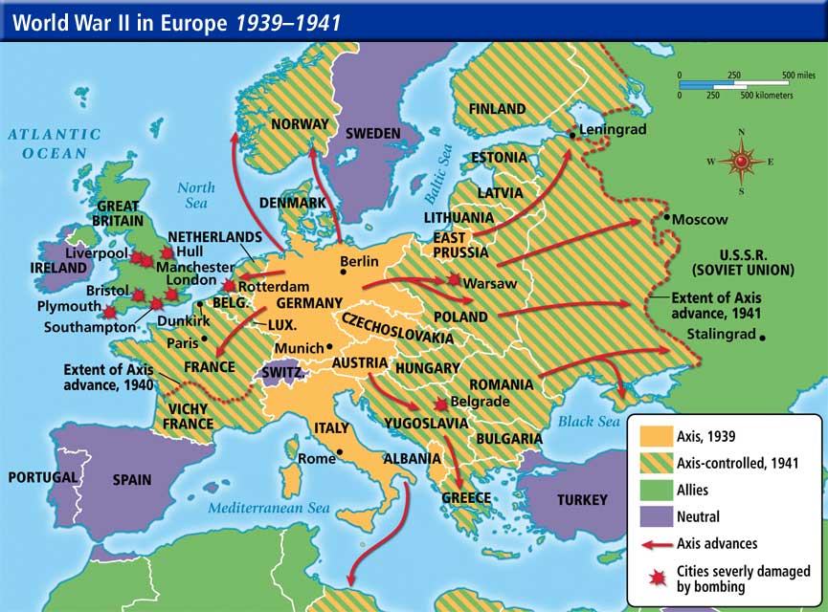

Slide 28
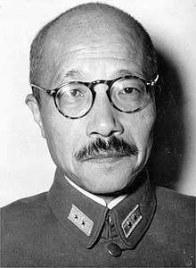

Slide 29
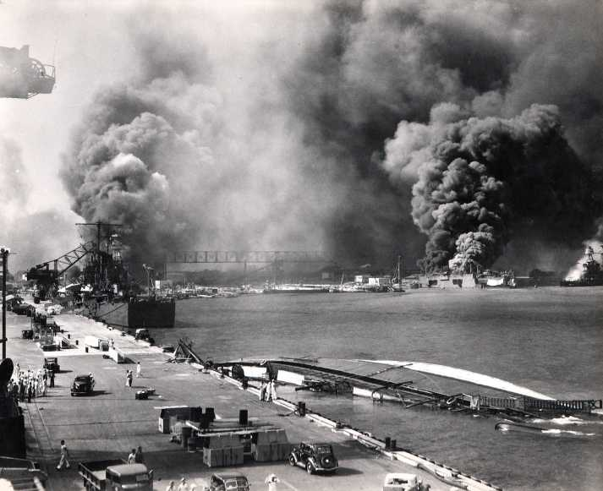

Slide 30
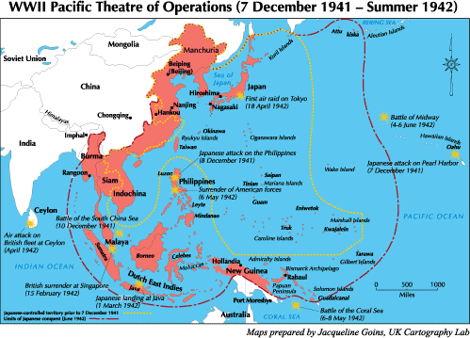

Slide 31
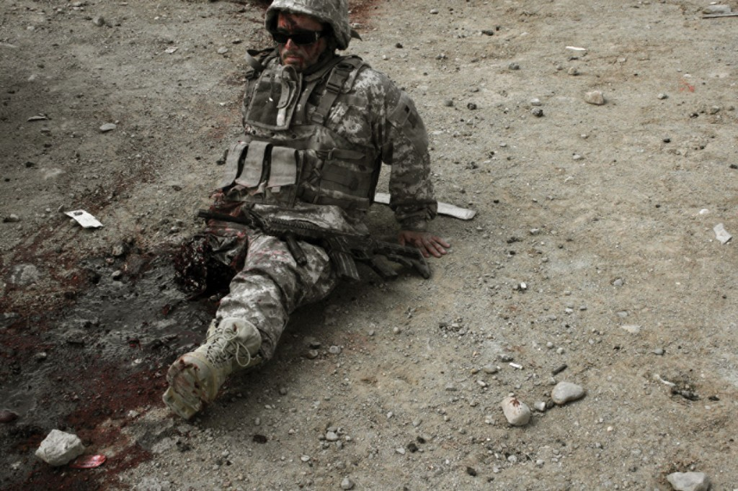
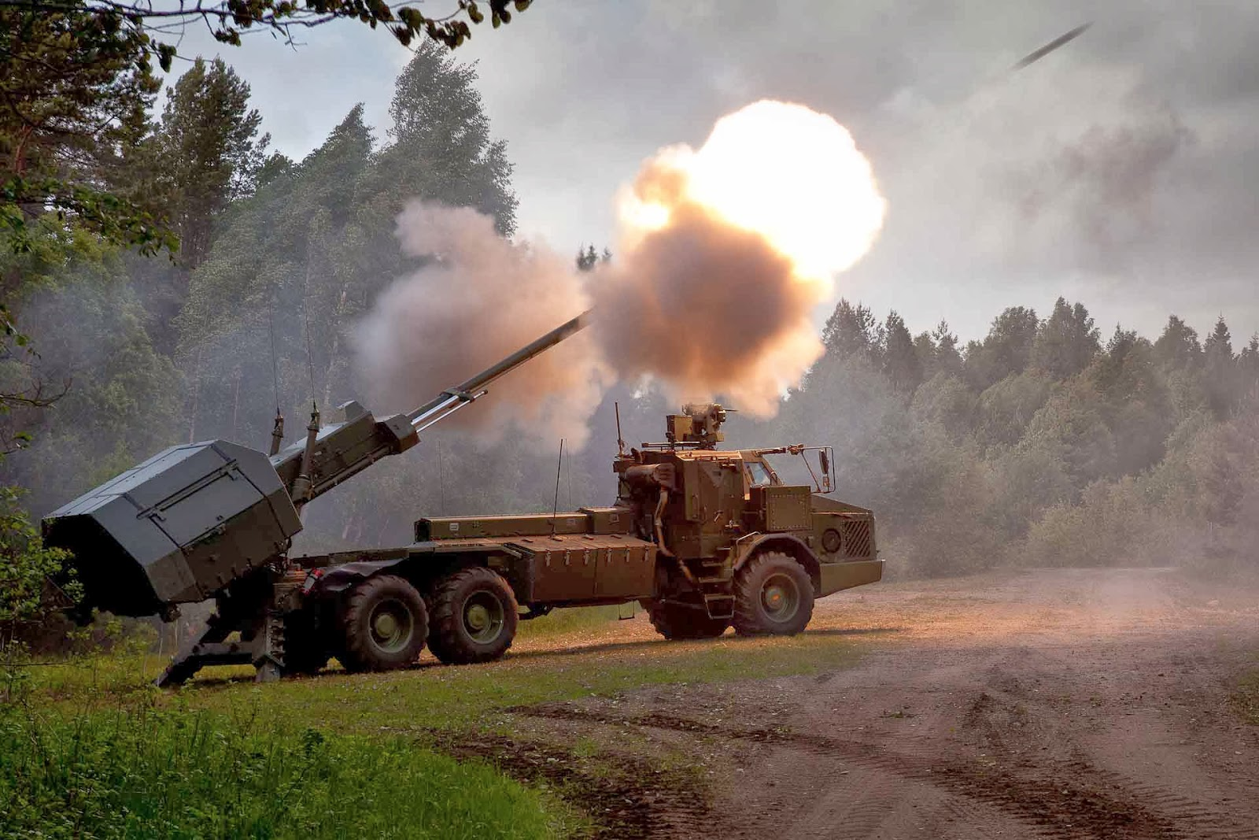

Slide 35
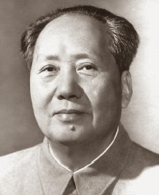

Slide 36
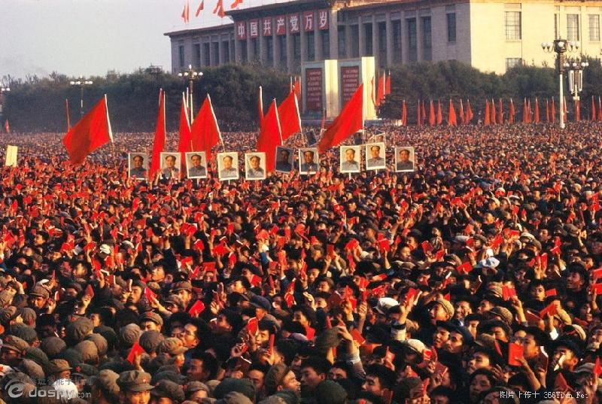

Slide 38
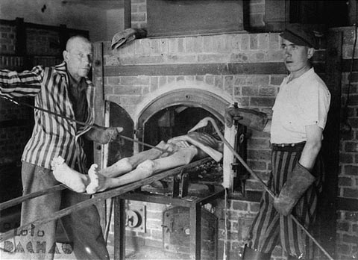

Slide 40
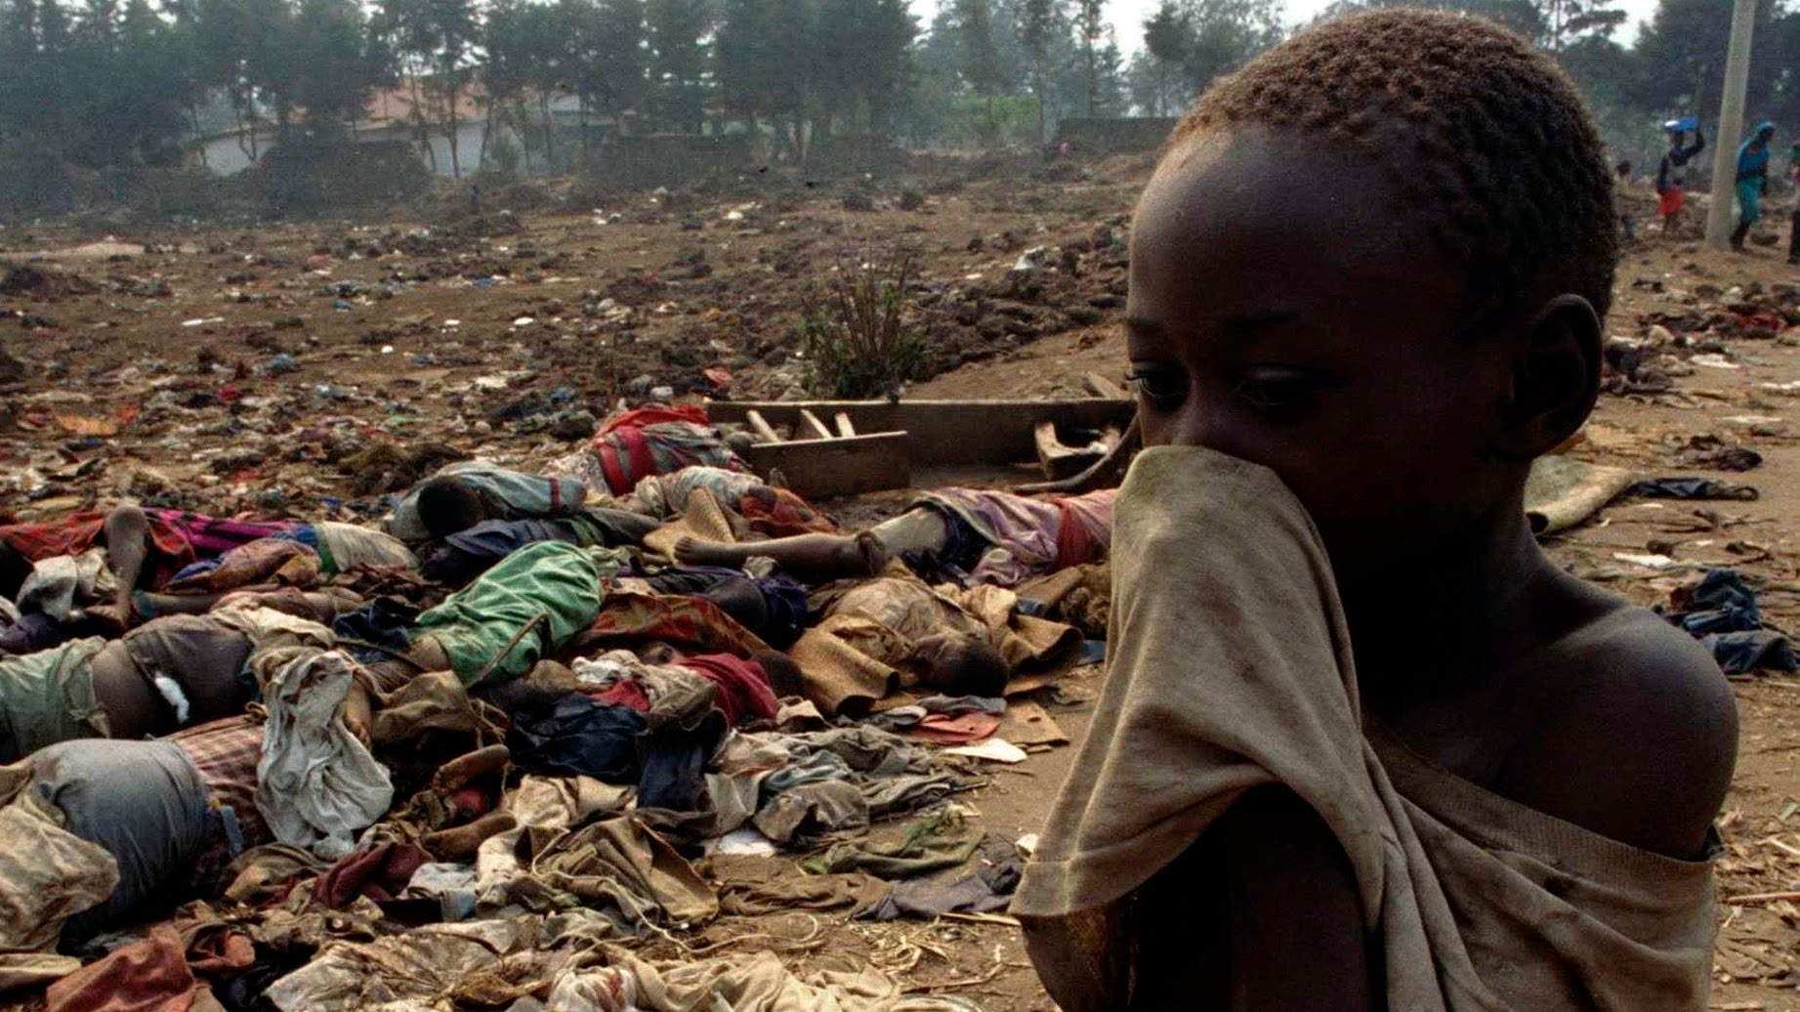

Slide 41
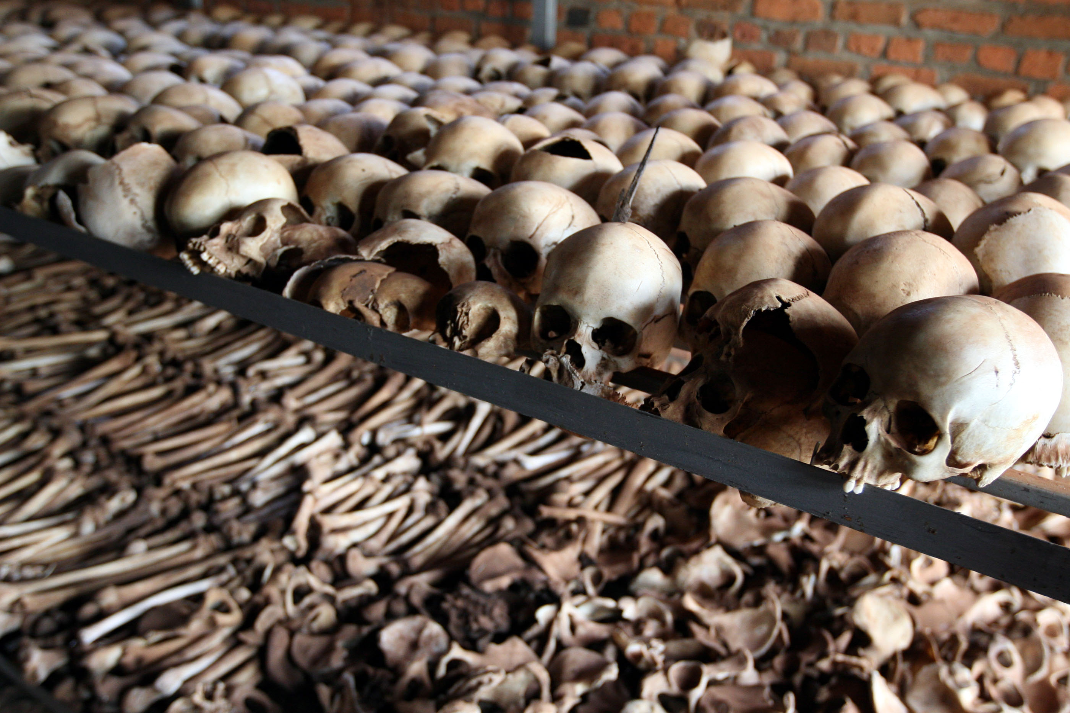

Slide 43
20th century:
39 million killed in war
167 million killed in state-sponsored violence

Slide 44
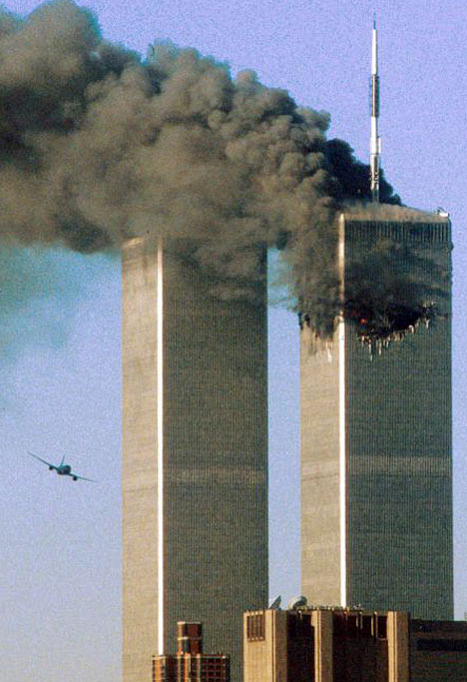

Slide 49
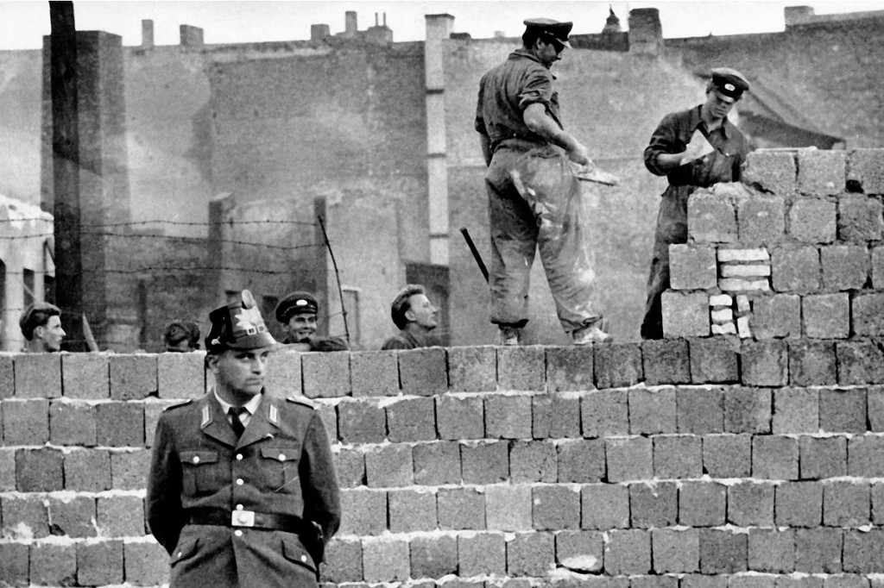

Slide 51
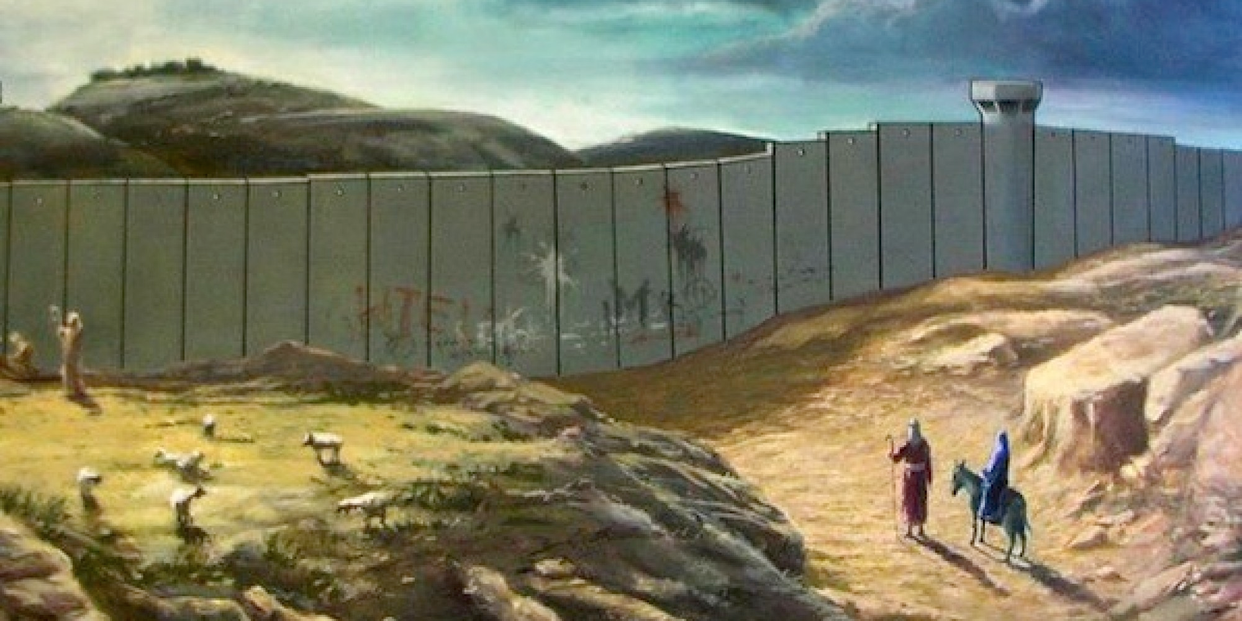

Slide 52
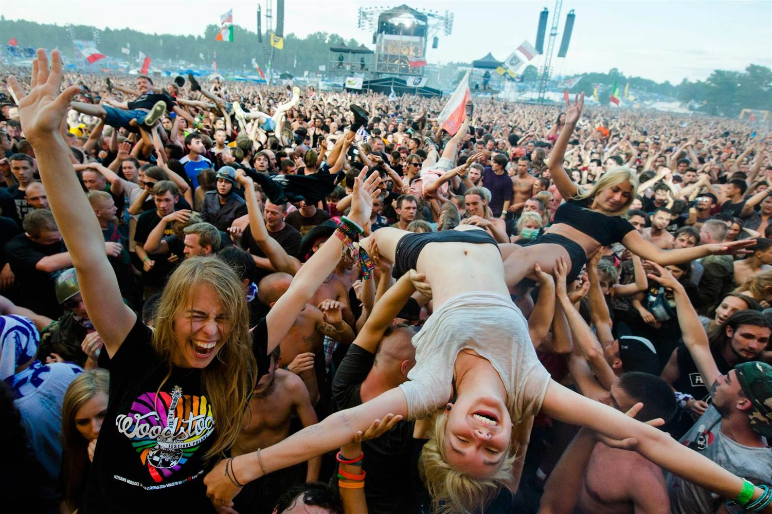

Slide 53
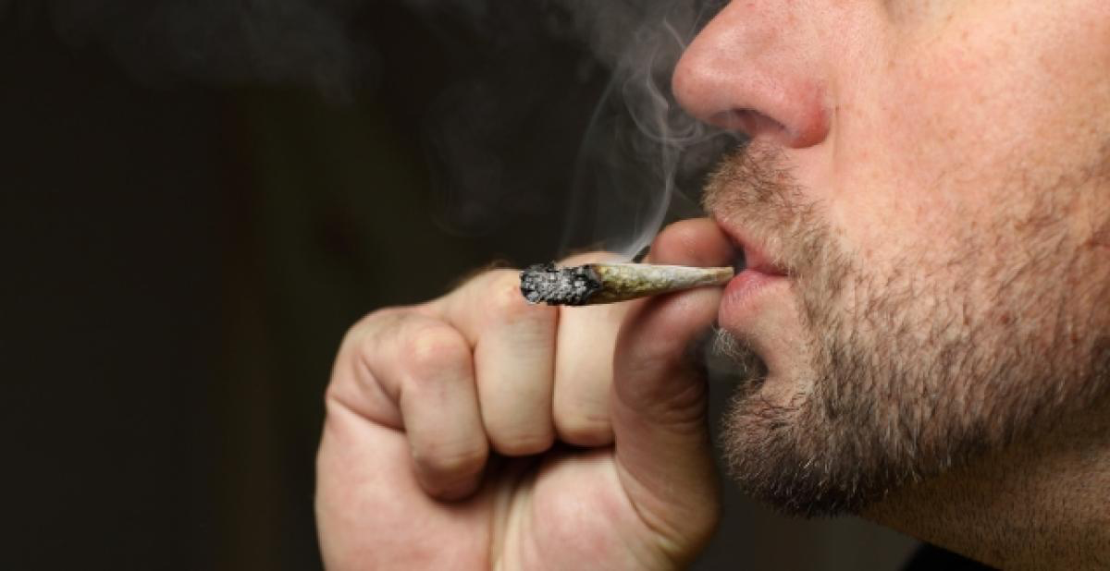

Slide 55
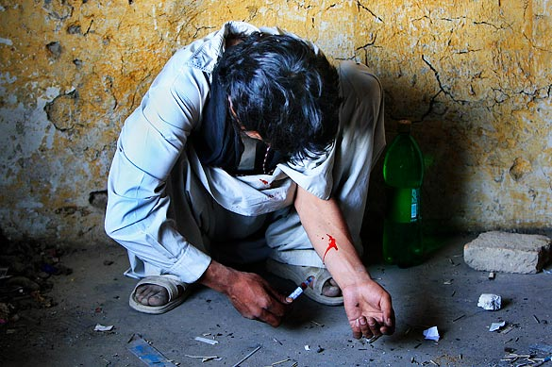

Slide 58
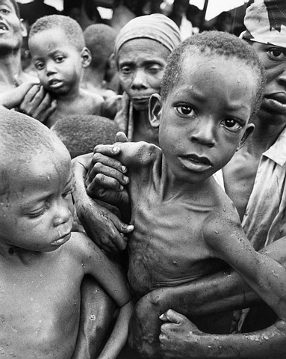

Slide 62
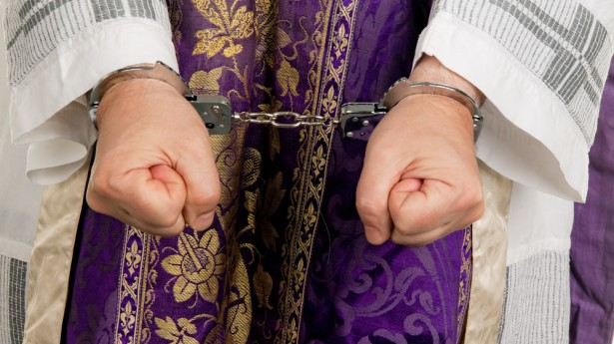

Slide 64
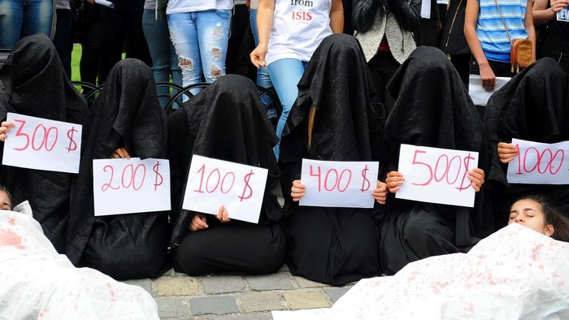

Slide 65
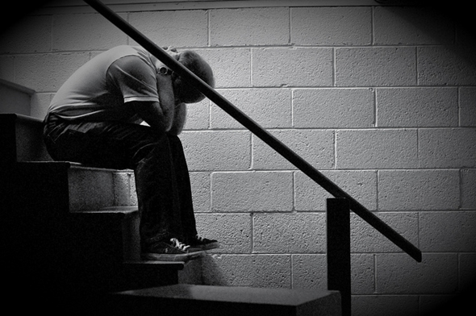

Slide 67
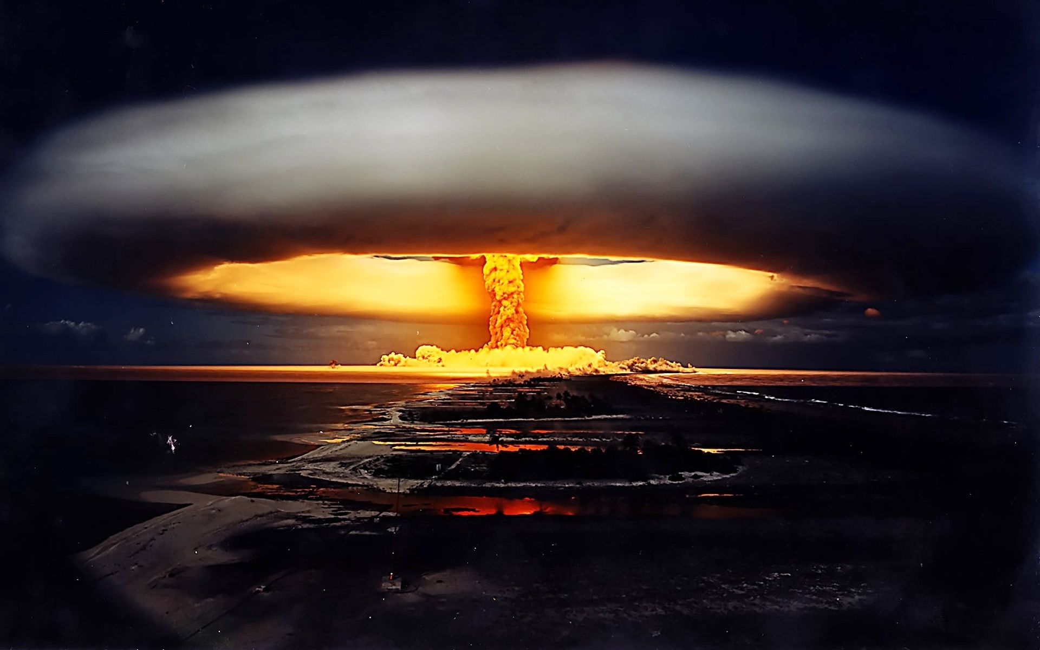

Slide 68
Suspicion:

Slide 69
Under Suspicion
Authority
Authority figures
The police
Teachers
Textbooks
Politics & political discourse
Government
Male leadership
Hollywood
Wall Street
Madison Avenue
The educational system (favoring the well-off)
The establishment
Historical records
Organized religion.
Religious texts—especially the Bible.

Slide 70
What’s the big deal?
Well, PM thinking has already affected your church youth group, campus ministry, younger singles and families—and even many in the previous generation!

Slide 71
In this presentation we’ll become familiar with 4 facets of PM, and learn 5 strategies for appropriate Christian response.

Slide 72
Four Facets

Slide 73
Facet 1:
Truths, not Truth

Slide 74
History: Winners write the history books. (This usually means privileged white males.)

Slide 75
History: Winners write the history books. (This usually means privileged white males.)
US history—Not presented from the viewpoint of the Indians, African slaves, women, or the disenfranchised.

Slide 76
History: Winners write the history books. (This usually means privileged white males.)
US history—Not presented from the viewpoint of the Indians, African slaves, women, or the disenfranchised.
The Canaanites didn’t write the book of Joshua.
Imagine how different 1 Samuel would read if it had been published by the Philistines!
Or if the events of Acts of the Apostles were recounted by the High Priest in Jerusalem!

Slide 77
Intertextuality

Slide 78
Many truths, many Christianities.
“That's your interpretation.”

Slide 80
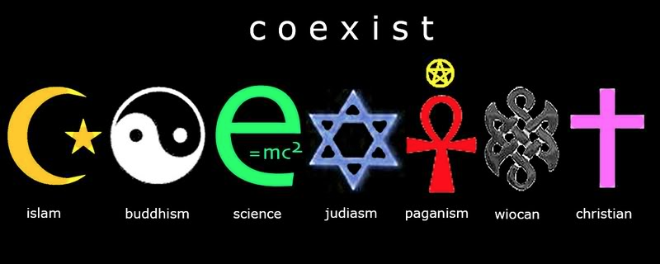

Slide 82
Isn’t one way up the mountain is as good as another?

Slide 83
All world religions equal?
Transformation of tolerance—from tolerance of persons to tolerance of ideas.

Slide 84
All world religions equal?
Transformation of tolerance—from tolerance of persons to tolerance of ideas.
G. K. Chesterton:
“There are those who hate Christianity and call their hatred an all-embracing love for all religions.”
“These are the days when the Christian is expected to praise every creed except his own.”

Slide 85
All world religions equal?
Transformation of tolerance—from tolerance of persons to tolerance of ideas.
G. K. Chesterton:
“There are those who hate Christianity and call their hatred an all-embracing love for all religions.”
“These are the days when the Christian is expected to praise every creed except his own.”
Experts note that the differences among the world’s religions greatly outweigh their similarities.

Slide 86
Multiple truths?

Slide 88
Multiple truths?
PM “truth” is flexible, plastic. Data, facts, info.

Slide 89
Multiple truths?
PM “truth” is flexible.
Select your “facts.” Impact of www. There’s so much info, it’s easier to pick one view you like than to evaluate all.

Slide 90
Multiple truths?
PM “truth” is flexible.
Select your “facts.”
No one can get at the truth directly (it’s inaccessible), but at least we can peel away the layers of the onion. (Of course, once that’s done, nothing is left!)

Slide 91
Multiple truths?
PM “truth” is flexible.
Select your “facts.”
No one can get at the truth directly.
Pretending that contradictory claims are equally true is nonsensical. This is a false egalitarianism of ideas.

Slide 92
Multiple truths?
PM “truth” is flexible.
Select your “facts.”
No one can get at the truth directly.
Pretending that contradictory claims are equally true is nonsensical.
As in mathematics, there will always be far more wrong answers than right ones. (This diversity does not mean there is no answer, or that the answer is unattainable.)

Slide 93
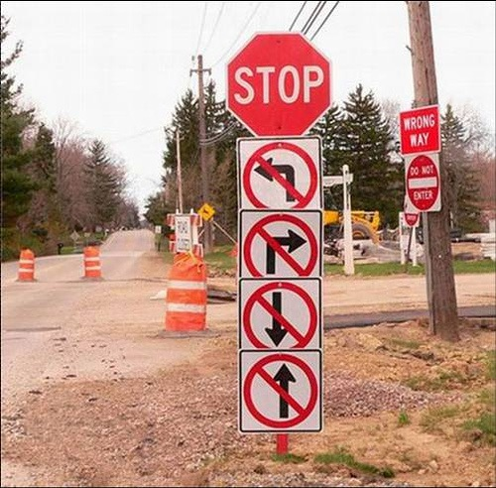
Multiple truths?
PM “truth” is flexible.
Select your “facts.”
No one can get at the truth directly.
Pretending that contradictory claims are equally true is nonsensical.
The “diversity” of correct and incorrect answers doesn’t prove there is no answer!
The PM notion of multiple TRUTHS, as opposed to one TRUTH, is opposed to the TRUTH!

Slide 94
Facet 2:
Values, not Morals

Slide 95
Moral relativism is the engine that drives postmodernism.

Slide 96
Anecdote: The PM with the “freeing” insight.

Slide 97
Anecdote: The PM with the “freeing” insight.
Moral relativism is an absolute truth claim. That is, each person decides his or her own moral course.

Slide 98
Anecdote: The PM with the “freeing” insight.
Moral relativism is an absolute truth claim. That is, each person decides his or her own moral course.
Values (modern lingo) > morals (classical parlance).

Slide 99
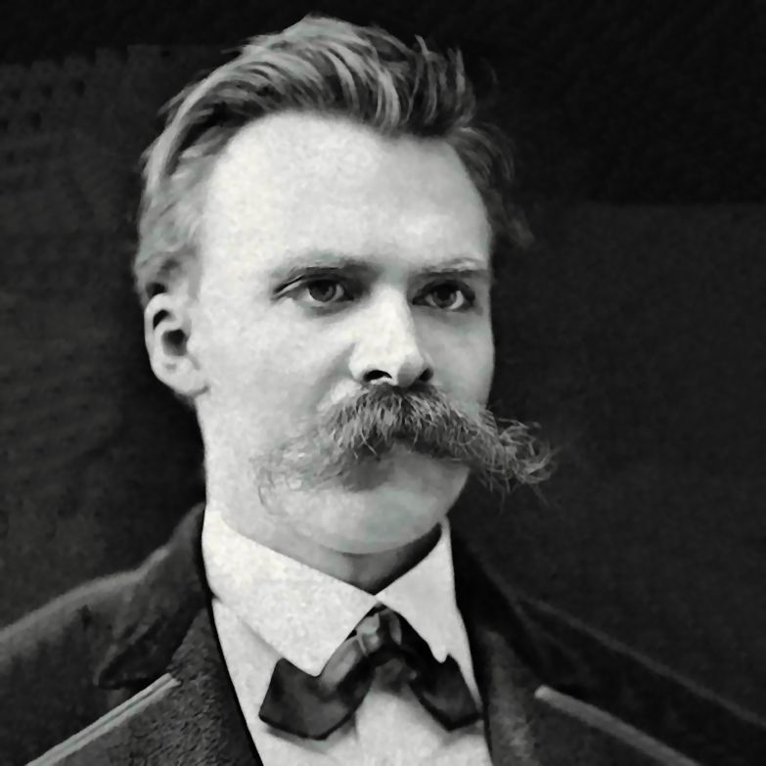
Friedrich Nietzsche
(1844-1900)

Slide 100
Anecdote: The PM with the “freeing” insight.
Moral relativism is an absolute truth claim. That is, each person decides his or her own moral course.
Values (modern lingo) > morals (classical parlance).
Nietzsche—only moral interpretations, not moral/immoral actions.

Slide 101
Anecdote: The PM with the “freeing” insight.
Moral relativism is an absolute truth claim. That is, each person decides his or her own moral course.
Values (modern lingo) > morals (classical parlance).
Nietzsche—only moral interpretations, not moral/immoral actions.
Inconsistent beliefs, sexual & gender confusion.

Slide 102
Anecdote: The PM with the “freeing” insight.
Moral relativism is an absolute truth claim. That is, each person decides his or her own moral course.
Values (modern lingo) > morals (classical parlance).
Nietzsche—only moral interpretations, not moral/immoral actions.
Inconsistent beliefs, sexual & gender confusion.
Criminals have done no wrong; they’re only “sick.”

Slide 103
Anecdote: The PM with the “freeing” insight.
Moral relativism is an absolute truth claim. That is, each person decides his or her own moral course.
Values (modern lingo) > morals (classical parlance).
Nietzsche—only moral interpretations, not moral/immoral actions.
Inconsistent beliefs, sexual & gender confusion.
Criminals have done no wrong; they’re only “sick.”
PM reduces morality and ethics to the level of personal preference.

Slide 105
Facet 3:
Inclusion, not Exclusion

Slide 106
Marginalization & exclusivism are bad.
Inclusion is good.
Christianity is exclusive.

Slide 107
Political oppression
Racism
Homophobia
Ageism
Patriarchy
Classism
Sexism
Evangelism

Slide 108
Political oppression
Racism
Homophobia
Ageism
Patriarchy
Classism
Sexism — M/F distinction
Evangelism is immoral

Slide 109
God our Savior… wants all people to be saved and to come to a knowledge of the truth. – 1 Tim 2:3b-4

Slide 110
God our Savior… wants all people to be saved and to come to a knowledge of the truth. – 1 Tim 2:3b-4
… I take no pleasure in the death of anyone, declares the Sovereign Lord. Repent and live! – Ezek 18:32

Slide 111
God our Savior… wants all people to be saved and to come to a knowledge of the truth. – 1 Tim 2:3b-4
… I take no pleasure in the death of anyone, declares the Sovereign Lord. Repent and live! – Ezek 18:32
The servant who knows the master’s will and does not get ready or does not do what the master wants will be beaten with many blows. But the one who does not know and does things deserving punishment will be beaten with few blows. From everyone who has been given much, much will be demanded; and from the one who has been entrusted with much, much more will be asked. – Luke 12:47-48; also
John 12:47-48

Slide 112
Yet ironically, those who refuse to believe PM rhetoric and toe the line are to be excluded.

Slide 113
Facet 4:
Journey, not Destination

Slide 114
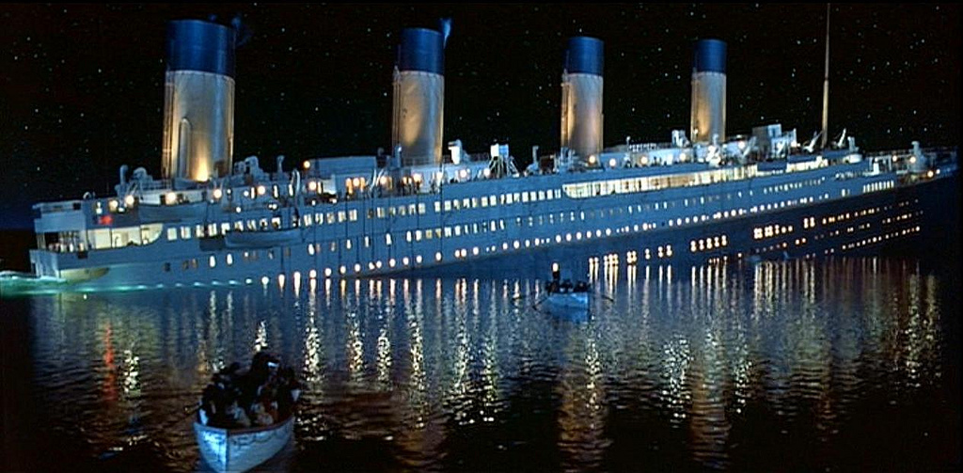

Slide 115
High school valedictorian (newspaper interview):

Slide 116
High school valedictorian (newspaper interview):
Intended major: “I don’t know.”
Career goals: “I’m not certain.. I’m not even certain I want a set career. Maybe I’ll skip from job to job. I don’t want to commit myself.”
“I look at a lot of people tied down to the job and I wonder if they’re really happy. But it’s probably too late for them to change. I don’t want to get like that.”
“I waste a lot of time, watching TV, or driving around, visiting friends.”

Slide 117
High school valedictorian (newspaper interview):
Intended major: “I don’t know.”
Career goals: “I’m not certain.. I’m not even certain I want a set career. Maybe I’ll skip from job to job. I don’t want to commit myself.”
“I look at a lot of people tied down to the job and I wonder if they’re really happy. But it’s probably too late for them to change. I don’t want to get like that.”
“I waste a lot of time, watching TV, or driving around, visiting friends.”
It doesn’t seem like this guy is going anywhere, does it? He’s spending too much time on journey, not enough on destination.

Slide 118
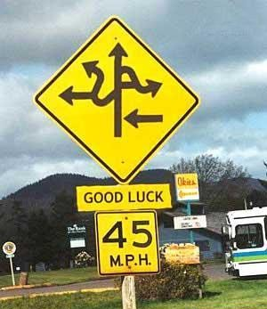

Slide 119
Truths, not Truth
Values, not Morals
Inclusion, not Exclusion
Journey, not Destination

Slide 120
Five Strategies

Slide 121
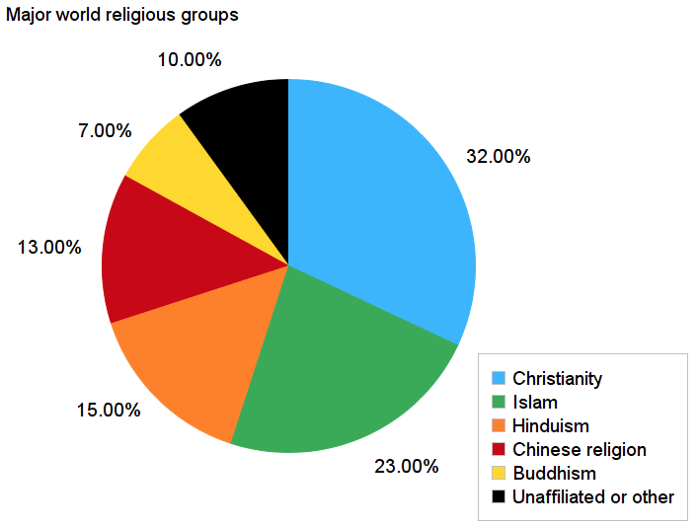

Slide 122
Most Christian study series assume a lazy or lukewarm or lapsed church member.

Slide 123
Most Christian study series assume a lazy or lukewarm or lapsed church member.
Word – Does this lesson actual prove the Bible is true? What about when people have questions or doubts?
Discipleship – (esp. when done early on) assumes and asks too much!
Sin – When someone has been conditioned to believe morality is a private or relative matter, this may not connect. And so on…
Needed are foundational studies on God, creation, the story of the Bible, and (often) even on Jesus.

Slide 124
Most Christian study series assume a lazy or lukewarm or lapsed church member.
Word – Does this lesson actual prove the Bible is true? What about when people have questions or doubts?
Discipleship – (esp. when done early on) assumes and asks too much!
Sin – When someone has been conditioned to believe morality is a private or relative matter, this may not connect. And so on…
Needed are foundational studies on God, creation, the story of the Bible, and (often) even on Jesus.
Our words often fall uselessly to the ground, like a proverb in the mouth of a fool (Prov 26:7).

Slide 125
According to Barna, 3 of the top 6 reasons young people are rejecting the faith of their parents are:
Reason 3: Churches antagonistic to science
Reason 5: The exclusive nature of Christianity
Reason 6: Church unfriendly to those who doubt

Slide 126
According to Barna, 3 of the top 6 reasons young people are rejecting the faith of their parents are:
Reason 3: Churches antagonistic to science
Reason 5: The exclusive nature of Christianity
Reason 6: Church unfriendly to those who doubt
Far too many Christians are oblivious of the intellectual and spiritual climate in which they live.

Slide 127
Strategy 1 : Intentional Interaction

Slide 128
Strategy 1 : Intentional Interaction
Reach out to members of other cultures and religions , not just those you feel comfortable around.

Slide 129
Strategy 1 : Intentional Interaction
Reach out to members of other cultures and religions , not just those you feel comfortable around.

Slide 130
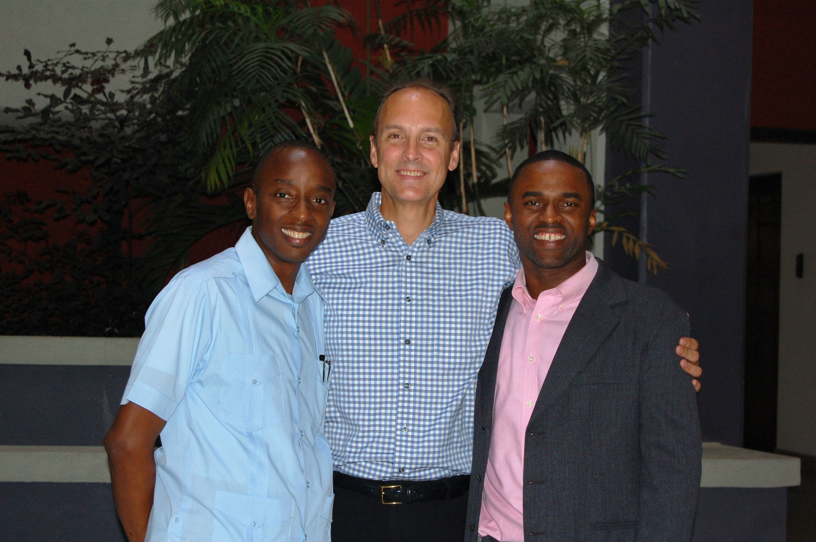
Strategy 1 : Intentional Interaction
Reach out to members of other cultures and religions , not just those you feel comfortable around.

Slide 131
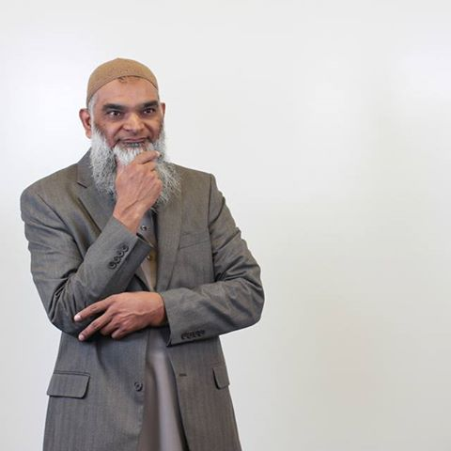
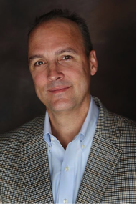
Debate with Sheikh Shabir Ally
Toronto, 27 Feb 2017
“Violence, the Bible, & the Qur’an”

Slide 132
Strategy 1: Intentional Interaction
Reach out to members of other cultures and religions , not just those you feel comfortable around.
Aim to foster friendship and trust.
Share your family.
Throw parties.
Do interesting things together—not just Bible studies!

Slide 133
Strategy 1: Intentional Interaction
Reach out to members of other cultures and religions , not just those you feel comfortable around.
Aim to foster friendship and trust.
Share your family.
Throw parties.
Do interesting things together—not just Bible studies!
Once again, don’t jump into evangelism proper without doing some pre-evangelism. This may take time!

Slide 134
Strategy 2: Be Culture Critics

Slide 135
Strategy 2: Be Culture Critics
Movies, TV shows, song lyrics, books…

Slide 136
Strategy 2: Be Culture Critics
Movies, TV shows, song lyrics, books…
What messages are we receiving from the younger generation?

Slide 137
Strategy 2: Be Culture Critics
Movies, TV shows, song lyrics, books…
What messages are we receiving from the younger generation?
Let’s become students of other worldviews.

Slide 138
Strategy 2: Be Culture Critics
Movies, TV shows, song lyrics, books…
What messages are we receiving from the younger generation?
Let’s become students of other worldviews.
Remember, Paul didn't quote the Bible to pagans (Acts 14; Acts 17).
Paul had invested time to learn how people think, what stories they have been told, their culture….

Slide 139
Strategy 3: Be Church Critics
What is off-putting for PMs?

Slide 141
Strategy 3 : Be Church Critics
Poorly prepared messages.
Hypocrisy

Slide 142
Strategy 3 : Be Church Critics
Poorly prepared messages.
Hypocrisy
Materialism / pursuing the American dream

Slide 143
Strategy 3 : Be Church Critics
Poorly prepared messages.
Hypocrisy
Materialism / pursuing the American dream
Callousness towards the needy

Slide 144
Strategy 3 : Be Church Critics
Poorly prepared messages.
Hypocrisy
Materialism / pursuing the American dream
Callousness towards the needy
Legalism: religion = rules

Slide 145
Strategy 3 : Be Church Critics
Poorly prepared messages.
Hypocrisy
Materialism / pursuing the American dream
Callousness towards the needy
Legalism: religion = rules
Shallow or corny religion

Slide 146
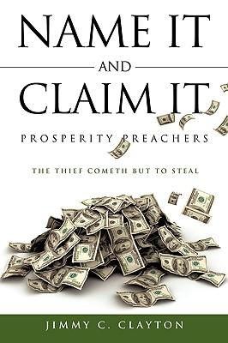

Slide 147
Shallow or Corny Religion
Health & Wealth teaching (Prosperity Theology)
PMs can see right through it (if they want to).
Signs & Wonders teaching.
The religion of many is thrill-seeking fantasy!
Shallow choruses and slogans
Esp. those downplaying or ignoring the suffering in the world. Authentic, biblical faith comes to terms with the real world.
The Myth of Christian America Defend it, and our story loses credibility; we’re little different from anyone else. No nation has ever been in covenant with God but ancient Israel.
Fundamentalist anti-science sentiment
Quite a few reject the findings of geology, physics, biology, and
cosmology, or poorly prepare their children to think scientifically.

Slide 148
Strategy 3: Be Church Critics
Poorly prepared messages.
Hypocrisy
Materialism / pursuing the American dream
Callousness towards the needy
Legalism: religion = rules
Shallow or corny religion

Slide 149
Strategy 3: Be Church Critics
Poorly prepared messages.
Hypocrisy
Materialism / pursuing the American dream
Callousness towards the needy
Legalism: religion = rules
Shallow or corny religion
We need to police ourselves. Like the prophets of old, all God’s people should be involved in some degree of reflection and feedback.

Slide 150
Strategy 4: Emphasize commonality
We too are suspicious of the system (Matt 23)—and the political system (“Go tell that fox…”, Luke 13). Jesus’ hardest challenges were to religious leaders (John 3:9).
The Bible affirms ecology (Gen 1:28).
Affirmation of marginalized (Luke 10:25-37; 38-42).
Respect for the physically challenged (Lev 19:14).
Diversity (minorities, Gentiles welcome; Rev 7:9).
We too are fellow seekers—we have not “arrived” (Psalm 27:28; Matt 6:33; Phil 3:12; Heb 11:14-16).

Slide 151
Strategy 4: Emphasize commonality
We too are suspicious of the system (Matt 23)—and the political system (“Go tell that fox…”, Luke 13). Jesus’ hardest challenges were to religious leaders (John 3:9).
The Bible affirms ecology (Gen 1:28).
Affirmation of marginalized (Luke 10:25-37; 38-42).
Respect for the physically challenged (Lev 19:14).
Diversity (minorities, Gentiles welcome; Rev 7:9).
We too are fellow seekers—we have not “arrived” (Psalm 27:28; Matt 6:33; Phil 3:12; Heb 11:14-16).

Slide 152
We have much in common with PMs; many of their observations are accurate, or contain a kernel of truth.

Slide 153
We have much in common with PMs; many of their observations are accurate, or contain a kernel of truth.
Let’s show respect (1 Pet 3:14-16). No room for patronizing comments—or whining about the younger generation – which every older generation, going back millennia, seems to have done!

Slide 154
We have much in common with PMs; many of their observations are accurate, or contain a kernel of truth.
Let’s show respect (1 Pet 3:14-16). No room for patronizing comments—or whining about the younger generation – which every older generation, going back millennia, seems to have done!
Don’t try to force everyone into the same mold!
(Remember, most of the planet needs pre-evangelism.)

Slide 155
Strategy 5: Scriptural Sensitivity

Slide 156
Scripture
The insight of Ambrose (340-397 AD) captures nicely the connection between God and Scripture. “As in Paradise, God walks in Scripture, seeking man.”

Slide 157
Scripture
The insight of Ambrose (340-397 AD) captures nicely the connection between God and Scripture. “As in Paradise, God walks in Scripture, seeking man.”
Acknowledge that in the Bible we find black & white, but also gray!

Slide 158
Scripture
The insight of Ambrose (340-397 AD) captures nicely the connection between God and Scripture. “As in Paradise, God walks in Scripture, seeking man.”
Acknowledge that in the Bible we find black & white, but also gray!
Acknowledge that not all biblical truths are equally important. Some commands are more important than others. The Bible isn’t “flat,” everything being on the same level, but varied. It has a topography, an interesting terrain.

Slide 159
Nuance
Balance
Wisdom

Slide 160
General
The insight of Ambrose (340-397 AD) captures nicely the connection between God and Scripture. “As in Paradise, God walks in Scripture, seeking man.”
Acknowledge that in the Bible we find black & white, but also gray!
Acknowledge that not all biblical truths are equally important. Some commands are more important than others. The Bible isn’t “flat,” everything being on the same level, but varied. It has a topography, an interesting terrain.
Emphasize that the biblical story is a true story, rooted in time & space, history & geography. It’s better than fiction.

Slide 161
Stories
PMs like stories.

Slide 162
Stories
PMs like stories.
Emphasize the biblical story, from Gen to Rev, from Abraham who wandered out of Ur to all the pilgrims on the journey to the Celestial City.
This story is anchored in history.

Slide 163
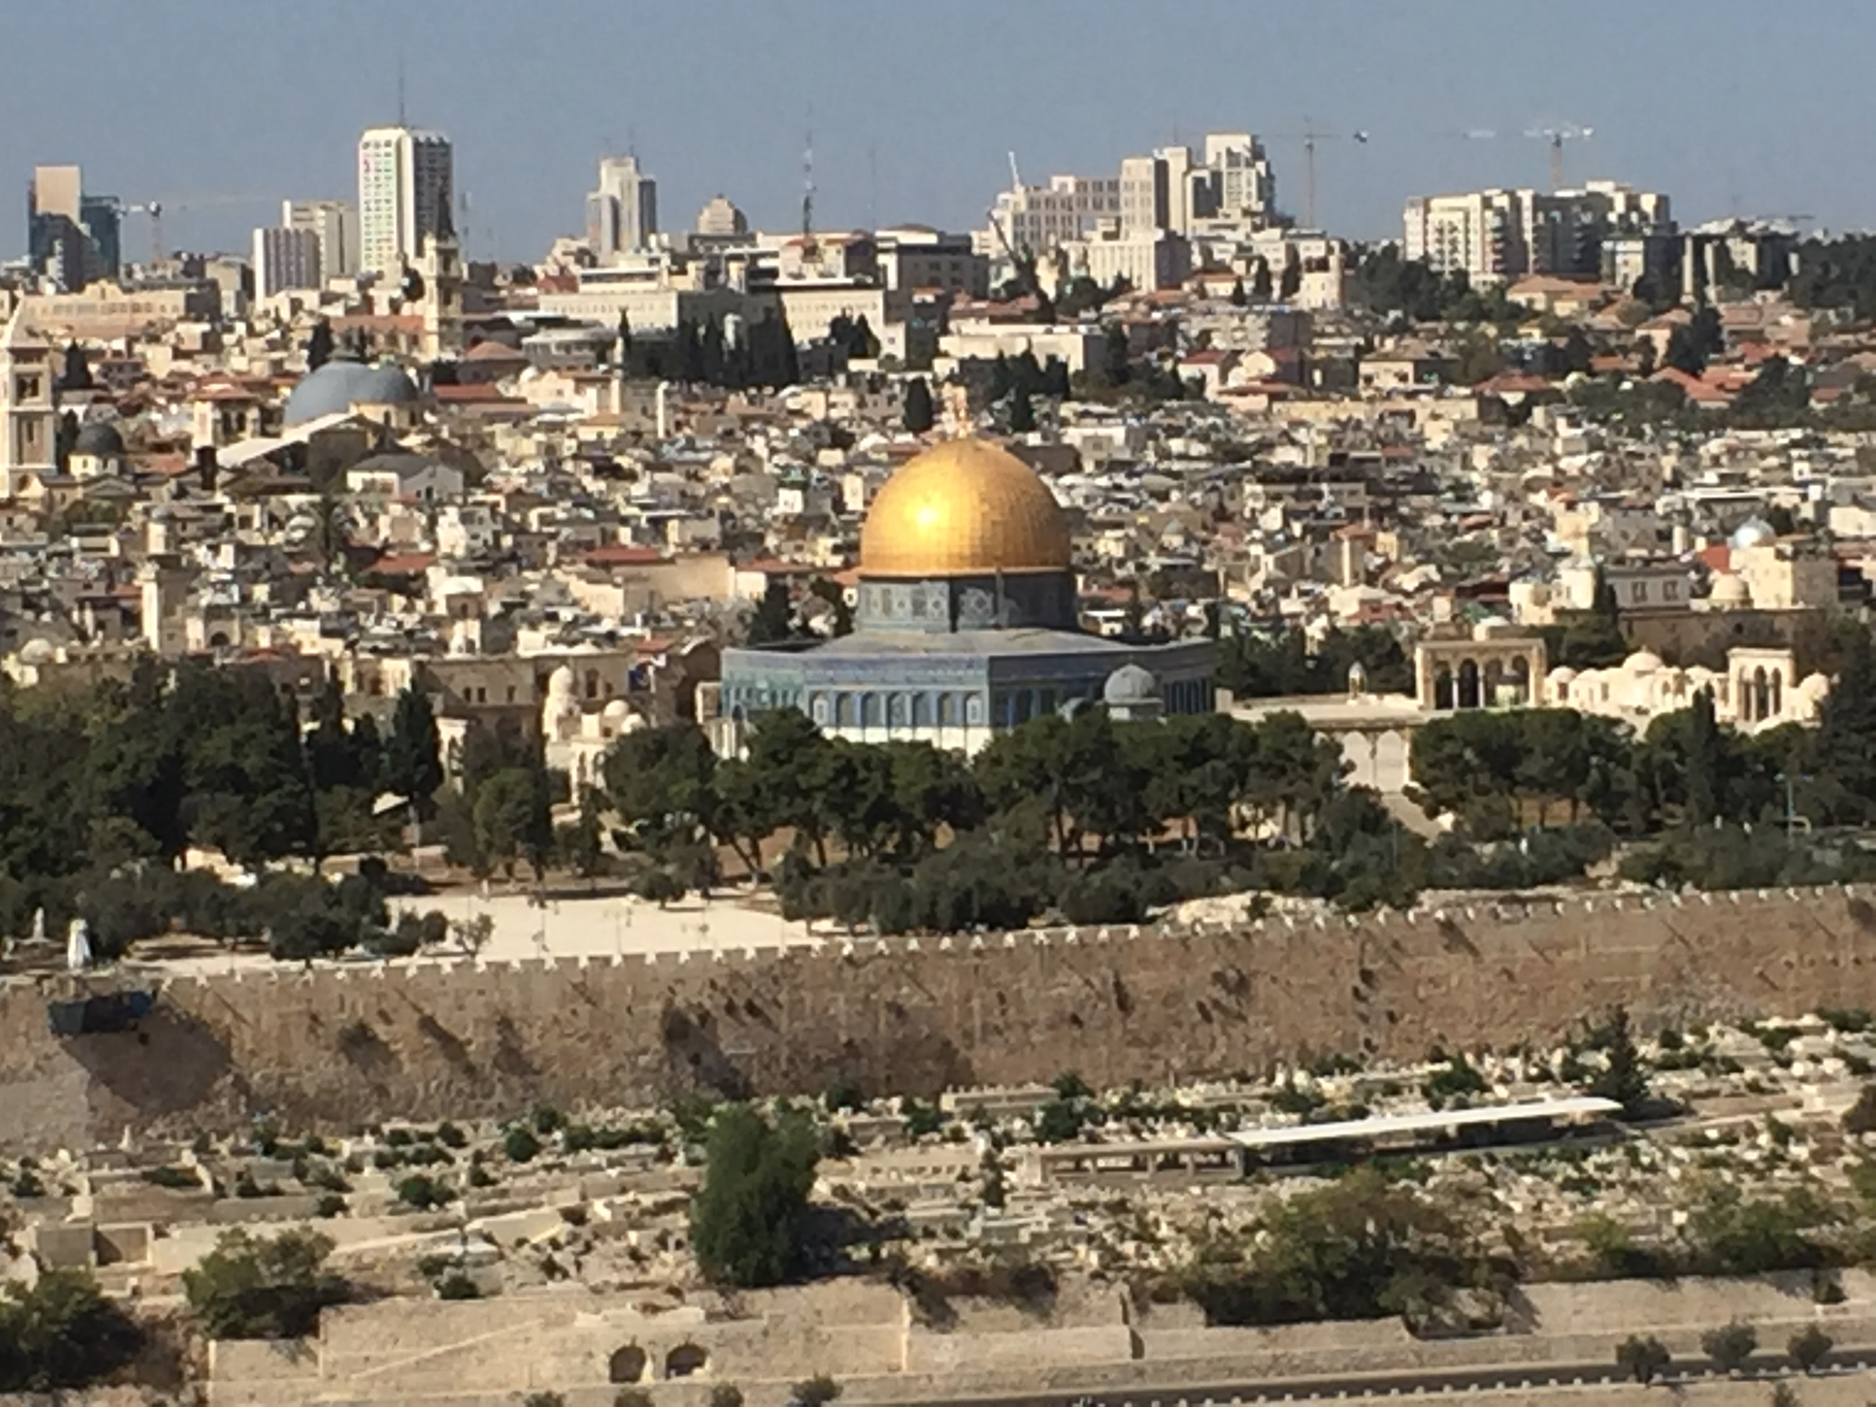

Slide 164
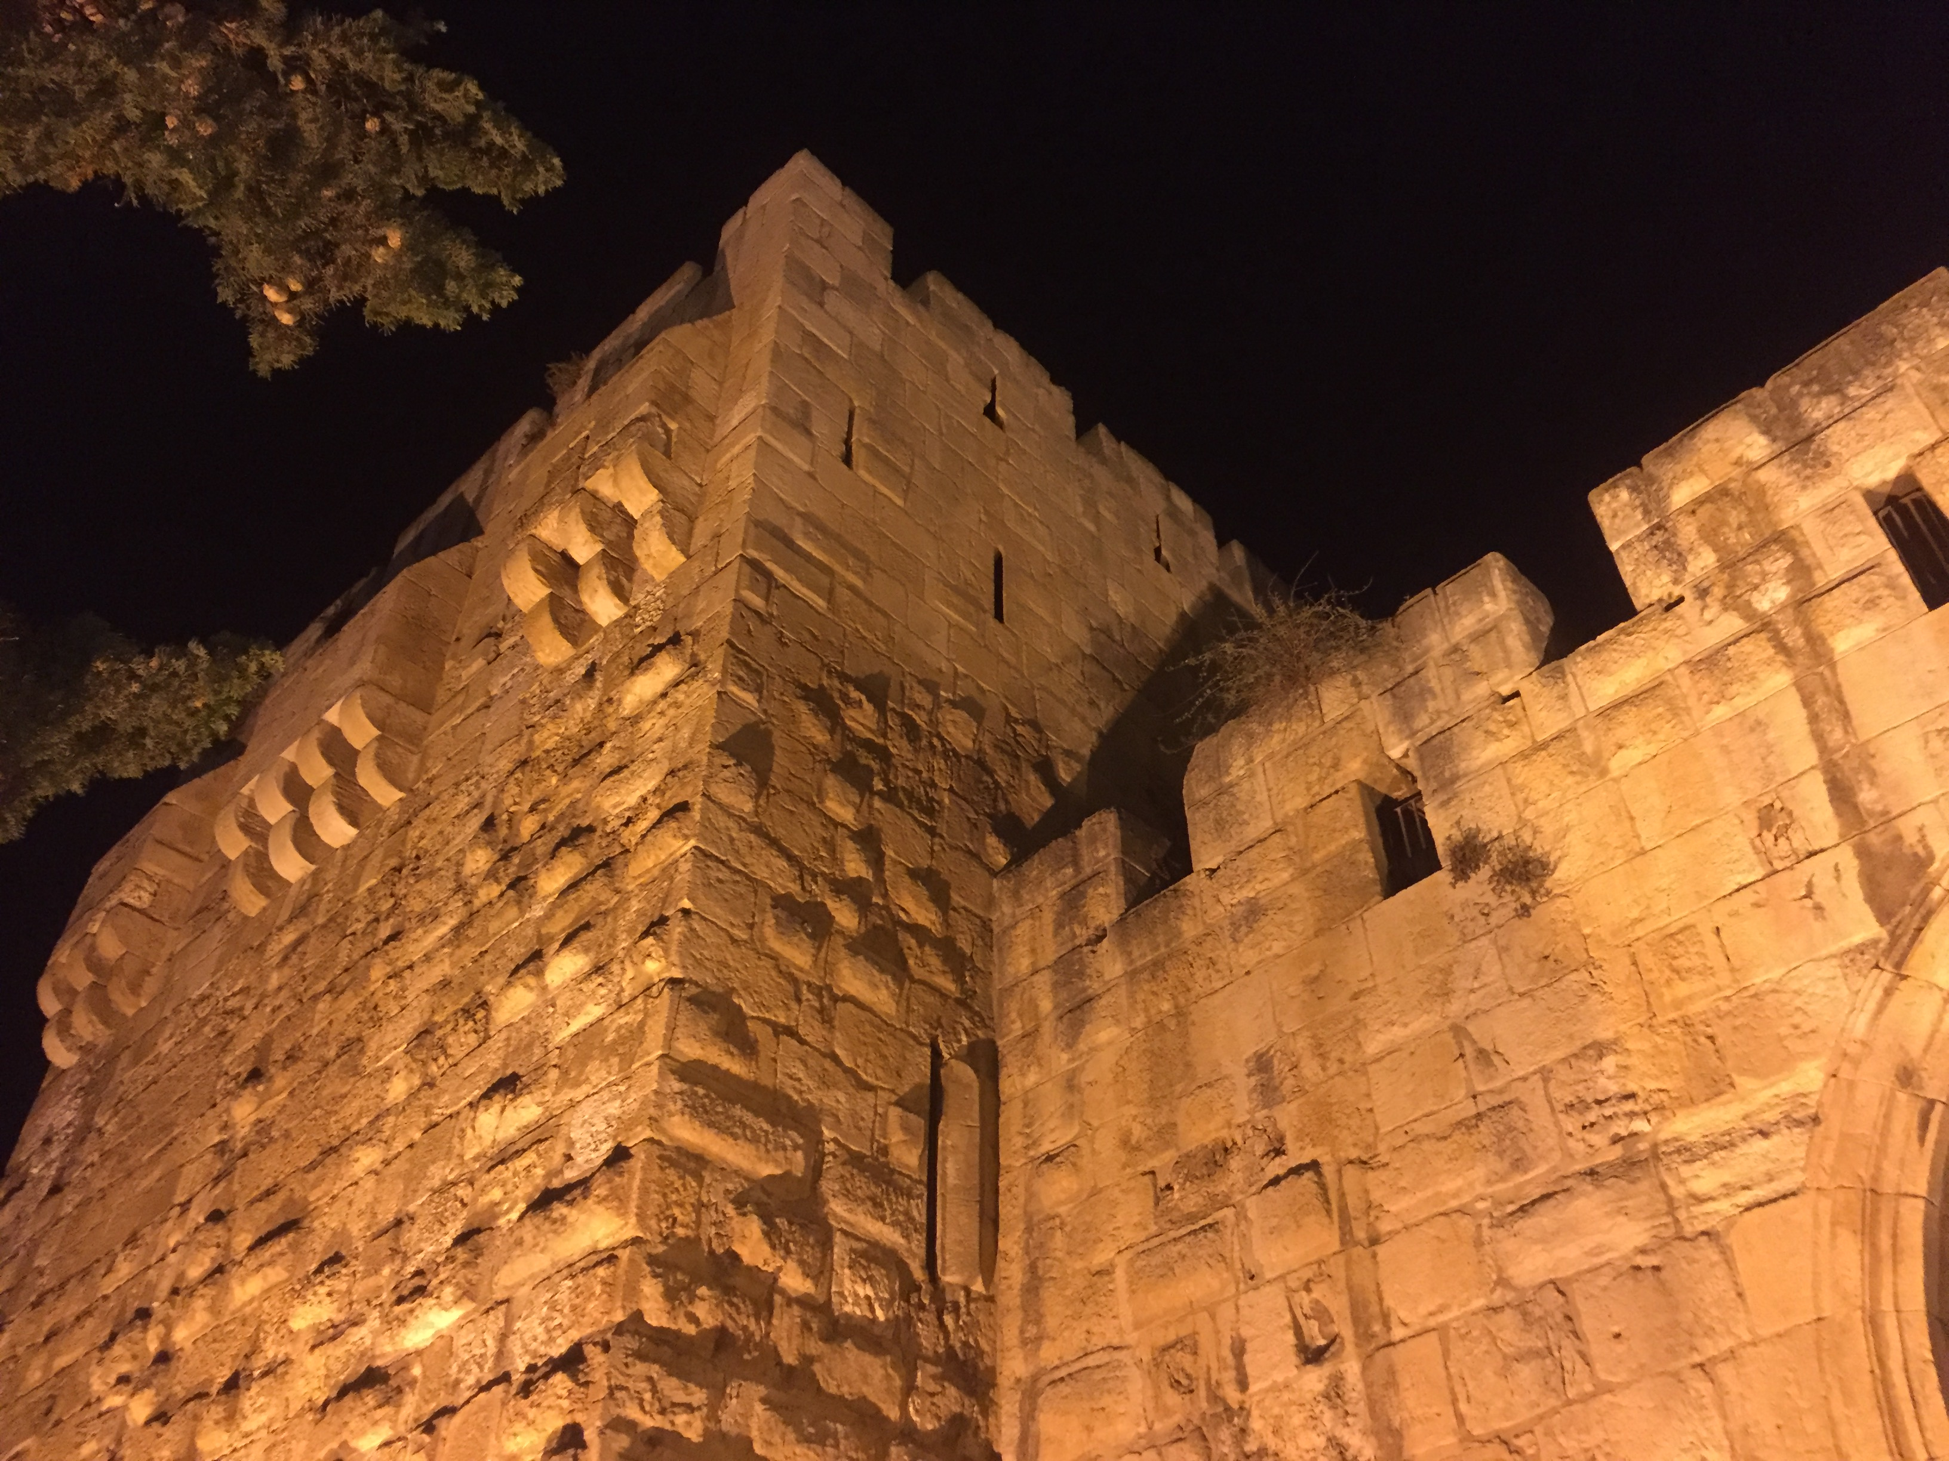

Slide 166
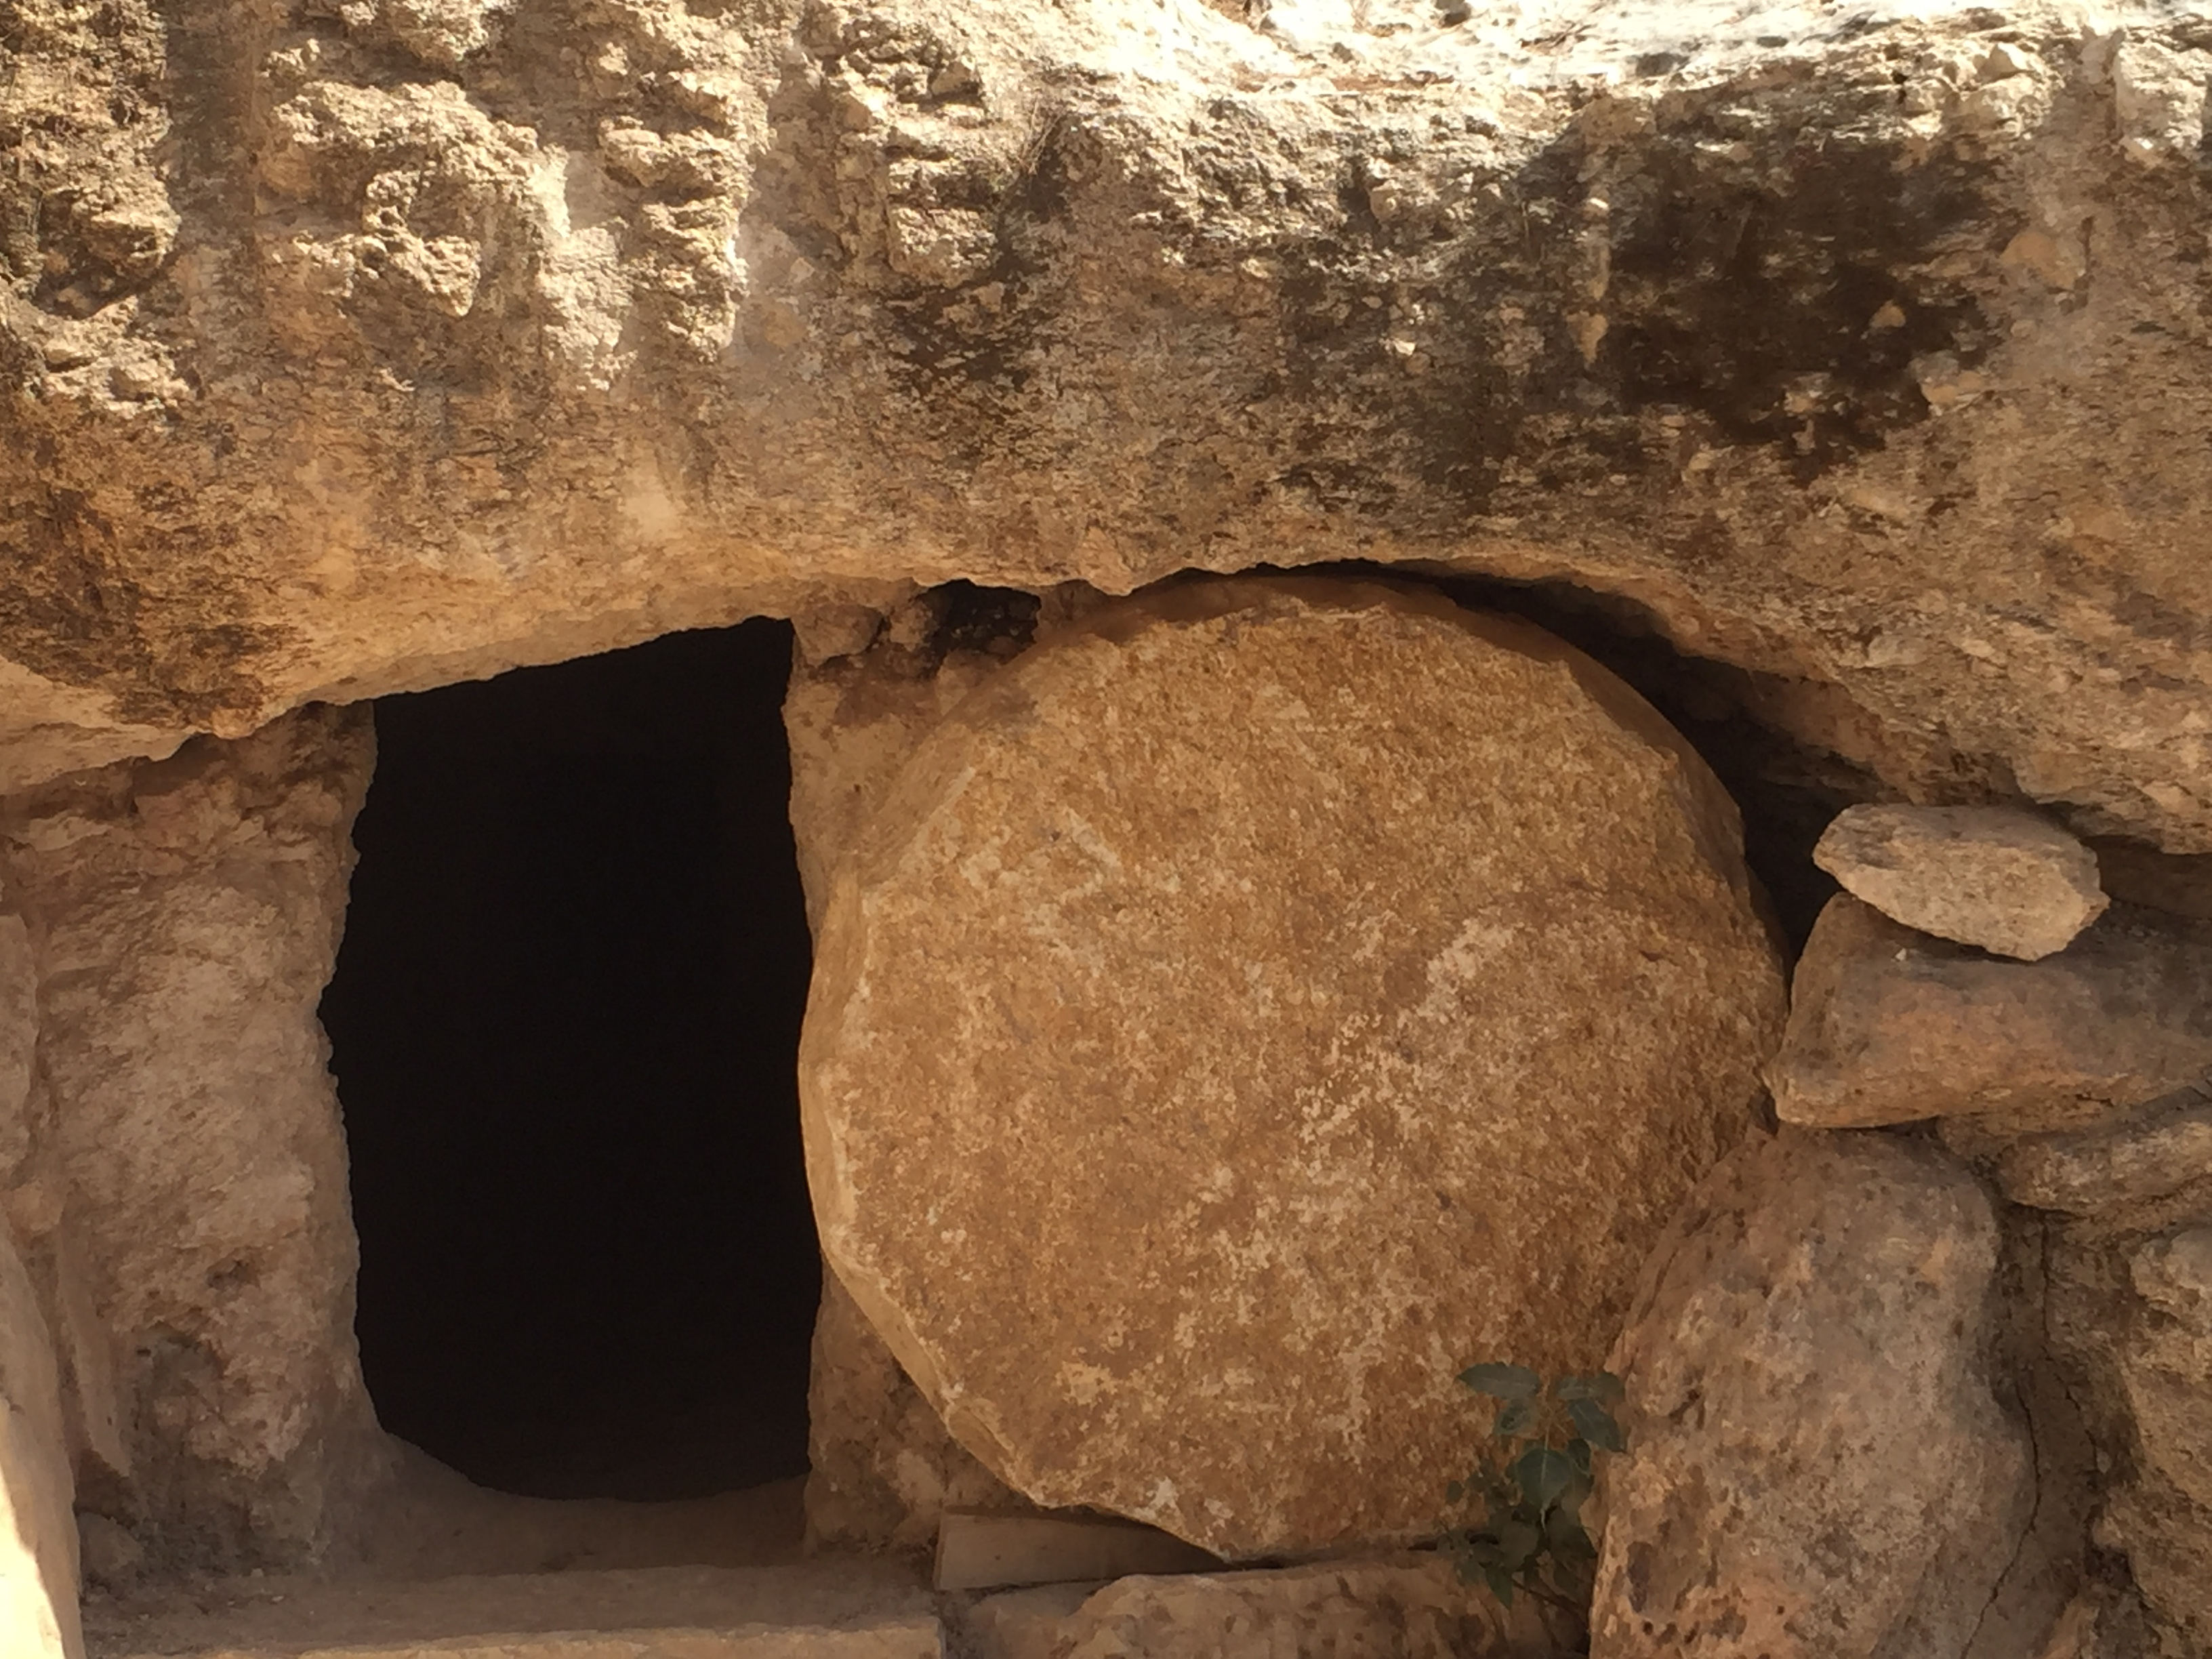

Slide 167
Stories
PMs like stories.
Emphasize the biblical story, from Gen to Rev, from Abraham who wandered out of Ur to all the pilgrims on the journey to the Celestial City.
This story is anchored in history.
We must help them to locate themselves in that narrative.

Slide 168
Easy on the proof-texting

Slide 169
Easy on the proof-texting
Avoid proof-texting (turning to single verses to prove a point). This can be bewildering! It’s like changing TV channel every 2 minutes.

Slide 171
Easy on the proof-texting
Avoid proof-texting (turning to single verses to prove a point). This can be bewildering! It’s like changing TV channel every 2 minutes.
This plays into the eclectic postmodern agenda. It looks like we are creatively combining scriptures to say what we want them to say!

Slide 172
Easy on the proof-texting
Avoid proof-texting (turning to single verses to prove a point). This can be bewildering! It’s like changing TV channel every 2 minutes.
This plays into the eclectic postmodern agenda. It looks like we are creatively combining scriptures to say what we want them to say!
It also panders to the short attention span of many in our day.

Slide 173
Easy on the proof-texting
Avoid proof-texting (turning to single verses to prove a point). This can be bewildering! It’s like changing TV channel every 2 minutes.
This plays into the eclectic postmodern agenda. It looks like we are creatively combining scriptures to say what we want them to say!
It also panders to the short attention span of many in our day.
Wherever possible, stick with one passage. Trust the Word. Have faith that God’s will is best revealed when we read it as it was written.

Slide 174
Learn to unpack the passage

Slide 175
Learn to unpack the passage
Example: John 14:6: Jesus said to [Thomas], “I am the way, and the truth, and the life. No one comes to the Father except through me.”

Slide 176
Learn to unpack the passage
Example: John 14:6: Jesus said to [Thomas], “I am the way, and the truth, and the life. No one comes to the Father except through me.”
This seems offensive. How should we handle passages like this?

Slide 177
Learn to unpack the passage
Example: John 14:6: Jesus said to [Thomas], “I am the way, and the truth, and the life. No one comes to the Father except through me.”
This seems offensive. How should we handle passages like this?
Let’s break it down.

Slide 178
WAY:

Slide 179
WAY:
Person > System. Preach Christ, not the church—people are less suspicious of him! (2 Cor 4:5)

Slide 180
WAY:
Person > System. Preach Christ, not the church—people are less suspicious of him! (2 Cor 4:5)
“The Way” was a term used for the early
Christians (Acts 9:2; 19:9,23; 24:14,22).
“The way” refers to people.

Slide 181
WAY:
Person > System. Preach Christ, not the church—people are less suspicious of him! (2 Cor 4:5)
“The Way” was a term used for the early
Christians (Acts 9:2; 19:9,23; 24:14,22).
“The way” refers to people.
The Bible is relational!

Slide 182
WAY:
Person > System. Preach Christ, not the church—people are less suspicious of him! (2 Cor 4:5)
“The Way” was a term used for the early
Christians (Acts 9:2; 19:9,23; 24:14,22).
“The way” refers to people.
The Bible is relational!
But also destinational. (Journey: John 10:10; destination: John 14:1-6.)

Slide 183
TRUTH:
Not doctrinal truth, as important as that is.
Again, the truth is a person, not a theological system.
The Word became flesh (John 1:14). This is the incarnation.

Slide 184
LIFE:
Not autonomy—but shared, selfless, sacrificial life.
PMs spend a lot of time in virtual worlds. Invite them to the real world… to God’s world.
Faith in Christ works. PMs tend to care more about whether something works then whether it’s true.
Invite them to taste and see that the Lord is good, and their confidence can be rooted in Christ—who is the truth.

Slide 185
It’s time for the church to wake up!
Never underestimate the power of ideas! PM is powerful, attractive, and prevalent.
We need to be informed.
Don’t let yourself be cowed. Christianity makes sense, and even if you can’t answer every criticism, it is still more reasonable, elegant, and satisfying than anything the PM world could offer.
… and….

Slide 186
"It is not bigotry to be certain we are right, but it is bigotry to be unable to imagine how we might possibly have gone wrong.”
– G. K. Chesterton

Slide 187
"It is not bigotry to be certain we are right, but it is bigotry to be unable to imagine how we might possibly have gone wrong" (G. K. Chesterton).
Christians don’t claim complete knowledge, only adequate knowledge. We strive to be respectful of others.
PM, on the other hand, disrespects other views of reality, whenever there is a truth claim.
Let’s approach the PM generation with the humility of Christ (Matt 11:29; Eph 4:2; Phil 2:3; 4:8; Col 3:12; Jas 3:13), with insight, solid preparation, and love.

Slide 188
Turner’s Creed
… We believe everything is OK as long as you don’t hurt anyone, to the best of your definition of hurt…
We believe in sex before, during, and after marriage… adultery is fun… sodomy’s OK. We believe that taboos are taboo.
We believe that everything is getting better despite evidence to the contrary. The evidence must be investigated—and you can prove anything with evidence…
Jesus was a good man just like Buddha, Mohammed, and ourselves. He was a good moral teacher, although we think his good morals were bad.
We believe that all religions are basically the same… They all
believe in love and goodness. They only differ on matters of
creation, sin, heaven, hell, God, and salvation…

Slide 189
We believe that humans are essentially good. It’s only their behavior that lets them down. This is the fault of society. Society is the fault of conditions. Conditions are the fault of society.
We believe that everyone must find the truth that is right for them. Reality will adapt accordingly. The universe will readjust. History will alter.
We believe that there is no absolute truth—excepting the truth that there is no absolute truth.
We believe in the rejection of creeds.

Slide 190
The complete notes for this talk may be found at my website, www.douglasjacoby.com.
Search phrase: UNBOXED.

