Slide 1
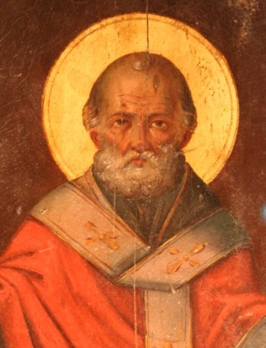
St. Nick: Christmas Lore or Historical Core?
Douglas Jacoby, IBTM
North River Church of Christ
4 Dec 2019

Slide 2
Notes:
This is the story of Nicholas of Myra, a 4th century Christian leader, who became "Saint Nick." Though Christmas lore is nearly all fictional, there is an historical core.

Slide 3
Notes:
This is the story of Nicholas of Myra, a 4th century Christian leader, who became "Saint Nick." Though Christmas lore is nearly all fictional, there is an historical core.

Slide 4
Notes:
This is the story of Nicholas of Myra, a 4th century Christian leader, who became "Saint Nick." Though Christmas lore is nearly all fictional, there is an historical core.

Slide 5
Notes:
This is the story of Nicholas of Myra, a 4th century Christian leader, who became "Saint Nick." Though Christmas lore is nearly all fictional, there is an historical core.

Slide 6
Notes:
This is the story of Nicholas of Myra, a 4th century Christian leader, who became "Saint Nick." Though Christmas lore is nearly all fictional, there is an historical core.

Slide 7
Notes:
This is the story of Nicholas of Myra, a 4th century Christian leader, who became "Saint Nick." Though Christmas lore is nearly all fictional, there is an historical core.

Slide 8
Notes:
This is the story of Nicholas of Myra, a 4th century Christian leader, who became "Saint Nick." Though Christmas lore is nearly all fictional, there is an historical core.

Slide 9
Notes:
This is the story of Nicholas of Myra, a 4th century Christian leader, who became "Saint Nick." Though Christmas lore is nearly all fictional, there is an historical core.

Slide 10
Notes:
This is the story of Nicholas of Myra, a 4th century Christian leader, who became "Saint Nick." Though Christmas lore is nearly all fictional, there is an historical core.

Slide 11
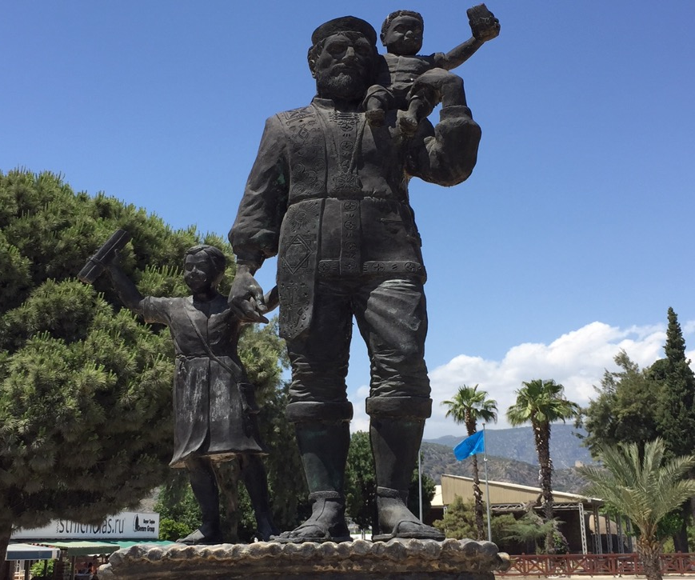
Notes:
(Nicolaus is the same name borne by one of the seven deacons in Acts 6 -- the only person by that name in the Bible, although it is possible that the heretical Nicolaitans (Rev 2:6,15) were trading on his name) CHILDREN STOCKY

Slide 12
Notes:
This is the story of Nicholas of Myra, a 4th century Christian leader, who became "Saint Nick." Though Christmas lore is nearly all fictional, there is an historical core.

Slide 13
Nicholas of Myra
Notes:
This is the story of Nicholas of Myra, a 4th century Christian leader, who became "Saint Nick." Though Christmas lore is nearly all fictional, there is an historical core.

Slide 14
Nicholas of Myra
Legend
Life
Legacy
Notes:
This is the story of Nicholas of Myra, a 4th century Christian leader, who became "Saint Nick." Though Christmas lore is nearly all fictional, there is an historical core.

Slide 15
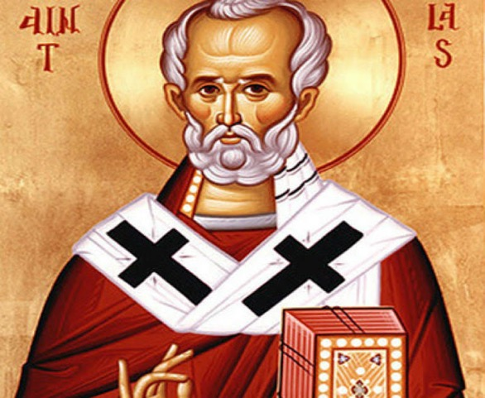
I. Legend
Notes:
This is the story of Nicholas of Myra, a 4th century Christian leader, who became "Saint Nick." Though Christmas lore is nearly all fictional, there is an historical core.

Slide 16
Legends of Nicholas
Nicholas was revered for his help to many persons, children and mariners especially. Not surprisingly, in the superstitious Middle Ages, the historical Nicholas was embellished:
❖ Children—3 girls too poor for a dowry. Money thrown through open window or down chimney. In some parts of the world, children may leave carrots and hay for St. Nick (who visits by quadruped, but not reindeer).
❖ Helped sailors in a storm—became the patron saint of sailors.
❖ He's also the patron saint of (repentant) thieves.
"One legend tells how during a terrible famine, a malicious butcher lured three little children into his house, where he killed them, placing their remains in a barrel to cure, planning to sell them off as ham. Saint Nicholas, visiting the region to care for the hungry, not only saw through the butcher's horrific crime but also resurrected the three boys from the barrel by his prayers." (Adapted from Wikipedia)

Slide 17
Legends of Nicholas
Nicholas was revered for his help to many persons, children and mariners especially. Not surprisingly, in the superstitious Middle Ages, the historical Nicholas was embellished:
❖ Children—3 girls too poor for a dowry. Money thrown through open window or down chimney. In some parts of the world, children may leave carrots and hay for St. Nick (who visits by quadruped, but not reindeer).
❖ Helped sailors in a storm—became the patron saint of sailors.
❖ He's also the patron saint of (repentant) thieves.
"One legend tells how during a terrible famine, a malicious butcher lured three little children into his house, where he killed them, placing their remains in a barrel to cure, planning to sell them off as ham. Saint Nicholas, visiting the region to care for the hungry, not only saw through the butcher's horrific crime but also resurrected the three boys from the barrel by his prayers." (Adapted from Wikipedia)

Slide 18
Legends of Nicholas
Nicholas was revered for his help to many persons, children and mariners especially. Not surprisingly, in the superstitious Middle Ages, the historical Nicholas was embellished:
❖ Children—3 girls too poor for a dowry. Money thrown through open window or down chimney. In some parts of the world, children may leave carrots and hay for St. Nick (who visits by quadruped, but not reindeer).
❖ Helped sailors in a storm—became the patron saint of sailors.
❖ He's also the patron saint of (repentant) thieves.
"One legend tells how during a terrible famine, a malicious butcher lured three little children into his house, where he killed them, placing their remains in a barrel to cure, planning to sell them off as ham. Saint Nicholas, visiting the region to care for the hungry, not only saw through the butcher's horrific crime but also resurrected the three boys from the barrel by his prayers." (Adapted from Wikipedia)

Slide 20
Legends of Nicholas
Nicholas was revered for his help to many persons, children and mariners especially. Not surprisingly, in the superstitious Middle Ages, the historical Nicholas was embellished:
❖ Children—3 girls too poor for a dowry. Money thrown through open window or down chimney. In some parts of the world, children may leave carrots and hay for St. Nick (who visits by quadruped, but not reindeer).
❖ Helped sailors in a storm—became the patron saint of sailors.
❖ He's also the patron saint of (repentant) thieves.
"One legend tells how during a terrible famine, a malicious butcher lured three little children into his house, where he killed them, placing their remains in a barrel to cure, planning to sell them off as ham. Saint Nicholas, visiting the region to care for the hungry, not only saw through the butcher's horrific crime but also resurrected the three boys from the barrel by his prayers." (Adapted from Wikipedia)

Slide 21
Legends of Nicholas
Nicholas was revered for his help to many persons, children and mariners especially. Not surprisingly, in the superstitious Middle Ages, the historical Nicholas was embellished:
❖ Children—3 girls too poor for a dowry. Money thrown through open window or down chimney. In some parts of the world, children may leave carrots and hay for St. Nick (who visits by quadruped, but not reindeer).
❖ Helped sailors in a storm—became the patron saint of sailors.
❖ He's also the patron saint of (repentant) thieves.
One legend tells how during a terrible famine, a malicious butcher lured three little children into his house, where he killed them, placing their remains in a barrel to cure, planning to sell them off as ham.
Saint Nicholas, visiting the region to care for the hungry, not only saw through the butcher's horrific crime but also resurrected (or communicated with) the three boys in the barrel by his prayers. (Adapted from Wikipedia)

Slide 22
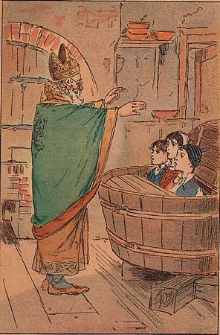

Slide 23
Three little children sought the plain / Gleaners of the golden grain / They lingered past the angel-song / And dewy shadows swept along / 'Mid the silence of the wood / The butcher's lonely cottage stood / "Butcher! lodge us for the night / Lodge us till the morning light."
"Enter in, ye children small / I can find a place for all” / The butcher seized a knife straightway / And did the little creatures slay / He put them in a tub of brine / In pieces small as they were swine.
St. Nicholas, at seven years end / His way did to the forest wend / He sought the butcher's cottage drear / "Butcher! I would rest me here!” / "Enter! enter, St. Nicholas! / You are welcome, St. Nicholas! / Enter! enter, St. Nicholas! / There's place for you the night to pass.”
Scarce had the Saint his entrance made / He would the supper board was laid / "Will you have of ham a slice?” "I will not, for it is not nice!” / "Of this veal you'll take a bit?” / "No! I do not relish it” / "Give me of the little swine / For seven long years hath lain in brine!"
The butcher caught the words he said / And forthwith from the portal fled / "Butcher! butcher! do not flee / Repent and God will pardon thee!” / St. Nicholas the tub drew near / And lo! he placed three fingers there.
The first one said, "I sweetly rest!” / The second said, "I too am blest!” / The third replied, “’Tis well with me / In Paradise I seem to be!”

Slide 24
II. Life
Notes:
This is the story of Nicholas of Myra, a 4th century Christian leader, who became "Saint Nick." Though Christmas lore is nearly all fictional, there is an historical core.

Slide 25
The Life of Nicholas
Born in the late 3rd century (270 ad) in Patara, in Asia Minor.

Slide 26
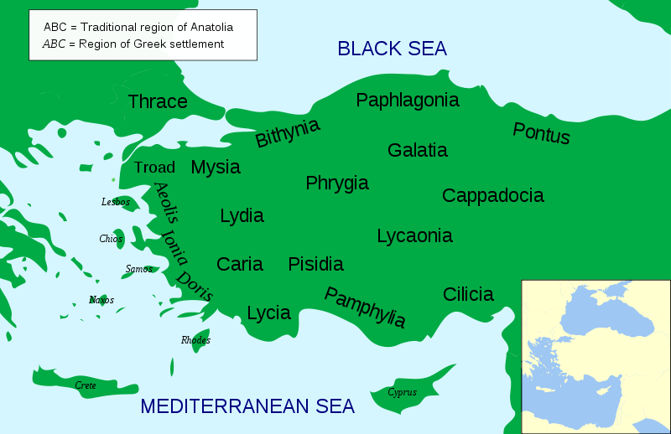
Notes:
Patara was in the region of Lycia (bottom left of map). -- Patara was opposite the island of Rhodes (look left).

Slide 27
Notes:
Patara was in the region of Lycia (bottom left of map). -- Patara was opposite the island of Rhodes (look left).

Slide 28
The Life of Nicholas
Born in the late 3rd century (270 ad) in Patara, in Asia Minor.

Slide 29
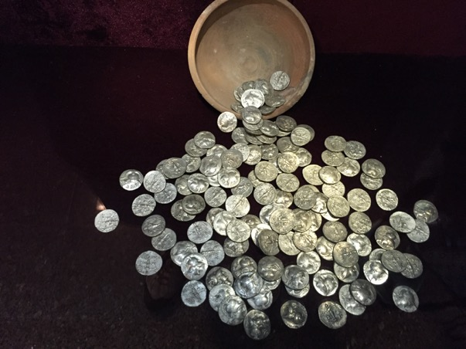
The Life of Nicholas
Born in the late 3rd century (270 ad) in Patara, in Asia Minor.
Nicholas' parents were wealthy, and so he grew up in privilege, and as an only child.

Slide 30
The Life of Nicholas
Born in the late 3rd century (270 ad) in Patara, in Asia Minor.
Nicholas' parents were wealthy, and so he grew up in privilege, and as an only child.
Yet both his parents died during an epidemic; young Nicholas was on his own. And rich.

Slide 31
The Life of Nicholas
Born in the late 3rd century (270 ad) in Patara, in Asia Minor.
Nicholas' parents were wealthy, and so he grew up in privilege, and as an only child.
Yet both his parents died during an epidemic; young Nicholas was on his own. And rich.
His uncle, who lived in Patara, and was the overseer of the church there, and took him under his wing.

Slide 33
The Life of Nicholas
Born in the late 3rd century (270 ad) in Patara, in Asia Minor.
Nicholas' parents were wealthy, and so he grew up in privilege, and as an only child.
Yet both his parents died during an epidemic; young Nicholas was on his own. And rich.
His uncle, who lived in Patara, and was the overseer of the church there, and took him under his wing.
He matured, gave generously to the poor, and rose in leadership to become principal leader in Myra.
Notes:
Apparently he struck everyone he met as an impressive and kind soul -- the ideal leader.

Slide 34
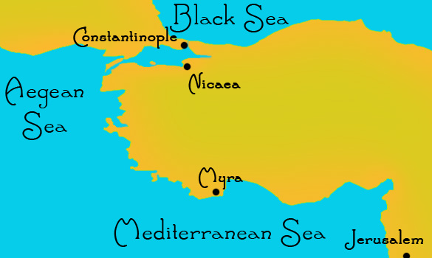

Slide 35
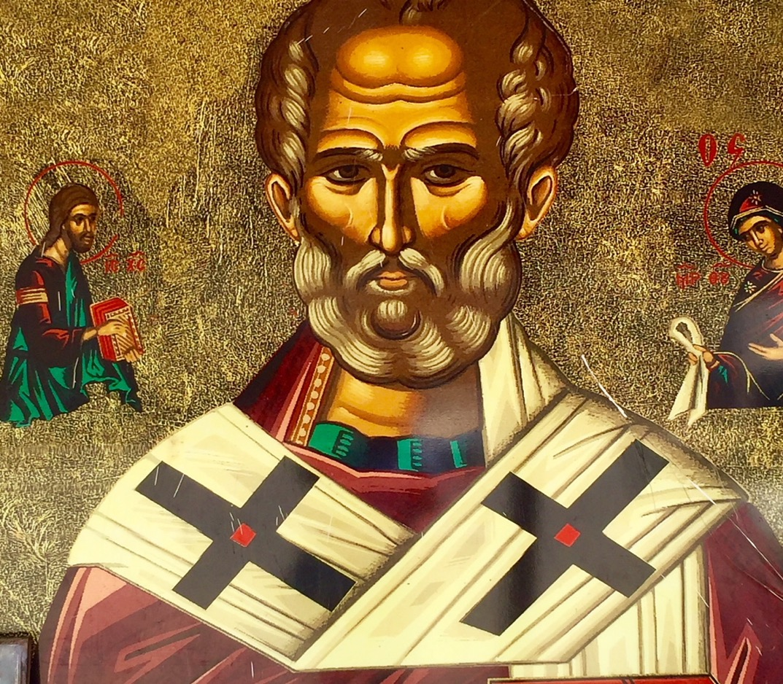

Slide 36
The Life of Nicholas
Born in the late 3rd century (270 ad) in Patara, in Asia Minor.
Nicholas' parents were wealthy, and so he grew up in privilege, and as an only child.
Yet both his parents died during an epidemic; young Nicholas was on his own. And rich.
His uncle, who lived in Patara, and was the overseer of the church there, and took him under his wingz
He matured, gave generously to the poor, and rose in leadership to become principal leader in Myra.
He spent most of his life in Myra, dying in 343.

Slide 37
The Life of Nicholas
Born in the late 3rd century (270 ad) in Patara, in Asia Minor.
Nicholas' parents were wealthy, and so he grew up in privilege, and as an only child.
Yet both his parents died during an epidemic; young Nicholas was on his own. And rich.
His uncle, who lived in Patara, and was the overseer of the church there, and took him under his wingz
He matured, gave generously to the poor, and rose in leadership to become principal leader in Myra.
He spent most of his life in Myra, dying in 343.
Initially buried on an island near Rhodes—later in Bari.

Slide 38
Notes:
Patara was in the region of Lycia (bottom left of map). -- Patara was opposite the island of Rhodes (look left).

Slide 39
Notes:
Patara was in the region of Lycia (bottom left of map). -- Patara was opposite the island of Rhodes (look left).

Slide 41
The Life of Nicholas
Born in the late 3rd century (270 ad) in Patara, in Asia Minor.
Nicholas' parents were wealthy, and so he grew up in privilege, and as an only child.
Yet both his parents died during an epidemic; young Nicholas was on his own. And rich.
His uncle, who lived in Patara, and was the overseer of the church there, and took him under his wingz
He matured, gave generously to the poor, and rose in leadership to become principal leader in Myra.
He spent most of his life in Myra, dying in 343.
Initially buried on an island near Rhodes—later in Bari.
Notes:
Yet there were to be decades of adventure, hardship, and spiritual growth before this great man of God passed on.

Slide 42
The Life of Nicholas
Born in the late 3rd century (270 ad) in Patara, in Asia Minor.
Nicholas' parents were wealthy, and so he grew up in privilege, and as an only child.
Yet both his parents died during an epidemic; young Nicholas was on his own. And rich.
His uncle, who lived in Patara, and was the overseer of the church there, and took him under his wingz
He matured, gave generously to the poor, and rose in leadership to become principal leader in Myra.
He spent most of his life in Myra, dying in 343.
Initially buried on an island near Rhodes—later in Bari.
Small in stature (2005 study of his remains revealed he was ~5’ tall, with a broken nose), large in faith & impact.
Notes:
Yet there were to be decades of adventure, hardship, and spiritual growth before this great man of God passed on.

Slide 43
Bones of Nicholas
Small in stature (2005 study of his remains revealed he was ~ 5’ tall, with a broken nose).
Bones—In the 11th C, Italians removed his bones to Bari, and smaller fragments to Venice. In 1993, scientific study of his original burial place supported the claim that both sets of bones came from the same body.
Notes:
Yet there were to be decades of adventure, hardship, and spiritual growth before this great man of God passed on.

Slide 45
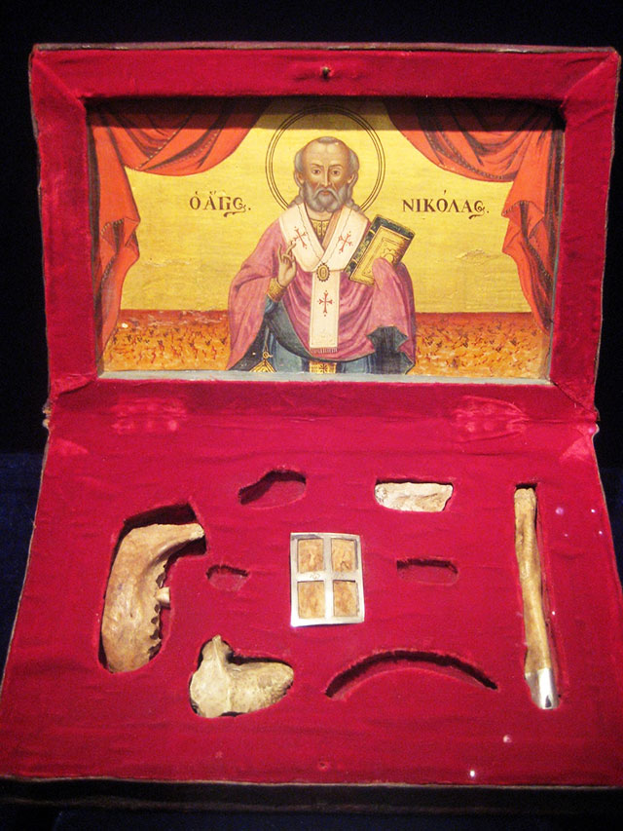

Slide 46
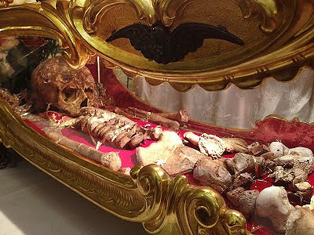

Slide 47
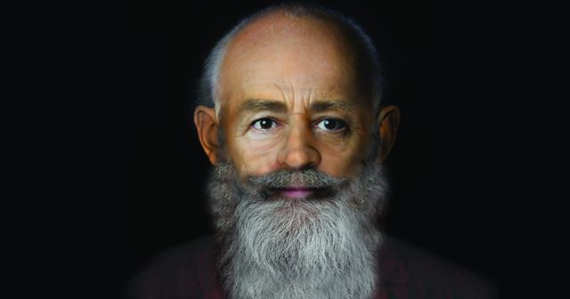

Slide 48
III. Legacy
Notes:
This is the story of Nicholas of Myra, a 4th century Christian leader, who became "Saint Nick." Though Christmas lore is nearly all fictional, there is an historical core.

Slide 49
Nicholas was imprisoned in the persecution of Diocletian.

Slide 50
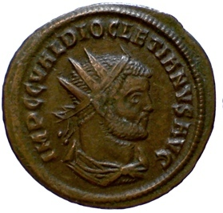
Persecution of Diocletian, 303-313 ad

Slide 51
Bishops (overseers) Buildings (converted homes) Bibles (or biblical books)
Notes:
Rescinded legal rights of Xns. UNIVERSAL SACRIFICE. Weakest in Gaul/Britain, strongest in the East (where N lived)

Slide 52
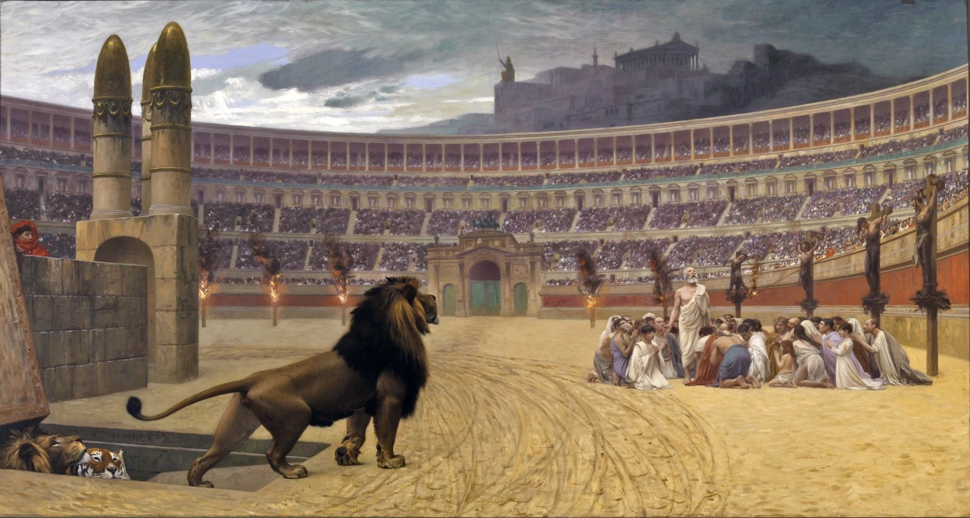
The Christian Martyrs’ Last Prayer
Jean-Léon Gérôme (1883)

Slide 53
CONFESSORS
WITNESSES

Slide 54
“Everyone therefore who acknowledges me before others, I also will acknowledge before my Father in heaven; but whoever denies me before others, I also will deny before my Father in heaven. Matthew 10:32-33

Slide 55
But they have conquered him
by the blood of the Lamb
and by the word of their testimony,
for they did not cling to life
even in the face of death.
Revelation 12:11

Slide 56
… Jesus Christ, the faithful witness, the firstborn of the dead, and the ruler of the kings of the earth… Revelation 1:5
Yet you are holding fast to my name, and you did not deny your faith in me even in the days of Antipas my witness, my faithful one, who was killed among you… Revelation 2:13

Slide 57
CONFESSORS
MARTYRS
TRAITORS

Slide 58
Nicholas was imprisoned in the persecution of Diocletian.
Notes:
303-311 AD
Feb 24, 303, after consulting Apollo
Britain to Anatolia
Rescinded legal rights
Demanded compliance with Roman religious practices
Later: target clergy—demand sacrifice to gods

Slide 59
Nicholas was imprisoned in the persecution of Diocletian.
Once released, Nicholas spent several years in Israel. He made his abode in a cave overlooking Bethlehem, in the company of several other holy men.
He also attended the Council of Nicaea (325). The city of Nicaea was southwest of Constantinople/Byzantium, the place where the first of the so-called Seven Ecumenical Councils took place. The emperor, Constantine, presided.

Slide 60
Nicholas was imprisoned in the persecution of Diocletian.
Once released, Nicholas spent several years in Israel. He made his abode in a cave overlooking Bethlehem, in the company of several other holy men.
He also attended the Council of Nicaea (325) – southwest of Constantinople/Byzantium, where the first of the so-called Seven Ecumenical Councils took place. The emperor, Constantine, presided.

Slide 62
Legacy of Nicholas
Popularity—He is known all over the Christian world, especially in Russia and Greece. St. Nicholas' Day is celebrated on 6 Dec.
Construction—His significant influence is suggested by the fact that 1000s of church buildings have been named after him.
Sinter Klaas is Dutch, a corruption of Saint Nicholas; appeared in English speaking world as Santa Claus. Dutch began custom of Christmas gift-giving, which spread to the New World when they came to New Amsterdam. Further evolution took place: North Pole, Teutonic customs, Polar Express, etc.
Person—He is remembered as one kind to children and to the poor. (Shouldn't every Christian be known for these qualities?)
Boldness. We also remember him for his courage!

Slide 63
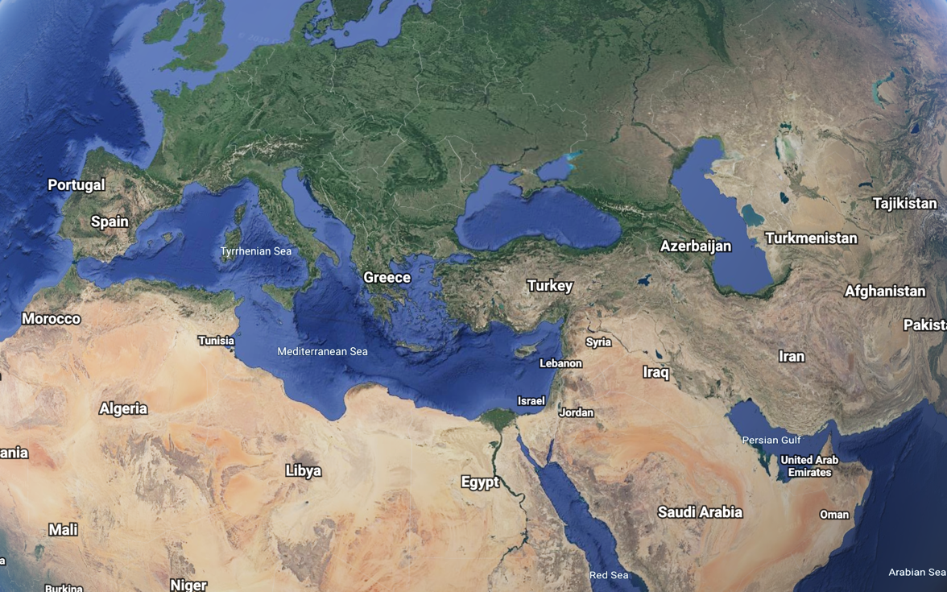
16 or 19—26 October 2020

Slide 64
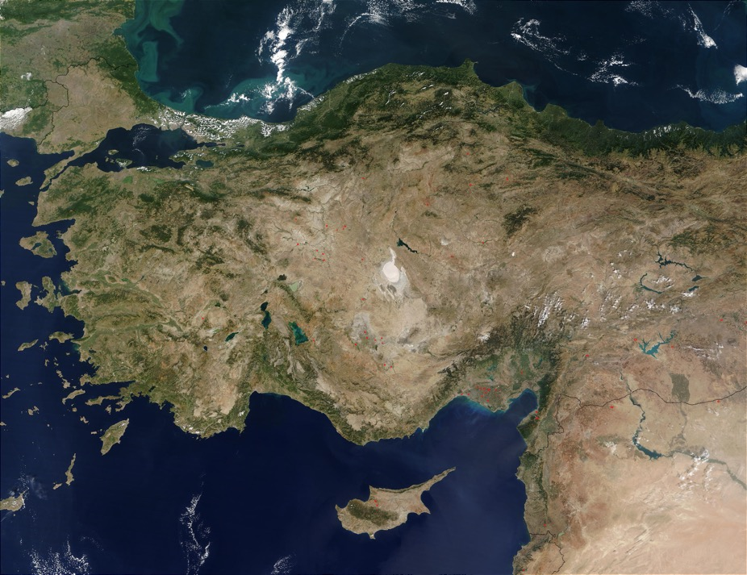
16 or 19—26 October 2020

Slide 65
16 or 19—26 October 2020

Slide 66
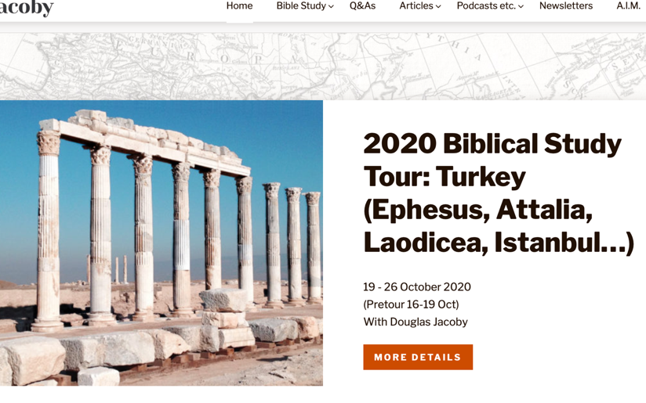
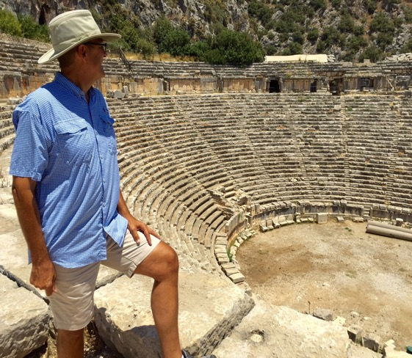
Notes:
For Christians interested in history and archaeology, they'll be spoiled rotten when they visit Turkey.

Slide 68
St. Nick: Christmas Lore or Historical Core?
Douglas Jacoby, IBTM
North River Church of Christ
4 Dec 2019

