Slide 1
Navigating the Modern /
Postmodern Landscape
Douglas Jacoby, M.T.S., D.Min.
San Antonio, 7 March 2020

Slide 2
PAUL COPAN <PAUL_COPAN@pba.edu>

Slide 3
The Postmodern Wave
Chattanooga Chapter
Dr. Douglas A. Jacoby
www.douglasjacoby.com

Slide 5
Navigating the Modern /
Postmodern Landscape
Douglas Jacoby, M.T.S., D.Min.
San Antonio, 7 March 2020

Slide 6
Three Observations
PM is hard to pin down, but easy to recognize—a suspicion more than a clearly defined ideology
A reaction to the optimism of modernism / failed political programs
Pretending to be true, even to free us from error, yet denying the very existence of truth.

Slide 7
[ Handout ]

Slide 8
Three Observations
PM is hard to pin down, but easy to recognize—a suspicion more than a clearly defined ideology
A reaction to the optimism of modernism / failed political programs
Pretending to be true, even to free us from error, yet denying the very existence of truth.

Slide 9
Post-modernism
Philosophy
Movement
Methodology
Mood
Wave
Suspicion

Slide 10
Three Observations
PM is hard to pin down, but easy to recognize—a suspicion more than a clearly defined ideology.
A reaction to the optimism of modernism / failed political programs
Pretending to be true, even to free us from error, yet denying the very existence of truth

Slide 11
Three Observations
PM is hard to pin down, but easy to recognize—a suspicion more than a clearly defined ideology.
A reaction to the optimism of modernism / failed political programs.
Pretending to be true, even to free us from error, yet denying the very existence of truth

Slide 12
Three Observations
PM is hard to pin down, but easy to recognize—a suspicion more than a clearly defined ideology.
A reaction to the optimism of modernism / failed political programs.
Pretending to be true, even to free us from error, yet denying the very existence of truth.
Notes:
DJ: 3 ug 8 gr educn + conversations ww

Slide 13
What’s the big deal?
PM thinking has already affected your church youth group, campus ministry, younger singles and families….

Slide 14
What’s the big deal?
PM thinking has already affected your church youth group, campus ministry, younger singles and families….

Slide 15


Slide 16


Slide 17


Slide 18
PM is the dominant philosophy of our age:

Slide 19
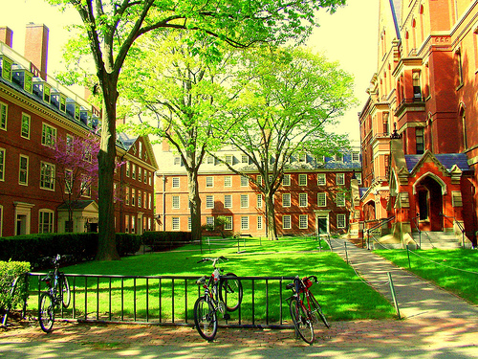

Slide 20
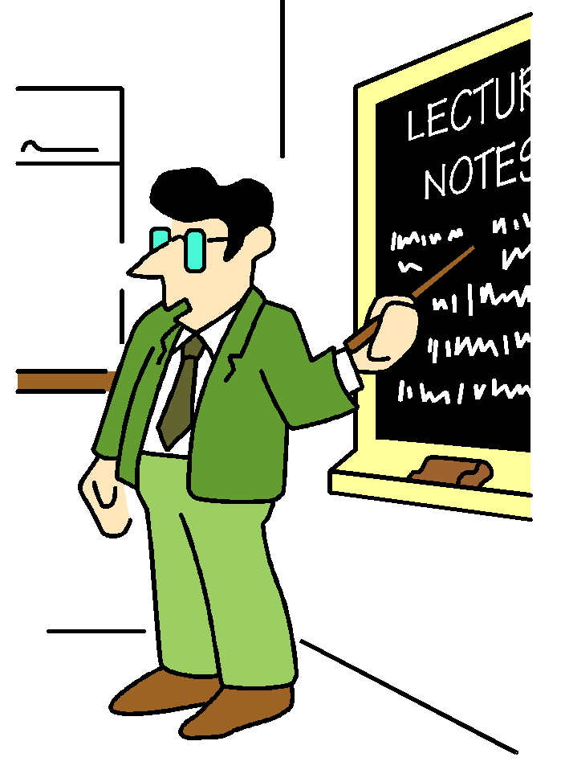

Slide 21


Slide 22
PM is the dominant philosophy of our age:
Universities Film Television
Literature Music Advertising
Jurisprudence Schools Government
Seminaries Sculpture Churches

Slide 23
PM = reaction to modernism.

Slide 24
PM = reaction to modernism.
19th century optimism

Slide 25
PM = reaction to modernism.
19th century optimism
Cosmos as a machine, completely intelligible through science

Slide 26
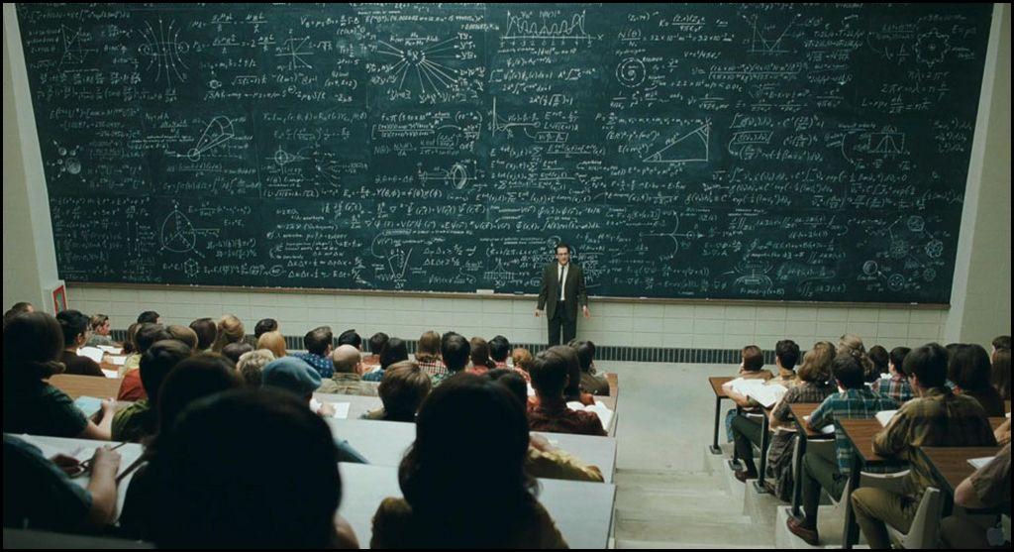

Slide 27
∫ ⅝(p₀ , p_{n})³ ∑(4/3pr³)∂²x∂y²
______________ _ ______________ +
√(E₁ - MC²⁾ √(E₂ - MC² )
∫ ⅝(p₁ , p_{n})² ∑(4/3pr³)∂x∂y
______________ _ ______________ _
√(E₁ - MC²⁾ √(E₂ – MC² )
∞/7 . ∫⅝(p₃ , p_{n})³ = God

Slide 28
PM = reaction to modernism.
19th century optimism
Cosmos as a machine, completely intelligible through science
Science as savior

Slide 29
PM = reaction to modernism.
19th century optimism
Cosmos as a machine, completely intelligible through science
Science as savior
Technology improving life

Slide 30


Slide 31
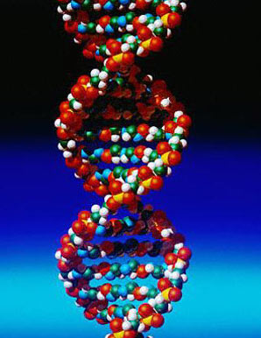



Slide 32
PM = reaction to modernism.
19th century optimism
Cosmos as a machine, completely intelligible through science
Science as savior
Technology improving life
Education bringing peaceful coexistence

Slide 33
PM = reaction to modernism.
19th century optimism
Cosmos as a machine, completely intelligible through science
Science as savior
Technology improving life
Education bringing peaceful coexistence
Utopian political programs

Slide 34
PM = reaction to modernism.
19th century optimism
Cosmos as a machine, completely intelligible through science
Science as savior
Technology improving life
Education bringing peaceful coexistence
Utopian political programs
We’ve learned nearly everything there is to learn.

Slide 35
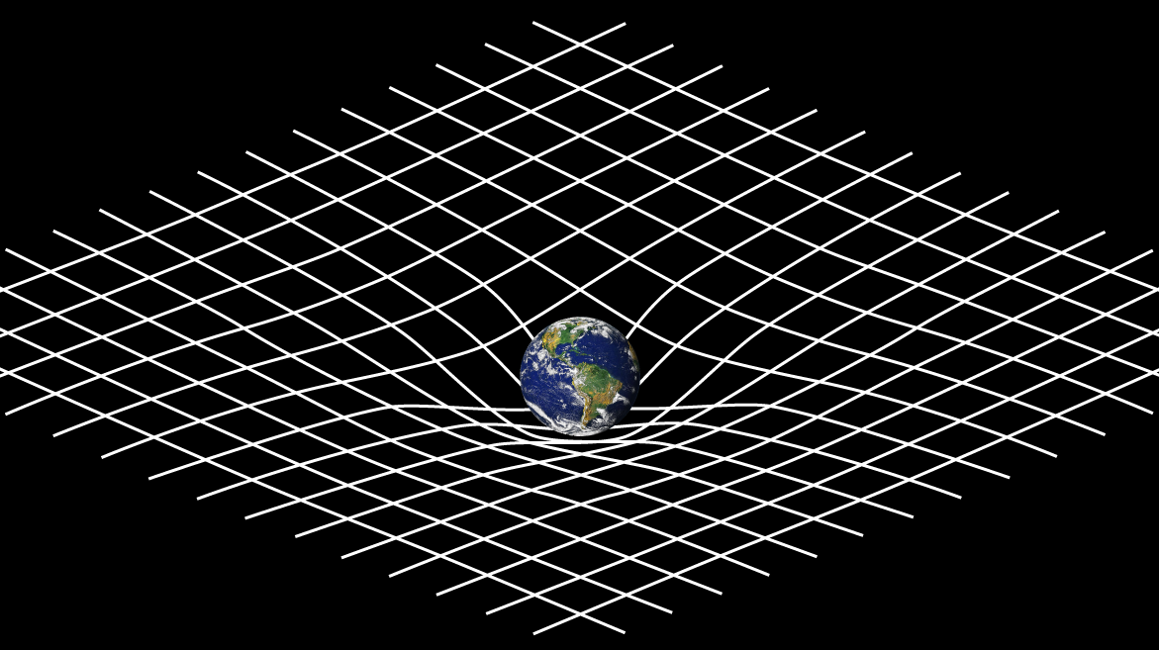

Slide 36


Slide 37
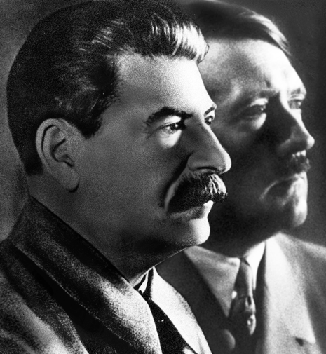
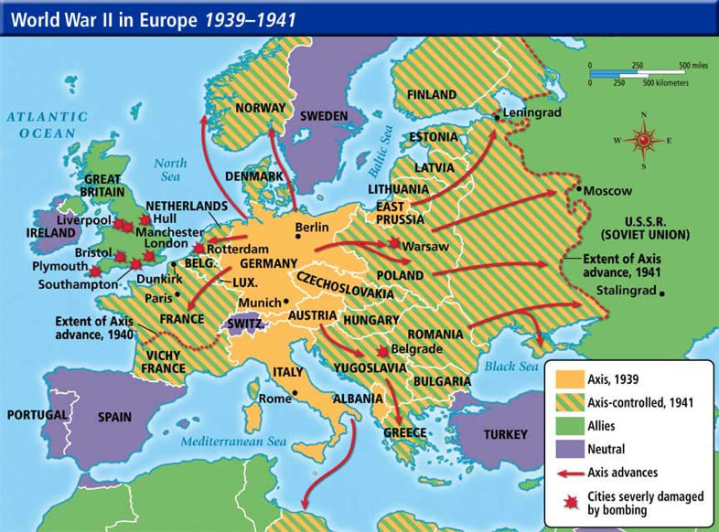

Slide 38
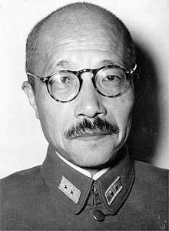
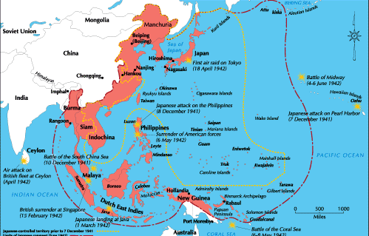
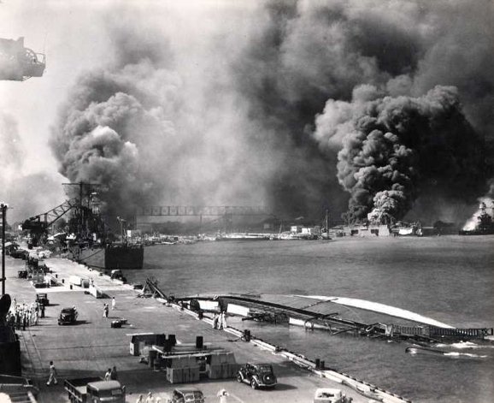

Slide 39

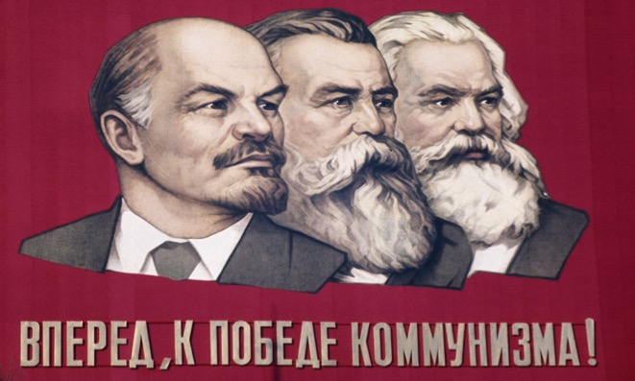

Slide 40
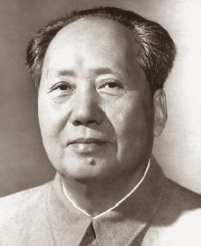
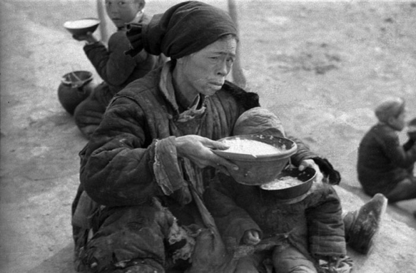
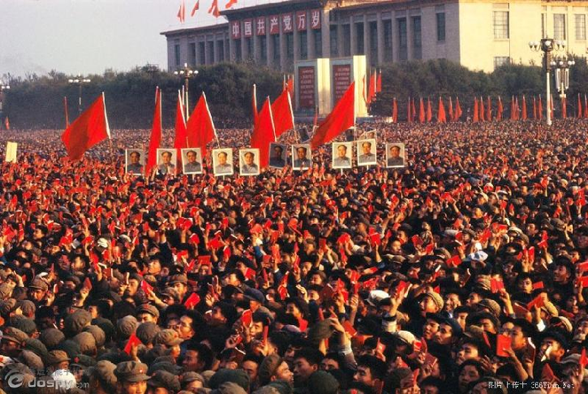

Slide 41


Slide 42
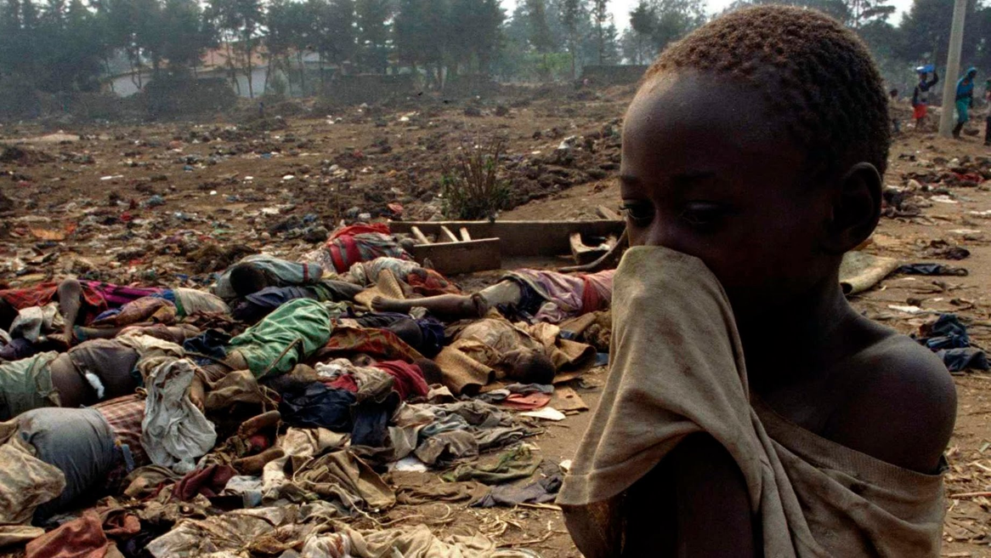
Notes:
Rwanda: 800,000 killed mainly by machete in 100 days. Armenian genocide (1.2m), 1915-20.

Slide 43
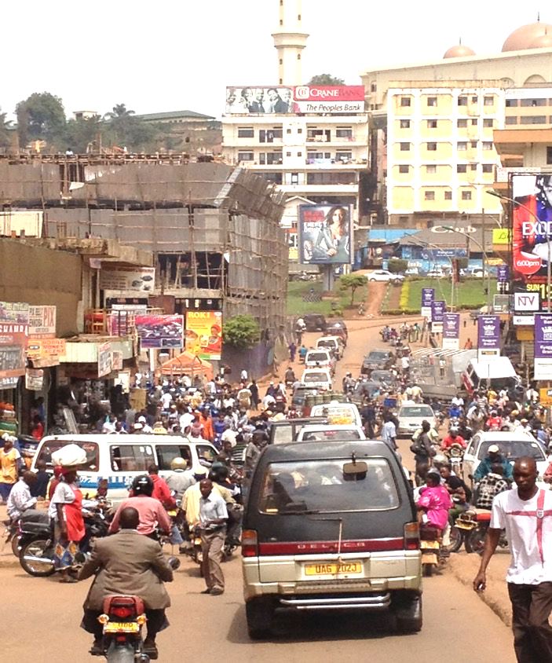

Slide 44
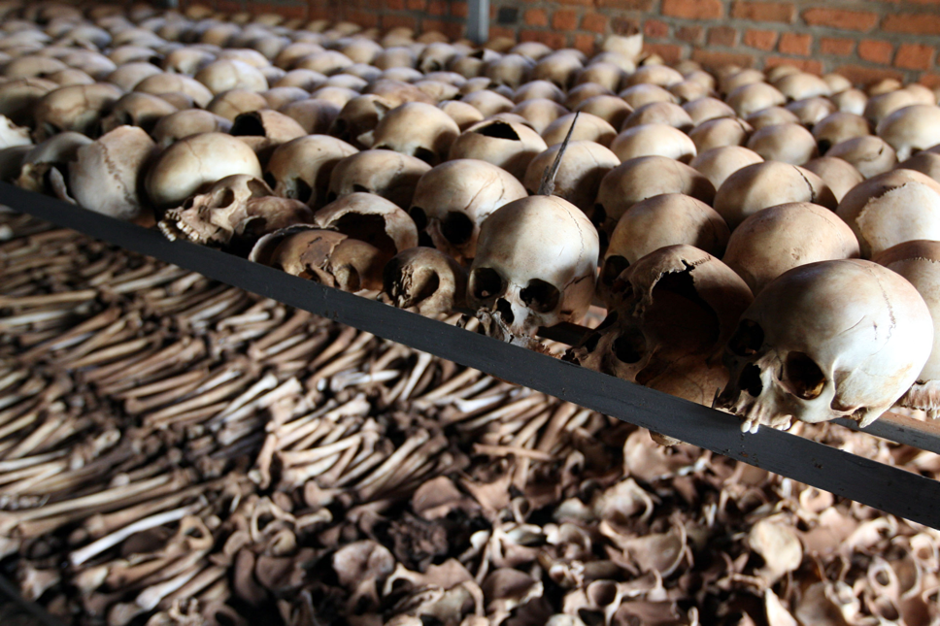
Notes:
Cambodia: 2m out of 7m (29%)… Sudan Romania Liberia

Slide 45
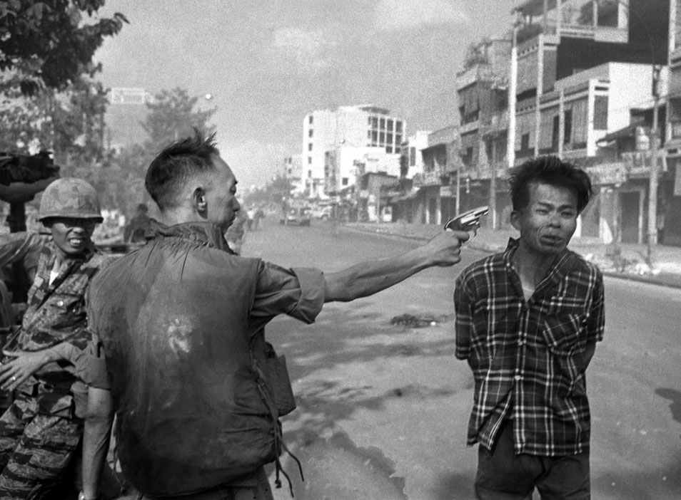

Slide 46
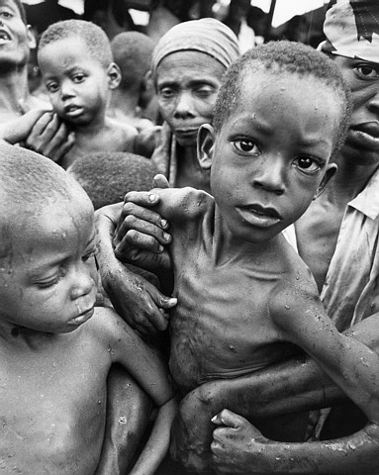

Slide 47


Slide 48
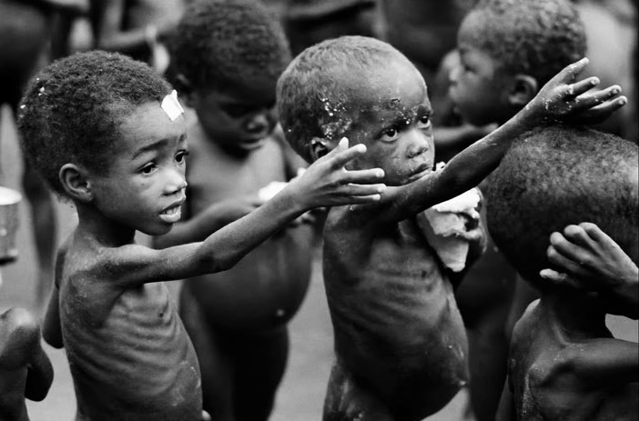

Slide 49
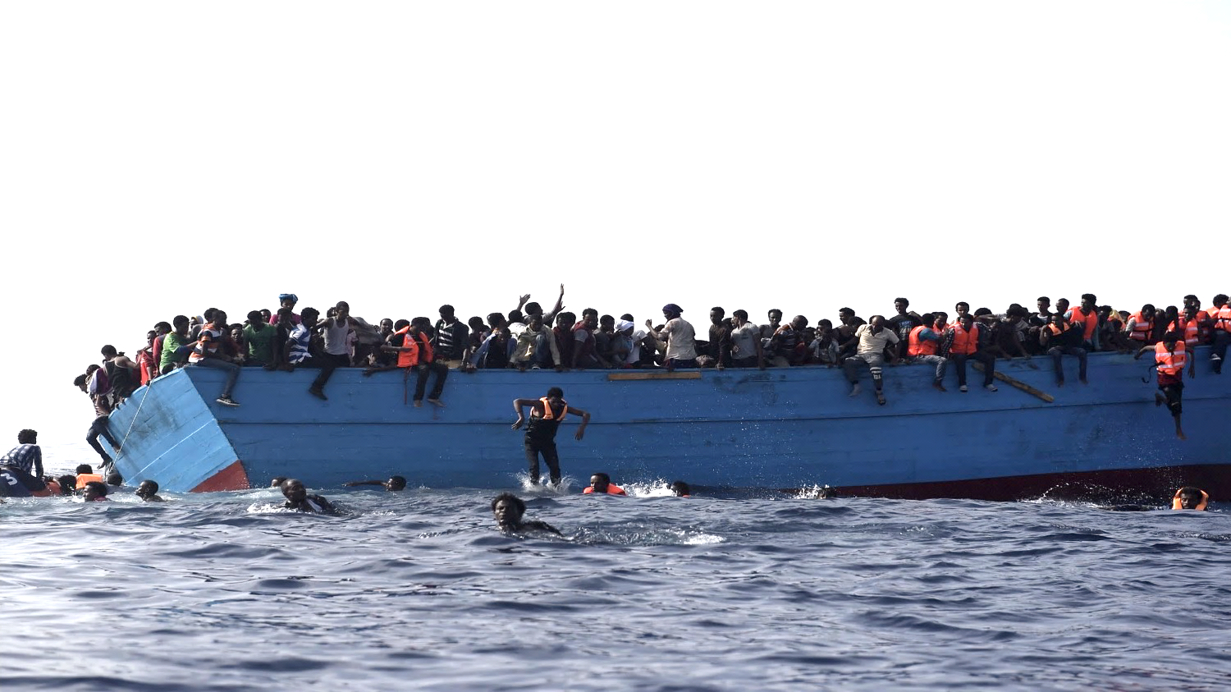

Slide 50
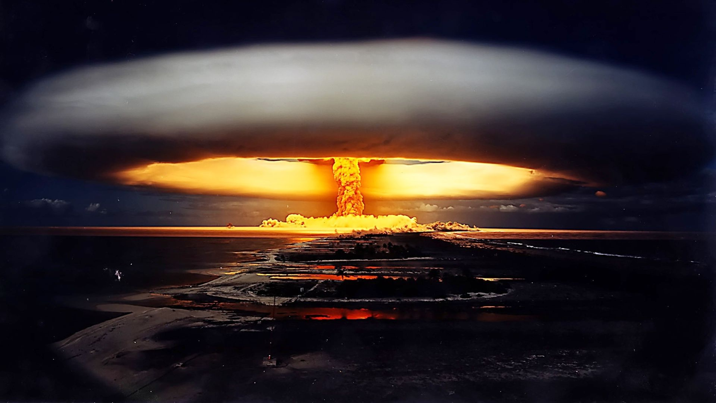

Slide 51
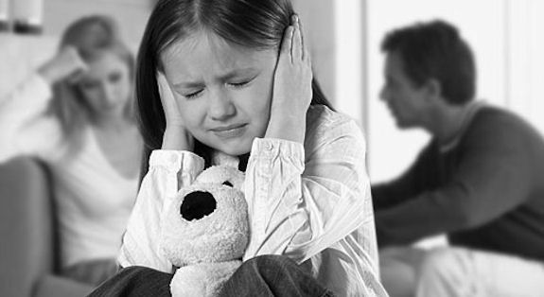

Slide 52
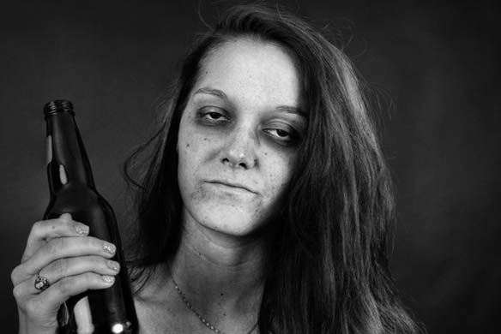

Slide 53
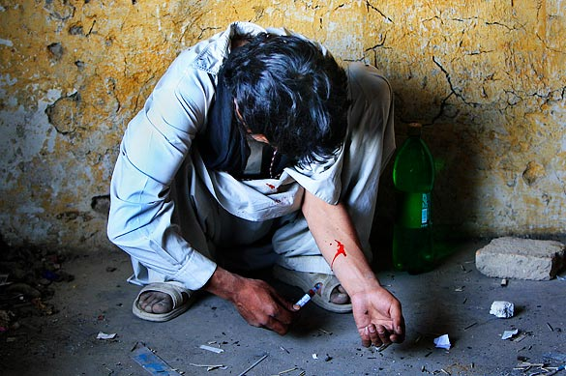

Slide 54
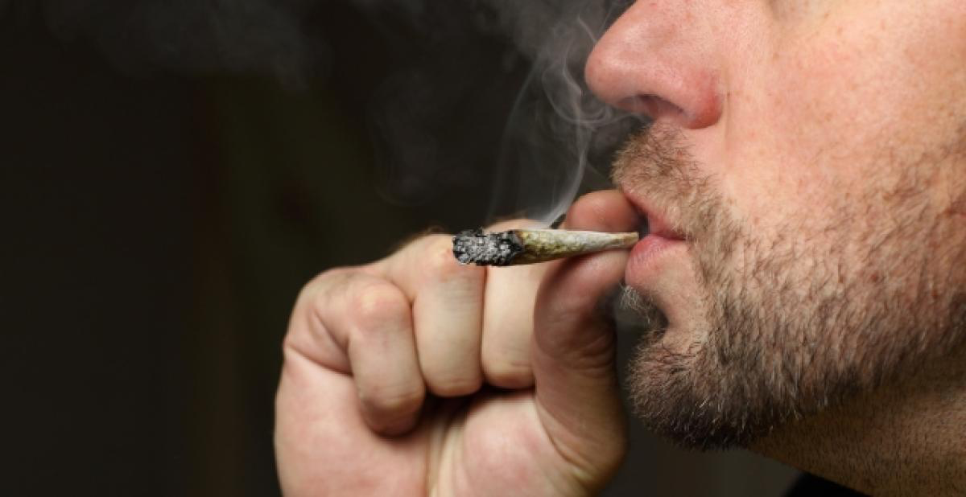

Slide 55


Slide 56
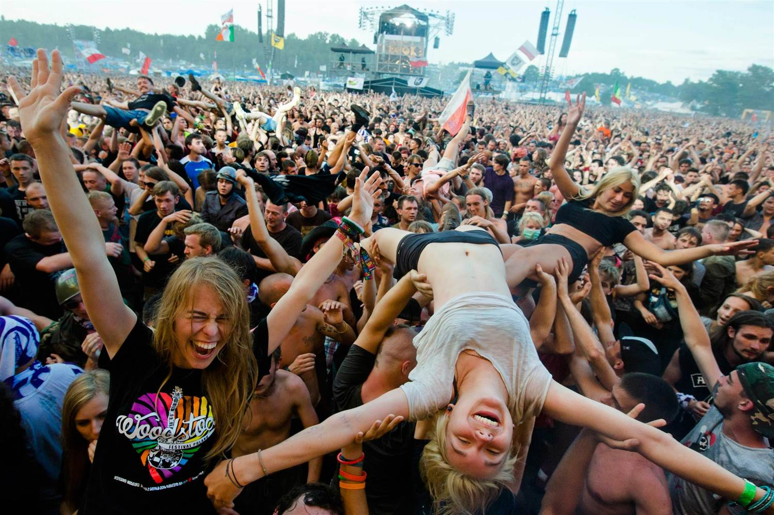

Slide 57
Suspicion

Slide 58
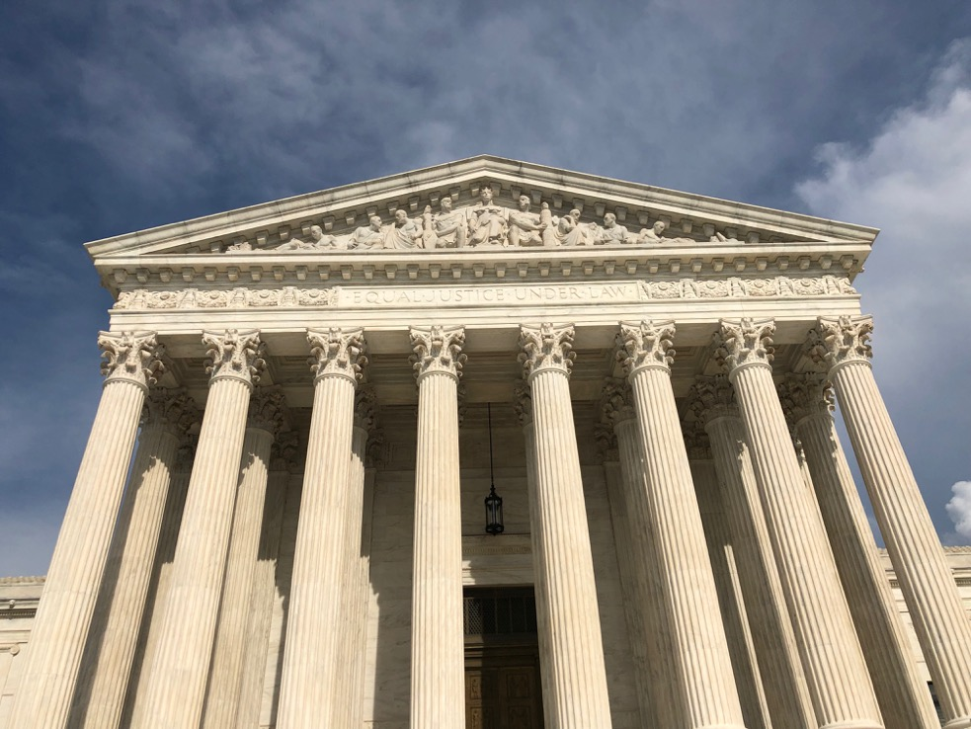

Slide 59
Under Suspicion
Authority
Authority figures
The police
Teachers
Textbooks
Politics & political discourse
Government
Male leadership
Hollywood
Wall Street
Madison Avenue
The educational system (favoring the well-off)
The establishment
Historical records
Organized religion
Religious texts—and especially the Bible

Slide 60
In this presentation we’ll become familiar with 4 facets of PM, and learn 5 strategies for appropriate Christian response.

Slide 61
Four Facets

Slide 62
Facet 1:
Truths, not Truth

Slide 63
Postmodernism (PM) is a curious blend of relativism (denying absolute truth) and strong, often strident, truth claims of its own.

Slide 64
  “Speak your truth.”

Slide 65


Slide 66


Slide 67
  Isn’t one way up the mountain is as good as another?

Slide 69
History: Winners write the history books. (This usually means privileged white males.)

Slide 70
History: Winners write the history books. (This usually means privileged white males.)
US history—Not presented from the viewpoint of the Indians, African slaves, women, or the disenfranchised.

Slide 71
History: Winners write the history books. (This usually means privileged white males.)
US history—Not presented from the viewpoint of the Indians, African slaves, women, or the disenfranchised.
The Canaanites didn’t write the book of Joshua.
Imagine how different 1 Samuel would read if it had been published by the Philistines!

Slide 72
History: Winners write the history books. (This usually means privileged white males.)
US history—Not presented from the viewpoint of the Indians, African slaves, women, or the disenfranchised.
The Canaanites didn’t write the book of Joshua.
Imagine how 1 Samuel would read if it had been published by the Philistines!

Slide 73
History: Winners write the history books. (This usually means privileged white males.)
US history—Not presented from the viewpoint of the Indians, African slaves, women, or the disenfranchised.
The Canaanites didn’t write the book of Joshua.
Imagine how 1 Samuel would read if it had been published by the Philistines!
Or if the events of Acts of the Apostles were recounted by the High Priest in Jerusalem!

Slide 74


Slide 75
Tolerance
Respect persons, not necessarily respecting their ideas.
We can’t demand that others
respect our ideas.

Slide 76
All world religions equal?
Transformation of tolerance—from tolerance of persons to tolerance of ideas.

Slide 77
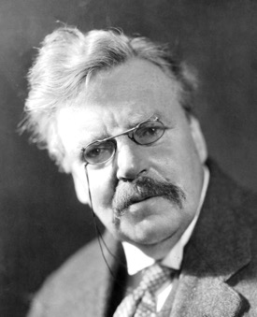
G. K. Chesterton (1874-1936):
  “There are those who hate Christianity and call their hatred an all-embracing love for all religions.”

Slide 78
G. K. Chesterton (1874-1936):
  “There are those who hate Christianity and call their hatred an all-embracing love for all religions.”
  “These are the days when the Christian is expected to praise every creed except his own.”

Slide 79
Experts note that the differences among the world’s religions greatly outweigh the similarities.

Slide 80
Multiple truths?
PM “truth” is flexible. Data, facts, info.

Slide 81
Multiple truths?
PM “truth” is flexible.
Select your “facts.” Impact of www.

Slide 82
Multiple truths?
PM “truth” is flexible.
Select your “facts.” Impact of www.
No one can get at the truth directly (it’s inaccessible), but at least we can peel away the layers of the onion. (Of course, once that’s done, nothing is left!)

Slide 83
Multiple truths?
PM “truth” is flexible.
Select your “facts.” Impact of www.
No one can get at the truth directly (it’s inaccessible), but at least we can peel away the layers of the onion. (Of course, once that’s done, nothing is left!)
Pretending contradictory claims are equally true is nonsensical. This is a false egalitarianism of ideas.

Slide 84
Multiple truths?
PM “truth” is flexible.
Select your “facts.” Impact of www.
No one can get at the truth directly (it’s inaccessible), but at least we can peel away the layers of the onion. (Of course, once that’s done, nothing is left!)
Pretending contradictory claims are equally true is nonsensical. This is a false egalitarianism of ideas.
As in mathematics, there will always be more wrong answers than right ones.

Slide 85
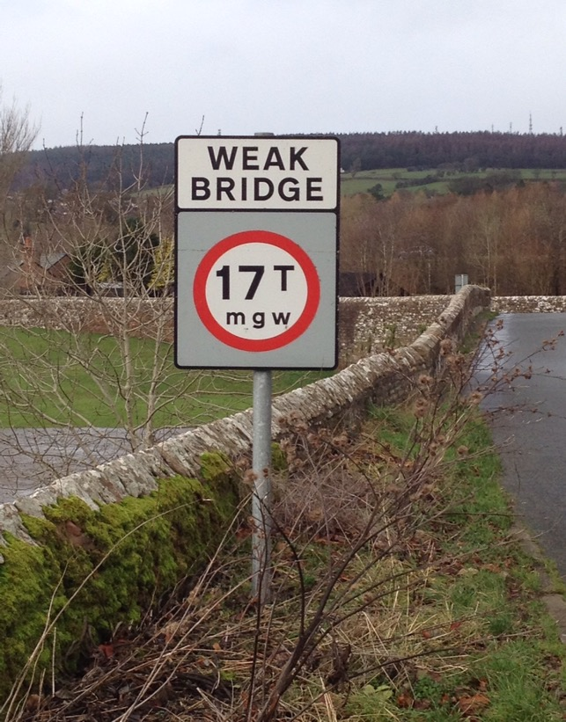

Slide 86
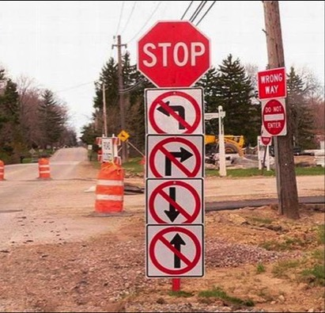

Slide 87
Facet 2:
Values, not Morals

Slide 88
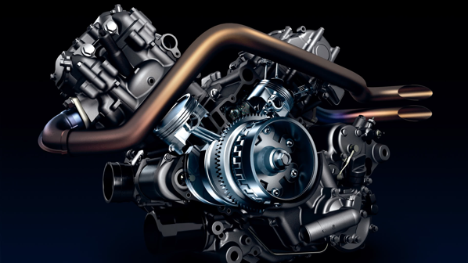
Moral relativism is the engine that drives postmodernism.

Slide 89
Moral relativism is an absolute truth claim. That is, each person decides his or her own moral course.

Slide 90
Moral relativism is an absolute truth claim. That is, each person decides his or her own moral course.
Values (modern lingo) > morals (classical parlance).

Slide 91
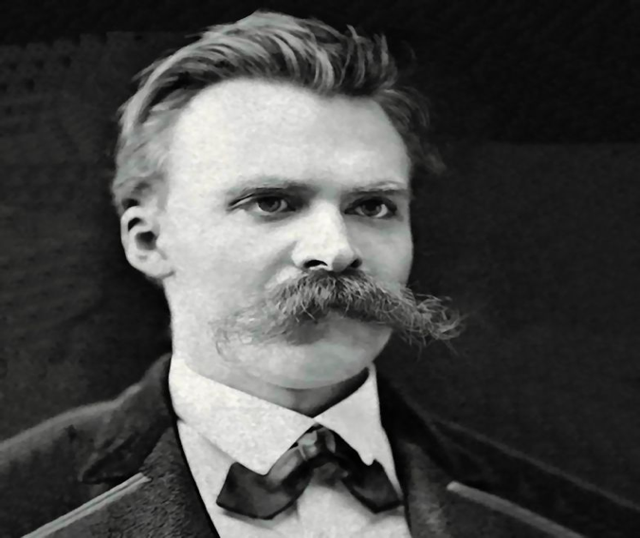
Friedrich Nietzsche
(1844-1900)

Slide 92
Values (modern lingo) > morals
Nietzsche—only moral “interpretations,” not moral/immoral actions

Slide 93
Moral relativism is an absolute truth claim. That is, each person decides his or her own moral course.
Values (modern lingo) > morals (classical parlance).
Nietzsche—only moral “interpretations,” not moral/immoral actions.

Slide 94
Moral relativism is an absolute truth claim. That is, each person decides his or her own moral course.
Values (modern lingo) > morals (classical parlance).
Nietzsche—only moral “interpretations,” not moral/immoral actions.

Slide 95
Moral relativism is an absolute truth claim. That is, each person decides his or her own moral course.
Values (modern lingo) > morals (classical parlance).
Nietzsche—only moral “interpretations,” not moral/immoral actions.
Criminals have done no wrong; they’re only “sick.”

Slide 96
Moral relativism is an absolute truth claim. That is, each person decides his or her own moral course.
Values (modern lingo) > morals (classical parlance).
Nietzsche—only moral “interpretations,” not moral/immoral actions.
Criminals have done no wrong; they’re only “sick.”
PM reduces morality and ethics to the level of personal preference.

Slide 97


Slide 98
Facet 3:
Inclusion, not Exclusion

Slide 99

Marginalization &
exclusivism are bad.
Inclusion is good.
Christianity is exclusive.

Slide 100

Carlton Pearson

Slide 101
Political oppression
Racism
Homophobia
Ageism
Patriarchy
Classism
Sexism — gender distinction
Evangelism is immoral (oppression)

Slide 102
… I take no pleasure in the death of anyone, declares the Sovereign Lord. Repent and live! – Ezek 18:32
God our Savior… wants all people to be saved and to come to a knowledge of the truth. – 1 Tim 2:3b-4

Slide 106
Yet ironically, all who refuse to believe PM rhetoric and toe the line are to be excluded.

Slide 107
Facet 4:
Journey, not Destination

Slide 108
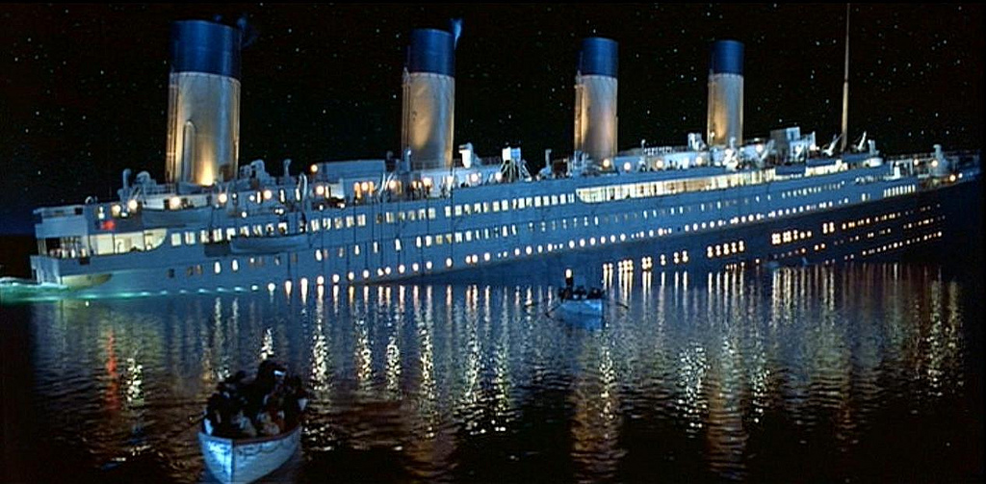

Slide 109
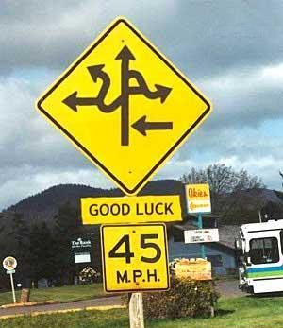

Slide 110
Truths, not Truth
Values, not Morals
Inclusion, not Exclusion
Journey, not Destination
Notes:
LEARN THESE!!! Everyone has an opinion – but few are well thought-through

Slide 111
Five Strategies

Slide 112
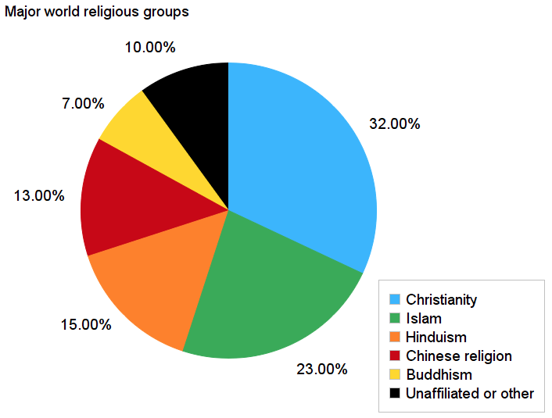

Slide 113
Most Christian study series assume a lazy or lukewarm or lapsed church member.
Word – Does this lesson actual prove the Bible is true? What about when people have questions or doubts?
Discipleship – (esp. when done early on) assumes and asks too much!
Sin – When someone has been conditioned to believe morality is a private or relative matter, this may not connect. And so on…
Needed are foundational studies on God, creation, the story of the Bible, and (often) even on Jesus.
Our words often fall uselessly to the ground, like a proverb in the mouth of a fool (Proverbs 26:7).

Slide 114
According to Barna, 3 of the top 6 reasons young people are rejecting the faith of their parents are:
Reason 3: Churches antagonistic to science
Reason 5: The exclusive nature of Christianity
Reason 6: Church unfriendly to those who doubt

Slide 115
According to Barna, 3 of the top 6 reasons young people are rejecting the faith of their parents are:
Reason 3: Churches antagonistic to science
Reason 5: The exclusive nature of Christianity
Reason 6: Church unfriendly to those who doubt
  Far too many Christians are oblivious of the intellectual and spiritual climate in which they live.

Slide 116
Strategy 1 : Interact intentionally

Slide 117

Strategy 1 : Interact intentionally
Reach out to members of other cultures and religions, not just those you feel comfortable around.

Slide 118
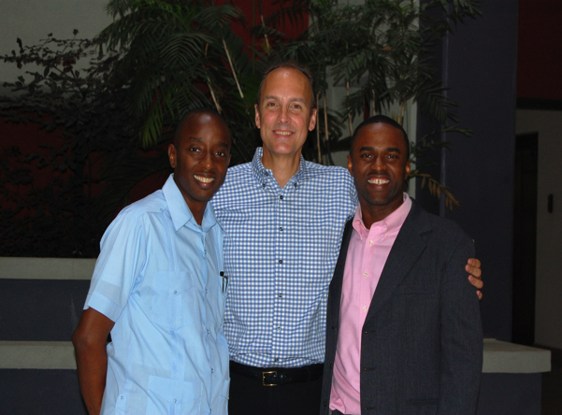
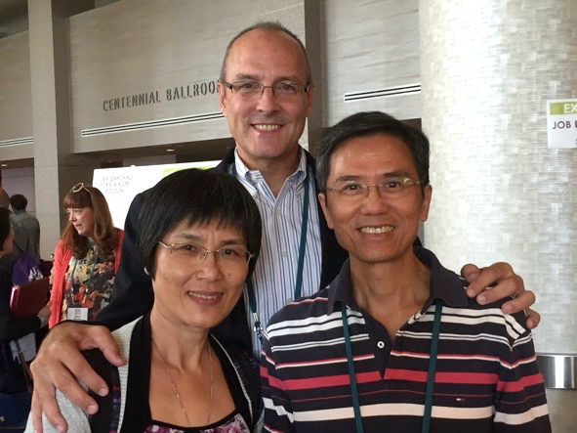
Strategy 1 : Interact intentionally
Reach out to members of other cultures and religions, not just those you feel comfortable around.

Slide 119
Strategy 1 : Interact intentionally
Reach out to members of other cultures and religions, not just those you feel comfortable around.
Aim to foster friendship and trust.
  Share your family.
  Throw parties.
  Do interesting things together—not just Bible studies!

Slide 120
Strategy 1 : Interact intentionally
Reach out to members of other cultures and religions, not just those you feel comfortable around.
Aim to foster friendship and trust.
  Share your family.
  Throw parties.
  Do interesting things together—not just Bible studies!
Shatter the negative stereotypes of Christians!
Once again, don’t jump into evangelism proper without doing some pre-evangelism. This may take time!

Slide 122
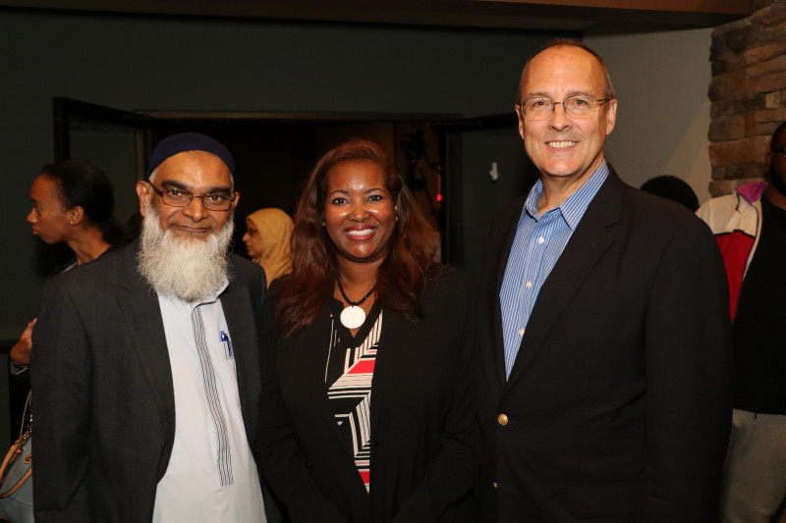

Slide 123
Strategy 1 : Interact intentionally
Reach out to members of other cultures and religions, not just those you feel comfortable around.
Aim to foster friendship and trust.
  Share your family.
  Throw parties.
  Do interesting things together—not just Bible studies!
Shatter the negative stereotypes of Christians!
Once again, don’t jump into evangelism proper without doing some pre-evangelism. This will take time!

Slide 124
Strategy 2: Emphasize commonality
We too are suspicious of the system (Matt 23)—and the political system (“Go tell that fox…”, Luke 13). Jesus’ hardest challenges were to religious leaders (John 3:9).
The Bible affirms ecology (Gen 1:28).
Affirmation of the marginalized (Luke 10:25-37; 38-42).
Respect for the physically challenged (Lev 19:14).
Diversity (minorities, Gentiles welcome; Rev 7:9).
We too are fellow seekers—we have not “arrived”
(Psalm 27:28; Matt 6:33; Phil 3:12; Heb 11:14-16).

Slide 125
Strategy 2: Emphasize commonality
We too are suspicious of the system (Matt 23)—and the political system (“Go tell that fox…”, Luke 13). Jesus’ hardest challenges were to religious leaders (John 3:9).
The Bible affirms ecology (Gen 1:28).
Affirmation of the marginalized (Luke 10:25-37; 38-42).
Respect for the physically challenged (Lev 19:14).
Diversity (minorities, Gentiles welcome; Rev 7:9).
We too are fellow seekers—we have not “arrived”
(Psalm 27:28; Matt 6:33; Phil 3:12; Heb 11:14-16).

Slide 126
Strategy 2: Emphasize commonality
We too are suspicious of the system (Matt 23)—and the political system (“Go tell that fox…”, Luke 13). Jesus’ hardest challenges were to religious leaders (John 3:9).
The Bible affirms ecology (Gen 1:28).
Affirmation of the marginalized (Luke 10:25-37; 38-42).
Respect for the physically challenged (Lev 19:14).
Diversity (minorities, Gentiles welcome; Rev 7:9).
We too are fellow seekers—we have not “arrived”
(Psalm 27:28; Matt 6:33; Phil 3:12; Heb 11:14-16).

Slide 127
Strategy 2: Emphasize commonality
We too are suspicious of the system (Matt 23)—and the political system (“Go tell that fox…”, Luke 13). Jesus’ hardest challenges were to religious leaders (John 3:9).
The Bible affirms ecology (Gen 1:28).
Affirmation of the marginalized (Luke 10:25-37; 38-42).
Respect for the physically challenged (Lev 19:14).
Diversity (minorities, Gentiles welcome; Rev 7:9).
We too are fellow seekers—we have not “arrived”
(Psalm 27:28; Matt 6:33; Phil 3:12; Heb 11:14-16).

Slide 128
Strategy 2: Emphasize commonality
We too are suspicious of the system (Matt 23)—and the political system (“Go tell that fox…”, Luke 13). Jesus’ hardest challenges were to religious leaders (John 3:9).
The Bible affirms ecology (Gen 1:28).
Affirmation of the marginalized (Luke 10:25-37; 38-42).
Respect for the physically challenged (Lev 19:14).
Diversity (minorities, Gentiles welcome; Rev 7:9).
We too are fellow seekers—we have not “arrived”
(Psalm 27:28; Matt 6:33; Phil 3:12; Heb 11:14-16).

Slide 129
Strategy 2: Emphasize commonality
We too are suspicious of the system (Matt 23)—and the political system (“Go tell that fox…”, Luke 13). Jesus’ hardest challenges were to religious leaders (John 3:9).
The Bible affirms ecology (Gen 1:28).
Affirmation of marginalized (Luke 10:25-37; 38-42).
Respect for the physically challenged (Lev 19:14).
Diversity (minorities, Gentiles welcome; Rev 7:9).
We too are fellow seekers—we have not “arrived”
(Psalm 27:28; Matt 6:33; Phil 3:12; Heb 11:14-16).

Slide 130
We have much in common with PMs; many of their observations are accurate, or contain a kernel of truth.

Slide 131
We have much in common with PMs; many of their observations are accurate, or contain a kernel of truth.
Let’s show respect (1 Pet 3:14-16). No room for patronizing comments—or whining about the younger generation – which every older generation, going back millennia, seems to have done!

Slide 132
Strategy 3: Critique Culture & Church

Slide 133
Strategy 3: Critique Culture & Church
Movies, TV shows, song lyrics, books…

Slide 134
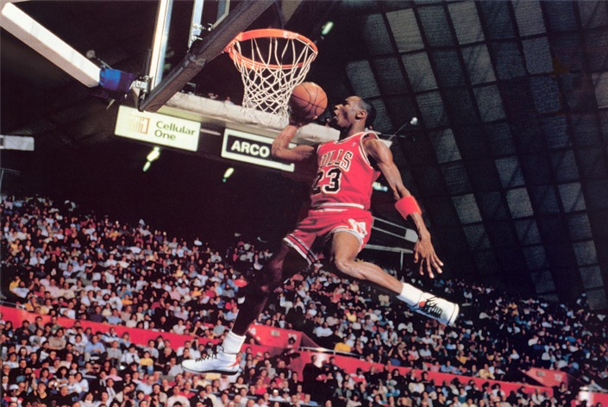
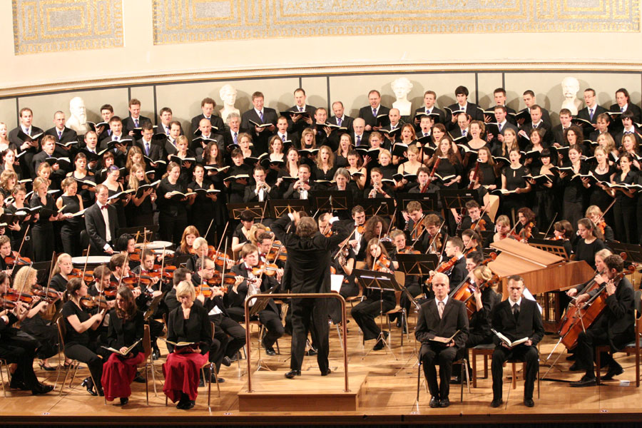
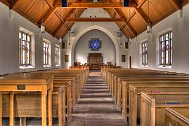


Slide 135
Strategy 3: Critique Culture & Church
Movies, TV shows, song lyrics, books…
Messages we’re receiving from the younger generation…

Slide 137
Strategy 3: Critique Culture & Church
Movies, TV shows, song lyrics, books…
Messages we’re receiving from the younger generation…
Let’s become students of other worldviews.
  Remember, Paul didn't quote the Bible to pagans (Acts 14; Acts 17).
  Paul had invested time to learn how people think, what stories they have been told, their culture….

Slide 138
Strategy 3: Critique Culture & Church
Movies, TV shows, song lyrics, books…
Messages we’re receiving from the younger generation…
Let’s become students of other worldviews.
  Remember, Paul didn't quote the Bible to pagans (Acts 14; Acts 17).
  Paul had invested time to learn how people think, what stories they have been told, their culture….

Slide 139
Strategy 3: Critique Culture & Church
Poorly prepared messages.
Hypocrisy
Materialism / pursuing the American dream
Callousness towards the needy
Legalism: religion = rules
Shallow or corny religion
  We need to police ourselves. Like the prophets of old, all God’s people should be involved in some degree of reflection and feedback.

Slide 140
Strategy 4:
Hold PMs to logic, consistency, and fairness

Slide 141
Strategy 4:
Hold PMs to logic, consistency, and fairness
PM strategy:
1. Be loud in your protestations.
2. Keep repeating your sound bite, over and over.
3. Question the motives of anyone who disagrees with you.

Slide 142
Strategy 4:
Hold PMs to logic, consistency, and fairness
PM strategy:
1. Be loud in your protestations.
2. Keep repeating your sound bite, over and over.
3. Question the motives of anyone who disagrees with you.

Slide 143
Strategy 4:
Hold PMs to logic, consistency, and fairness
PM strategy:
1. Be loud in your protestations.
2. Keep repeating your sound bite, over and over.
3. Question the motives of anyone who disagrees with you.

Slide 144
Strategy 4:
Hold PMs to logic, consistency, and fairness
PM strategy:
1. Be loud in your protestations.
2. Keep repeating your sound bite, over and over.
3. Question the motives of anyone who disagrees with you.

Slide 145
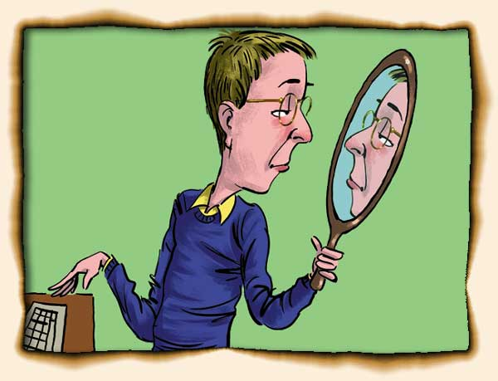

Slide 146
a. Claiming to know = arrogance
Trying to persuade = bigotry
Trying to change the world = tyranny

Slide 147
a. Claiming to know = arrogance
b. Trying to persuade = bigotry
Trying to change the world = tyranny

Slide 148
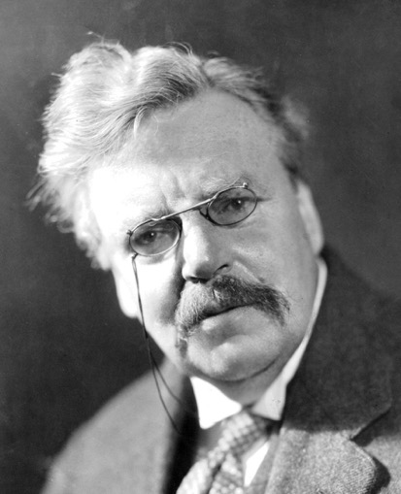
"It is not bigotry to be certain we are right, but it is bigotry to be unable to imagine how we might possibly have gone wrong" (G. K. Chesterton).

Slide 149
"It is not bigotry to be certain we are right, but it is bigotry to be unable to imagine how we might possibly have gone wrong" (G. K. Chesterton).
Christians don’t claim complete knowledge, only adequate knowledge.
We strive to be respectful of others, to embody the humility of Christ (Matt 11:29; Eph 4:2; Phil 2:3; 4:8; Col 3:12; Jas 3:13).
Many PM, on the other hand, disrespect other views of reality, whenever there is a truth claim.

Slide 150
"It is not bigotry to be certain we are right, but it is bigotry to be unable to imagine how we might possibly have gone wrong" (G. K. Chesterton).
Christians don’t claim complete knowledge, only adequate knowledge.
We strive to be respectful of others, to embody the humility of Christ (Matt 11:29; Eph 4:2; Phil 2:3; 4:8; Col 3:12; Jas 3:13).
Many PM, on the other hand, disrespect other views of reality, whenever there is a truth claim.

Slide 151
a. Claiming to know = arrogance
b. Trying to persuade = bigotry
c. Trying to change the world = tyranny

Slide 152
Thus any religious or political belief can be dismissed!
But:
Lack of engagement with actual reasons
Attack on words and definitions
Pointless to engage in reasoned discourse, since there is no reason
Lincoln-Douglas debates v. “entertainment.”

Slide 153
Thus any religious or political belief can be dismissed!
But:
Little engagement with actual reasons
Attacks on words and definitions
Pointless to engage in reasoned discourse, since there is no reason
Lincoln-Douglas debates v. “entertainment.”

Slide 154
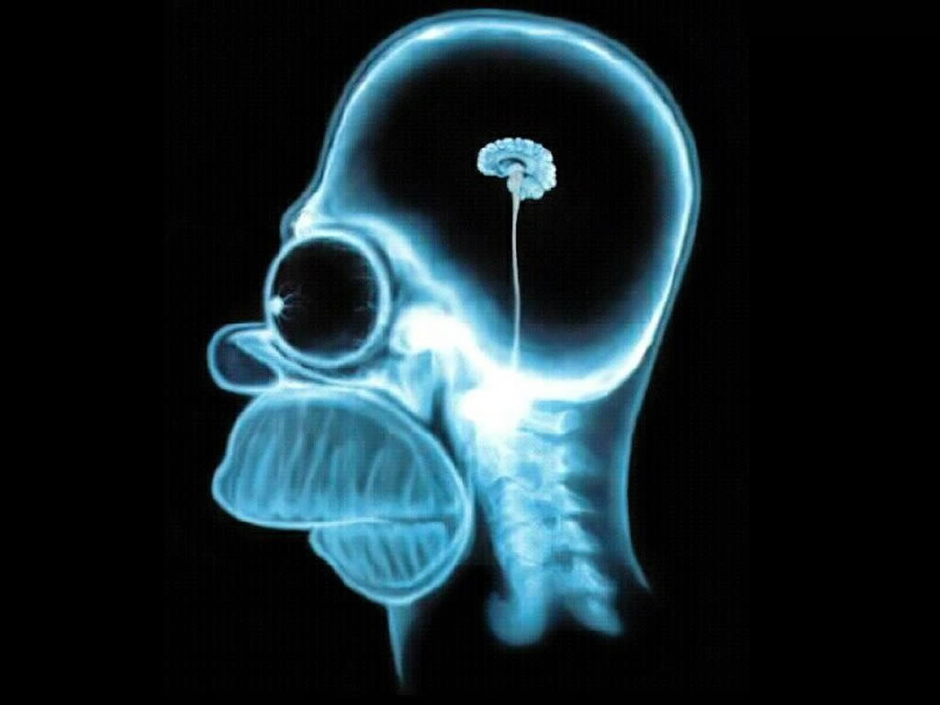
Notes:
Everyone has an opinion – but few are well thought-through

Slide 155
Strategy 5:
Handle Scripture Sensitively & Skillfully
Notes:
What is off-putting for PMs?

Slide 156
Scripture
Acknowledge that in the Bible we find black & white, but also gray!

Slide 157
Scripture
Acknowledge that in the Bible we find black & white, but also gray!
Acknowledge that not all biblical truths are equally important. Some commands are more important than others. The Bible isn’t “flat,” everything being on the same level, but varied. It has a topography, an interesting terrain. Don’t flatten it!

Slide 158
Scripture
Acknowledge that in the Bible we find black & white, but also gray!
Acknowledge that not all biblical truths are equally important. Some commands are more important than others. The Bible isn’t “flat,” everything being on the same level, but varied. It has a topography, an interesting terrain. Don’t flatten it!
Emphasize that the biblical story is a true story, rooted in time & space, history & geography. It’s better than fiction.

Slide 159
Go easy on the proof-texting

Slide 160
Go easy on the proof-texting
Avoid proof-texting (turning to single verses to prove a point). This can be bewildering! It’s like changing TV channel every 2 minutes.

Slide 161


Slide 162
Go easy on the proof-texting
Avoid proof-texting (turning to single verses to prove a point). This can be bewildering! It’s like changing TV channel every 2 minutes.
This plays into the eclectic postmodern agenda. It looks like we are creatively combining scriptures to say what we want them to say!

Slide 163
Go easy on the proof-texting
Avoid proof-texting (turning to single verses to prove a point). This can be bewildering! It’s like changing TV channel every 2 minutes.
This plays into the eclectic postmodern agenda. It looks like we are creatively combining scriptures to say what we want them to say!
It also panders to the short attention span of many in our day.

Slide 164
Go easy on the proof-texting
Avoid proof-texting (turning to single verses to prove a point). This can be bewildering! It’s like changing TV channel every 2 minutes.
This plays into the eclectic postmodern agenda. It looks like we are creatively combining scriptures to say what we want them to say!
It also panders to the short attention span of many in our day.
Wherever possible, stick with one passage. Trust the Word. Have faith that God’s will is best revealed when we read it as it was written.

Slide 165
Learn to unpack the passage

Slide 167
Learn to unpack the passage
Example: John 14:6: Jesus said to [Thomas], “I am the way, and the truth, and the life. No one comes to the Father except through me.”

Slide 168
WAY:

Slide 169
WAY:
Person > System. Preach Christ, not the church—people are less suspicious of him! (2 Cor 4:5)

Slide 170
WAY:
Person > System. Preach Christ, not the church—people are less suspicious of him! (2 Cor 4:5)
“The Way” was a term used for the early
Christians (Acts 9:2; 19:9,23; 24:14,22).
“The way” refers to people.
The Bible is relational!

Slide 171
WAY:
Person > System. Preach Christ, not the church—people are less suspicious of him! (2 Cor 4:5)
“The Way” was a term used for the early
Christians (Acts 9:2; 19:9,23; 24:14,22).
“The way” refers to people.
The Bible is relational!

Slide 172
WAY:
Person > System. Preach Christ, not the church—people are less suspicious of him! (2 Cor 4:5)
“The Way” was a term used for the early
Christians (Acts 9:2; 19:9,23; 24:14,22).
“The way” refers to people.
The Bible is relational!
But also destinational.

Slide 173
WAY:
Person > System. Preach Christ, not the church—people are less suspicious of him! (2 Cor 4:5)
“The Way” was a term used for the early
Christians (Acts 9:2; 19:9,23; 24:14,22).
“The way” refers to people.
The Bible is relational!
But also destinational.
(Journey: John 10:10; destination: John 14:1-6.)

Slide 174
TRUTH:
Not doctrinal truth, as important as that is.
Again, the truth is a person, not a theological system.
The Word became flesh (John 1:14). This is the incarnation.

Slide 175
LIFE:
Not autonomy—but shared, selfless, sacrificial life.
PMs spend a lot of time in virtual worlds. Invite them to the real world… to God’s world.
Faith in Christ works. PMs tend to care more about whether something works then whether it’s true.
Invite them to taste and see that the Lord is good, and their confidence can be rooted in Christ—who is the truth.

Slide 176
Truths, not Truth
Values, not Morals
Inclusion, not Exclusion
Journey, not Destination
Notes:
LEARN THESE!!! Everyone has an opinion – but few are well thought-through

Slide 177
Interact intentionally
Emphasize commonality
Critique culture & church
Hold PMs Accountable
Handle Scripture skillfully
Notes:
LEARN THESE!!! Everyone has an opinion – but few are well thought-through

Slide 178
Let’s be alert!

Slide 179
Let’s be alert!
Never underestimate the power of ideas!
PM is powerful, attractive, and prevalent.

Slide 180
Let’s be alert!
Never underestimate the power of ideas!
PM is powerful, attractive, and prevalent.
We need to be informed.

Slide 181
Let’s be alert!
Never underestimate the power of ideas!
PM is powerful, attractive, and prevalent.
We need to be informed.
We don’t need to be bullied.
Christianity makes sense, and even if you can’t answer every criticism, the faith is still more reasonable, elegant, and satisfying than anything the PM world has to offer.

Slide 182
Let’s be alert!
Never underestimate the power of ideas!
PM is powerful, attractive, and prevalent.
We need to be informed.
We don’t need to be bullied.
Christianity makes sense. Even if we can’t answer every criticism, the faith is still more reasonable, elegant, and satisfying than anything the PM has to offer.

Slide 183
Navigating the Modern/
Postmodern Landscape
Douglas Jacoby, M.T.S., D.Min.
San Antonio, 7 March 2020

Slide 184
Navigating the Modern /
Postmodern Landscape
Douglas Jacoby, M.T.S., D.Min.
San Antonio, 7 March 2020

Slide 185
Sign up for the weekly newsletter
Text the word DISCIPLE to 66866
Notes:
$2 off books….. $3 if you are a website MEMBER

Slide 186
Turner’s Creed
… We believe everything is OK as long as you don’t hurt anyone, to the best of your definition of hurt…
We believe in sex before, during, and after marriage… adultery is fun… sodomy’s OK. We believe that taboos are taboo.
We believe that everything is getting better despite evidence to the contrary. The evidence must be investigated—and you can prove anything with evidence…
Jesus was a good man just like Buddha, Mohammed, and ourselves. He was a good moral teacher, although we think his good morals were bad.
We believe that all religions are basically the same… They all believe in love and goodness. They only differ on matters of creation, sin, heaven, hell, God, and salvation…

Slide 187
Turner’s Creed
… We believe everything is OK as long as you don’t hurt anyone, to the best of your definition of hurt…
We believe in sex before, during, and after marriage… adultery is fun… sodomy’s OK. We believe that taboos are taboo.
We believe that everything is getting better despite evidence to the contrary. The evidence must be investigated—and you can prove anything with evidence…
Jesus was a good man just like Buddha, Mohammed, and ourselves. He was a good moral teacher, although we think his good morals were bad.
We believe that all religions are basically the same… They all believe in love and goodness. They only differ on matters of creation, sin, heaven, hell, God, and salvation…

Slide 188
Turner’s Creed
… We believe everything is OK as long as you don’t hurt anyone, to the best of your definition of hurt…
We believe in sex before, during, and after marriage… adultery is fun… sodomy’s OK. We believe that taboos are taboo.
We believe that everything is getting better despite evidence to the contrary. The evidence must be investigated—and you can prove anything with evidence…
Jesus was a good man just like Buddha, Mohammed, and ourselves. He was a good moral teacher, although we think his good morals were bad.
We believe that all religions are basically the same… They all believe in love and goodness. They only differ on matters of creation, sin, heaven, hell, God, and salvation…

Slide 189
Turner’s Creed
… We believe everything is OK as long as you don’t hurt anyone, to the best of your definition of hurt…
We believe in sex before, during, and after marriage… adultery is fun… sodomy’s OK. We believe that taboos are taboo.
We believe that everything is getting better despite evidence to the contrary. The evidence must be investigated—and you can prove anything with evidence…
Jesus was a good man just like Buddha, Mohammed, and ourselves. He was a good moral teacher, although we think his good morals were bad.
We believe that all religions are basically the same… They all believe in love and goodness. They only differ on matters of creation, sin, heaven, hell, God, and salvation…

Slide 190
Turner’s Creed
… We believe everything is OK as long as you don’t hurt anyone, to the best of your definition of hurt…
We believe in sex before, during, and after marriage… adultery is fun… sodomy’s OK. We believe that taboos are taboo.
We believe that everything is getting better despite evidence to the contrary. The evidence must be investigated—and you can prove anything with evidence…
Jesus was a good man just like Buddha, Mohammed, and ourselves. He was a good moral teacher, although we think his good morals were bad.
We believe that all religions are basically the same… They all believe in love and goodness. They only differ on matters of creation, sin, heaven, hell, God, and salvation…

Slide 191
Turner’s Creed
… We believe everything is OK as long as you don’t hurt anyone, to the best of your definition of hurt…
We believe in sex before, during, and after marriage… adultery is fun… sodomy’s OK. We believe that taboos are taboo.
We believe that everything is getting better despite evidence to the contrary. The evidence must be investigated—and you can prove anything with evidence…
Jesus was a good man just like Buddha, Mohammed, and ourselves. He was a good moral teacher, although we think his good morals were bad.
We believe that all religions are basically the same… They all believe in love and goodness. They only differ on matters of creation, sin, heaven, hell, God, and salvation…

Slide 192
We believe that humans are essentially good. It’s only their behavior that lets them down. This is the fault of society. Society is the fault of conditions. Conditions are the fault of society.
We believe that everyone must find the truth that is right for them. Reality will adapt accordingly. The universe will readjust. History will alter.
We believe that there is no absolute truth—excepting the truth that there is no absolute truth.
We believe in the rejection of creeds.

Slide 193
We believe that humans are essentially good. It’s only their behavior that lets them down. This is the fault of society. Society is the fault of conditions. Conditions are the fault of society.
We believe that everyone must find the truth that is right for them. Reality will adapt accordingly. The universe will readjust. History will alter.
We believe that there is no absolute truth—excepting the truth that there is no absolute truth.
We believe in the rejection of creeds.

Slide 194
We believe that humans are essentially good. It’s only their behavior that lets them down. This is the fault of society. Society is the fault of conditions. Conditions are the fault of society.
We believe that everyone must find the truth that is right for them. Reality will adapt accordingly. The universe will readjust. History will alter.
We believe that there is no absolute truth—excepting the truth that there is no absolute truth.
We believe in the rejection of creeds.

