Slide 1
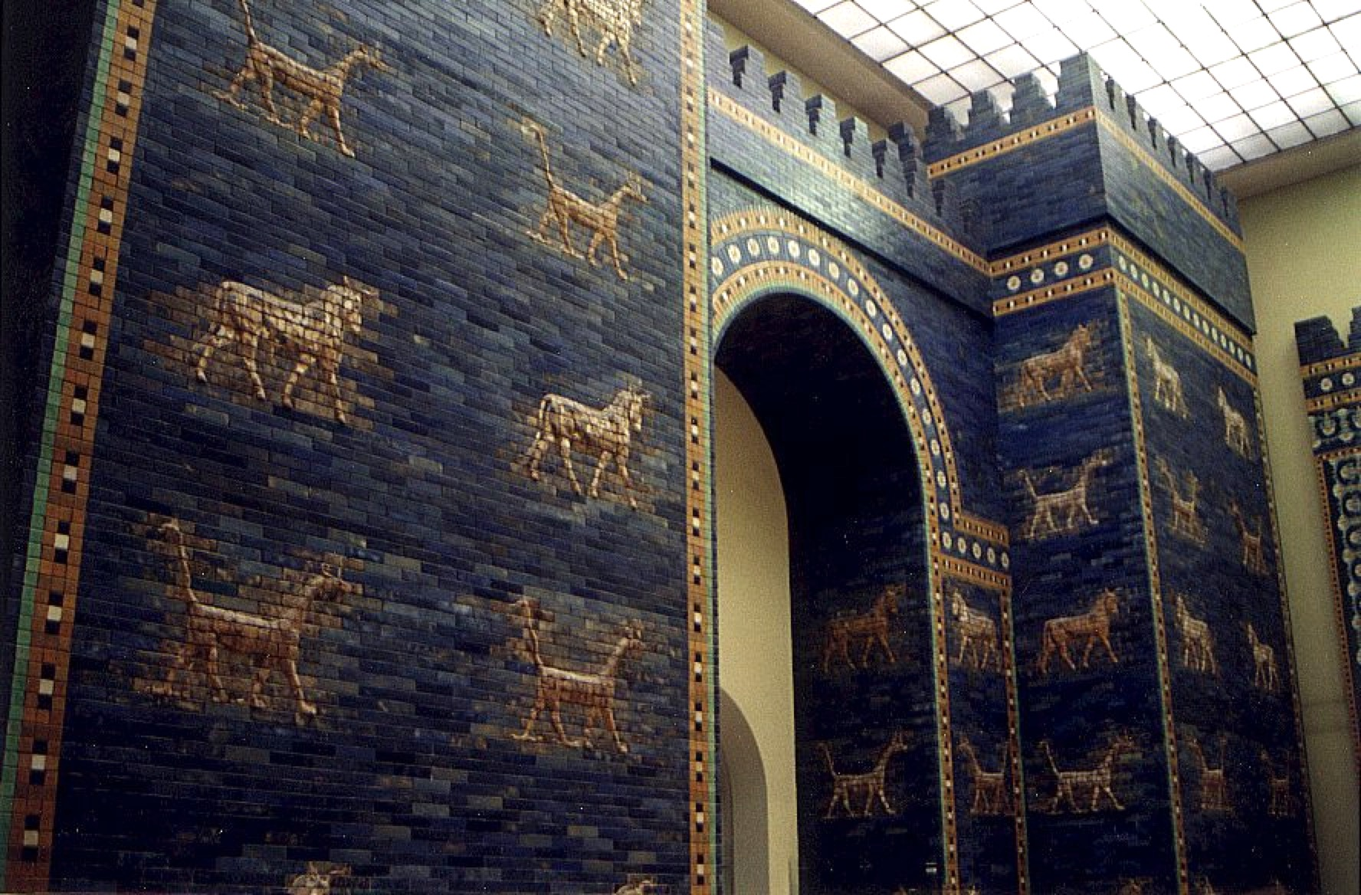
BIBLICAL ARCHAEOLOGY
Unearthing the Truth
Dr. D. A. Jacoby, Atlanta
São Paulo, 14 May 2017

Slide 2
Memberships
Evangelical Philosophical Society
Strength in Weakness Ministries
Athens Institute of Ministry
American Association of Christian Counselors
American Scientific Affiliation
Biblical Archaeological Society

Slide 3
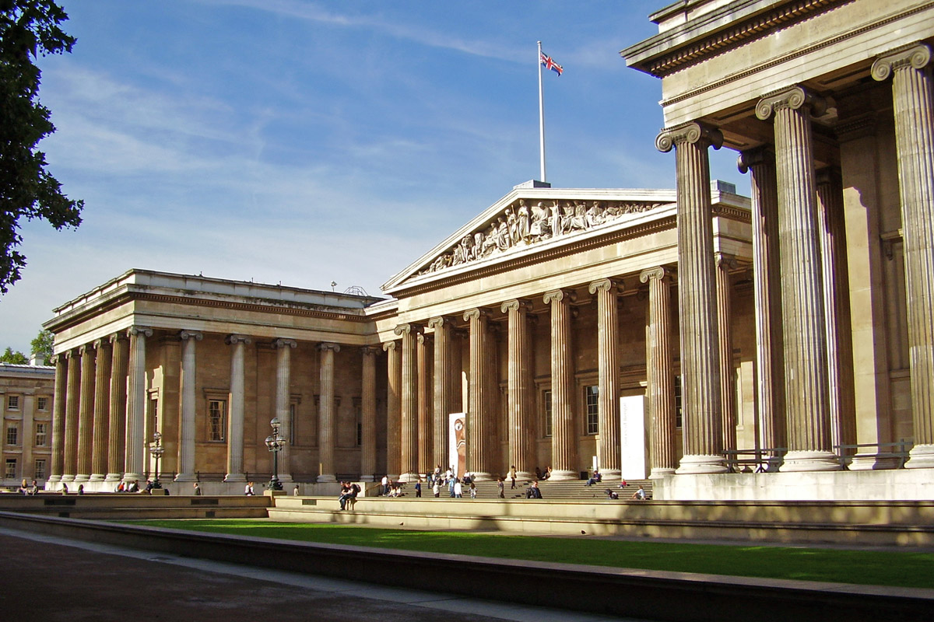

Slide 4
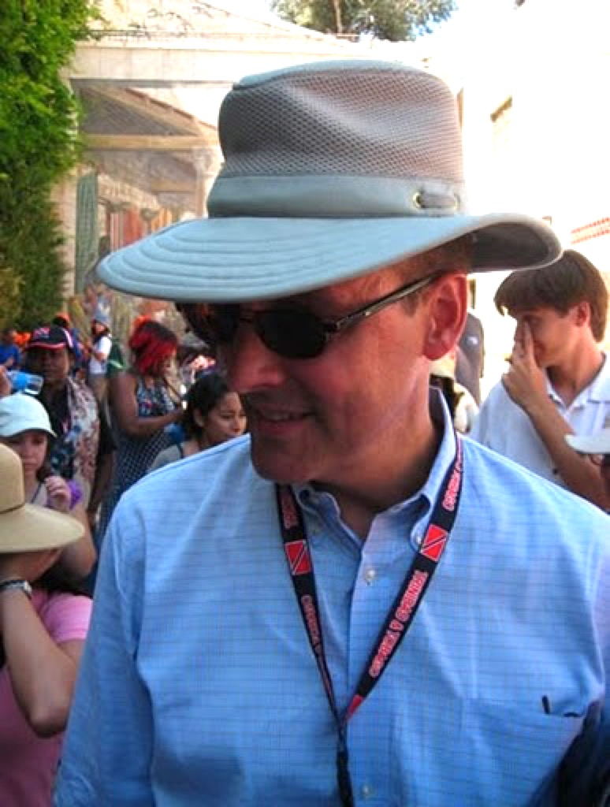

Slide 5
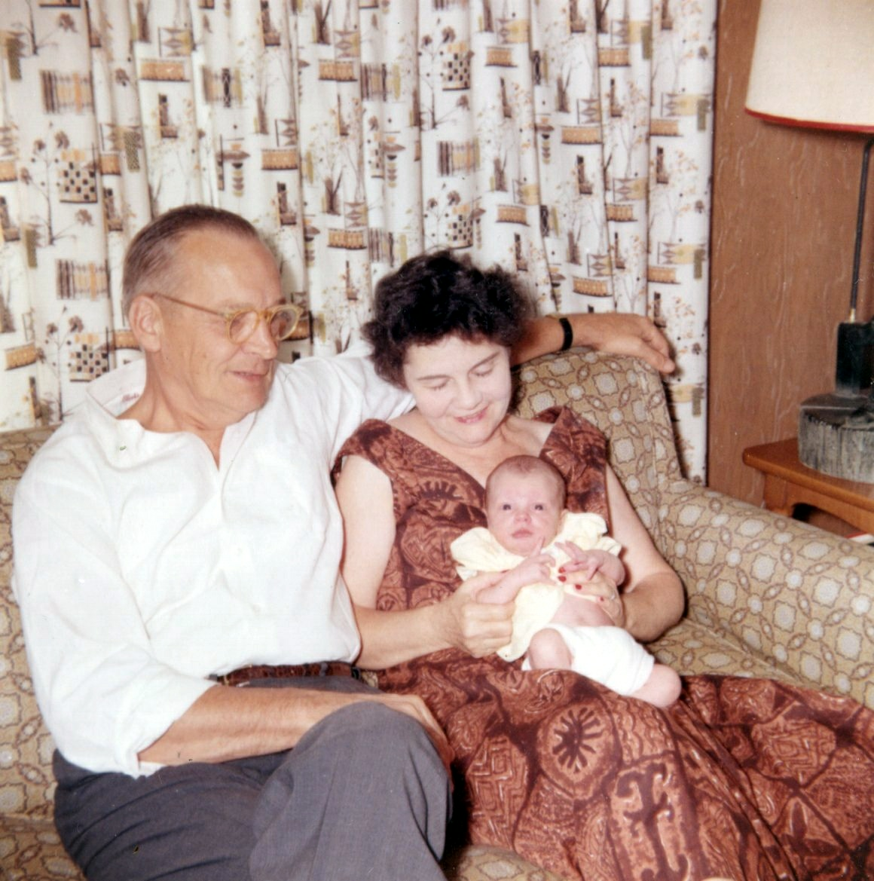

Slide 7
Athens, Corinth, Delphi, Patmos—Greece
Giza & Cairo—Egypt
Paris—France
Petra—Jordan
Rome, Pompeii, Herculaneum—Italy
London, Oxford, Stratford—UK
Pergamum, Laodicea, Ephesus, Colossae, Hierapolis, Sardis, Istanbul—Turkey
Berlin, Wittenberg—Germany
Zürich, Geneva--Switzerland
Jerusalem—Israel (1997, 1998, 1999, 2008, 2011, 2016, 2017, 2018)

Slide 8
Solid evidence

Slide 9
Top finds: Old Testament
Gilgamesh Epic and Epic of Atrahasis; Amarna Letters; David Inscription from Tel Dan; reliefs from Sargon’s palace; reliefs from Nimrud; ancient Near Eastern ziggurats (30 in all); Black Obelisk of Shalmaneser III; excavations at Ebla, Mari, Nuzi, Ur, Çatal Höyük, Hazor, Laish, Jerusalem, and many other cities; Hezekiah’s Tunnel; Taylor Prism; Nabonidus tablets; Cyrus Cylinder; Dead Sea Scrolls.

Slide 10
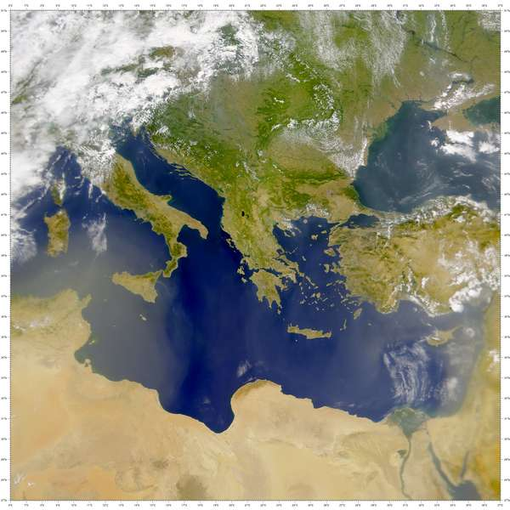

Slide 11
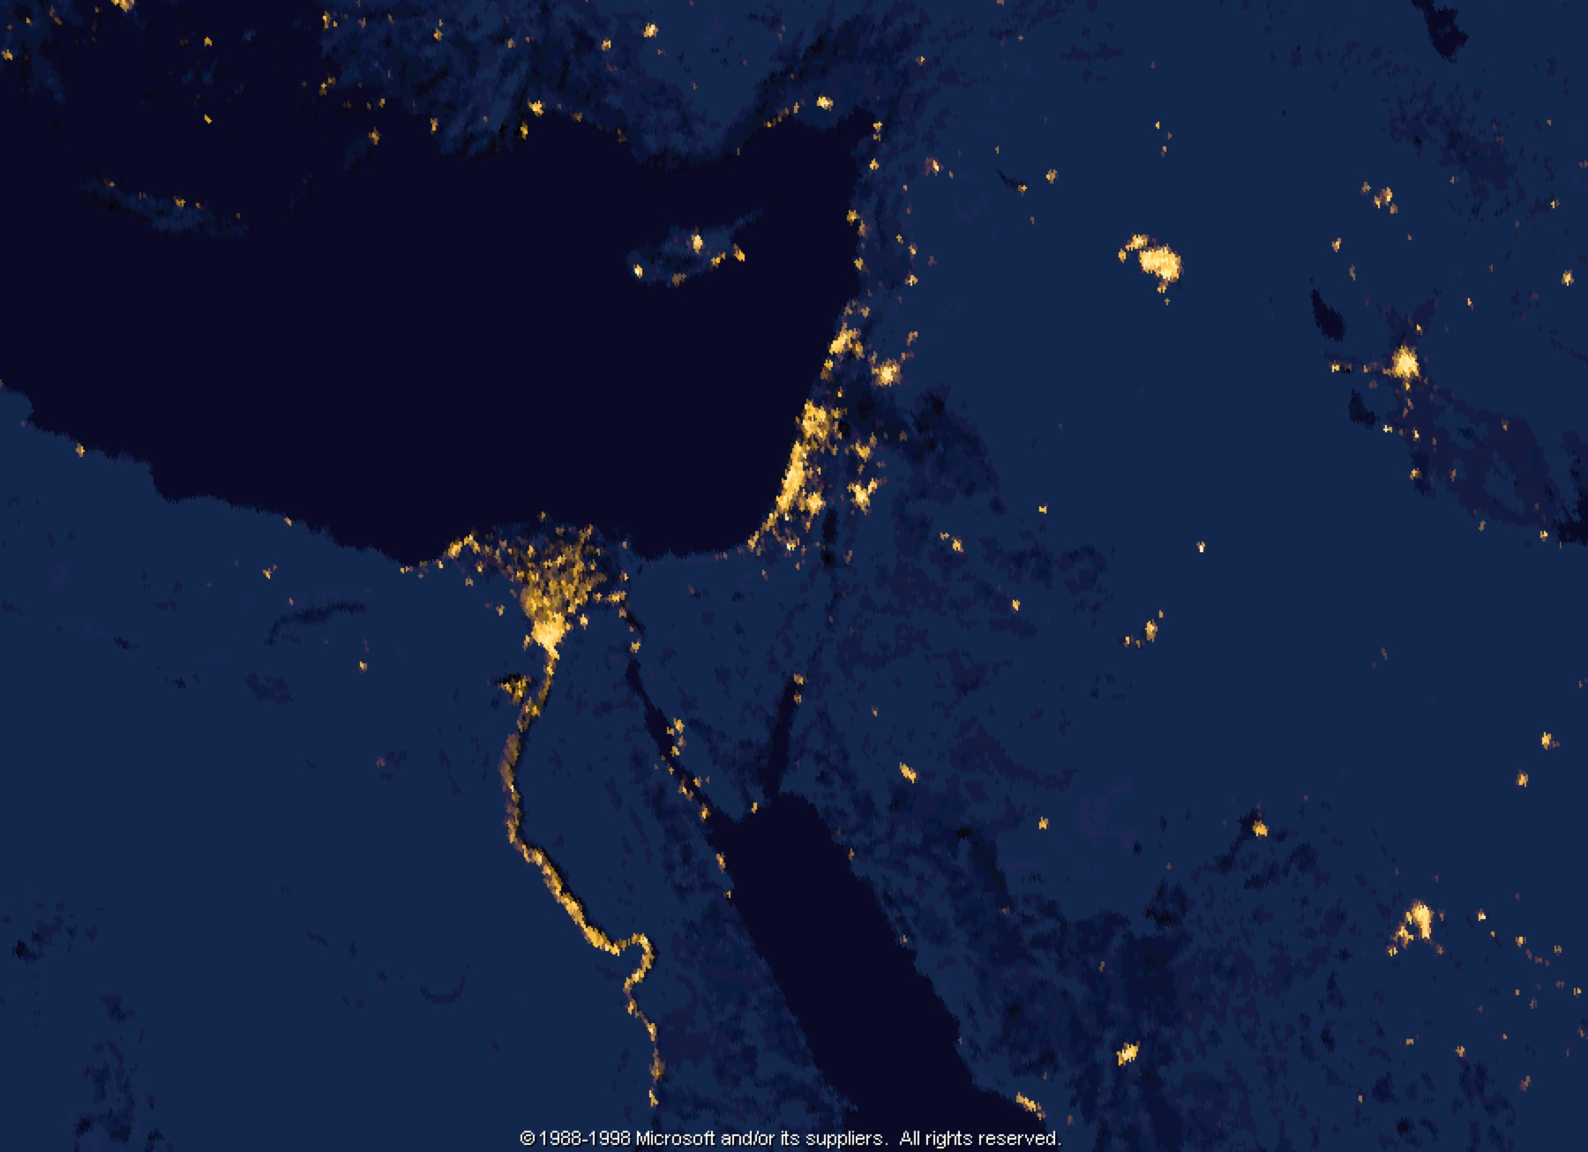
Israel/Middle East

Slide 12
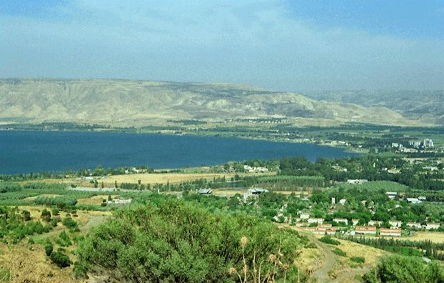

Slide 13
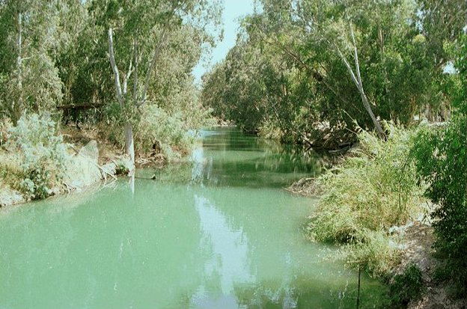

Slide 14
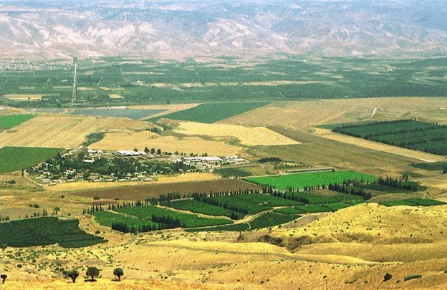

Slide 15
Historicity:
Peter (64 AD): We did not follow cleverly invented stories when we told you about the power and coming of our Lord Jesus Christ, but we were eyewitnesses of his majesty. - 2 Peter 1:16
John (90 AD): That which was from the beginning, which we have heard, which we have seen with our eyes, which we have looked at and our hands have touched—this we proclaim concerning the Word of life... We proclaim to you what we have seen and heard, so that you also may have fellowship with us. And our fellowship is with the Father and with his Son, Jesus Christ. - 1 John 1:1-3
Paul (56 AD): And if Christ has not been raised, our preaching is useless and so is your faith. More than that, we are then found to be false witnesses about God, for we have testified about God that he raised Christ from the dead... And if Christ has not been raised, your faith is futile; you are still in your sins... If only for this life we have hope in Christ, we are to be pitied more than all men. - 1 Corinthians 15:14-19

Slide 16
Historicity:
Peter (64 AD): We did not follow cleverly invented stories when we told you about the power and coming of our Lord Jesus Christ, but we were eyewitnesses of his majesty. - 2 Peter 1:16
John (90 AD): That which was from the beginning, which we have heard, which we have seen with our eyes, which we have looked at and our hands have touched—this we proclaim concerning the Word of life... We proclaim to you what we have seen and heard, so that you also may have fellowship with us. And our fellowship is with the Father and with his Son, Jesus Christ. - 1 John 1:1-3
Paul (56 AD): And if Christ has not been raised, our preaching is useless and so is your faith. More than that, we are then found to be false witnesses about God, for we have testified about God that he raised Christ from the dead... And if Christ has not been raised, your faith is futile; you are still in your sins... If only for this life we have hope in Christ, we are to be pitied more than all men. - 1 Corinthians 15:14-19

Slide 17
Solid evidence
Flimsy evidence

Slide 18
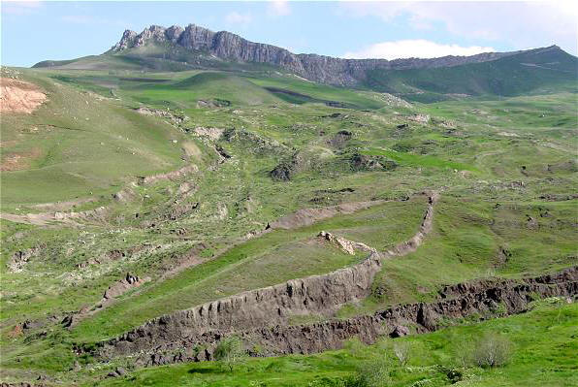

Slide 19
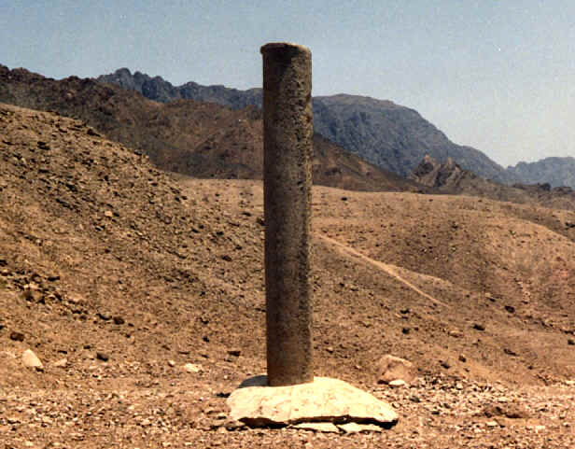
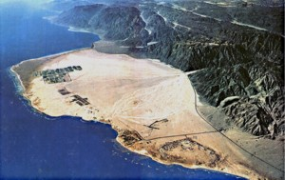
Solomon's
“memorial pillars”“

Slide 20
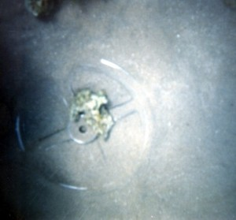
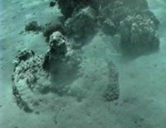
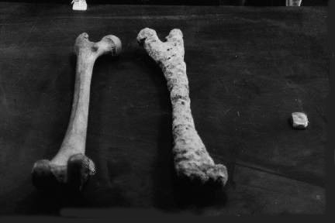
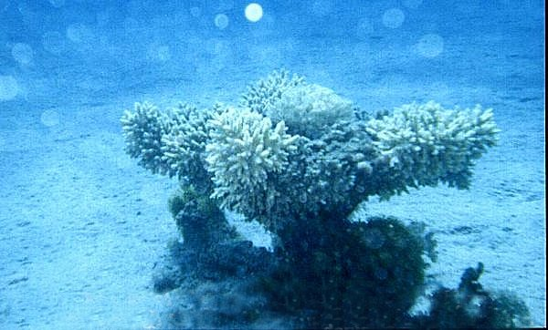
Pharaoh's “Drowned Army”

Slide 21
Solid evidence
Flimsy evidence
Hoaxes

Slide 22
“Adam and Eve’s Tomb Found in Israel”
— The Sun, 4 May 1993, 20-21

Slide 23
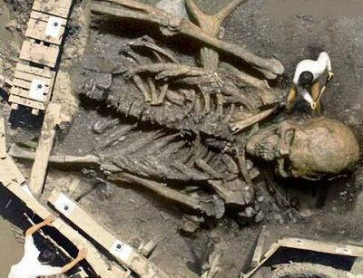

Slide 24
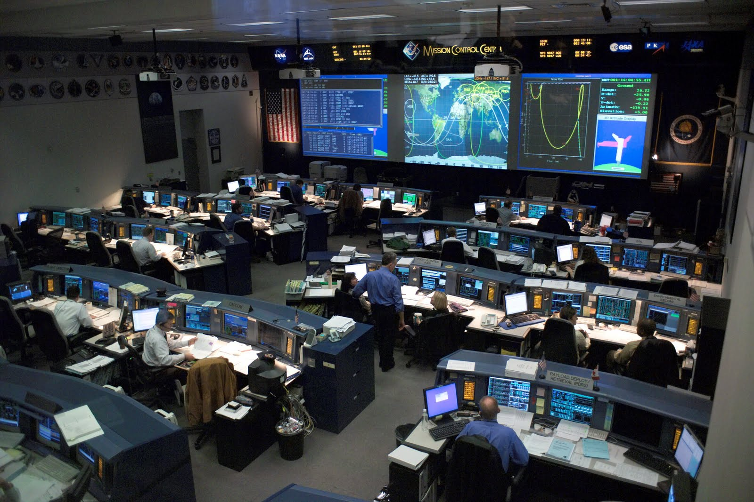

Slide 25
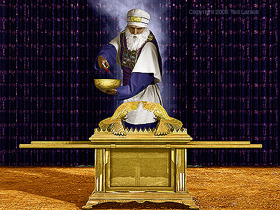

Slide 26
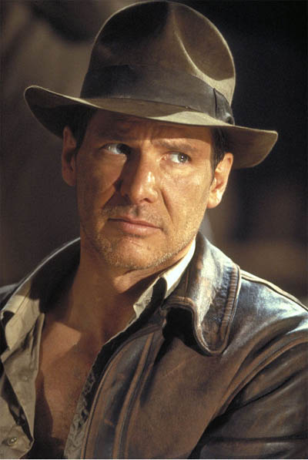

Slide 27
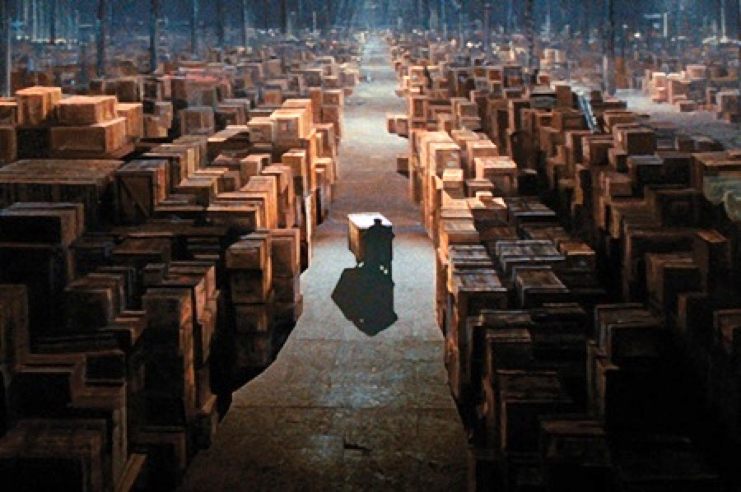

Slide 28
No direct archaeological evidence:
The Exodus, Noah’s ark, the ark of the covenant, Nephilim, the 10 Commandments, humans coexisting with dinosaurs, Jesus’ sandals, the Holy Cross, Peter’s nets, Joseph’s saw, Mary’s footprints, John’s dentures, Bartholomew’s kidney stones, etc…

Slide 29
Through the Israeli Antiquities Authority database alone, armchair archaeologists now have access to over 100,000 archaeological relics discovered in the state of Israel since 1948!
“Only a fraction”...
1… of what is made or written survives.
2… of the available archaeological sites have been surveyed.
3… of the surveyed sites have been excavated.
4… of an excavation site is actually examined.
5… of what is examined is eventually reported and published.
– Randall Price, The Stones Cry Out

Slide 30
Unearthing the Truth
PART I: OLD TESTAMENT

Slide 31
Old Testament

Slide 32
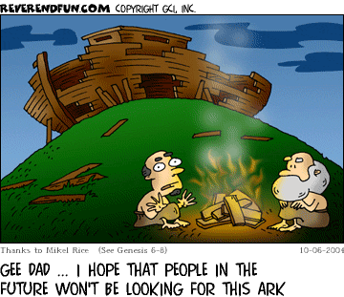

Slide 33
Gilgamesh Epic
Enuma Elish – Mesopotamian Creation
Gilgamesh Epic – Mesopotamian Flood Story
Atrahasis Epic – “Babylonian Genesis”

Slide 34
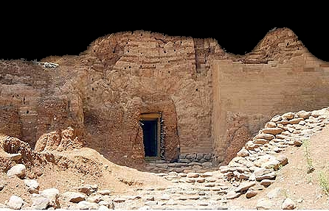
GATE AT LAISH (DAN)‏

Slide 35
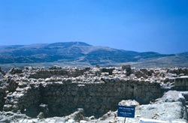
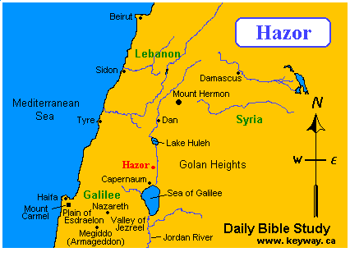
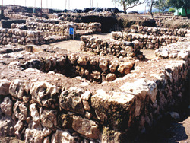

Slide 36
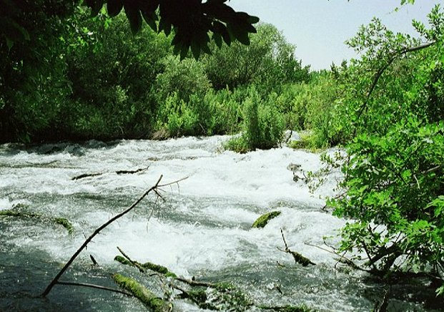
Dan

Slide 37
David: mentioned 1048 times in the Bible

Slide 38
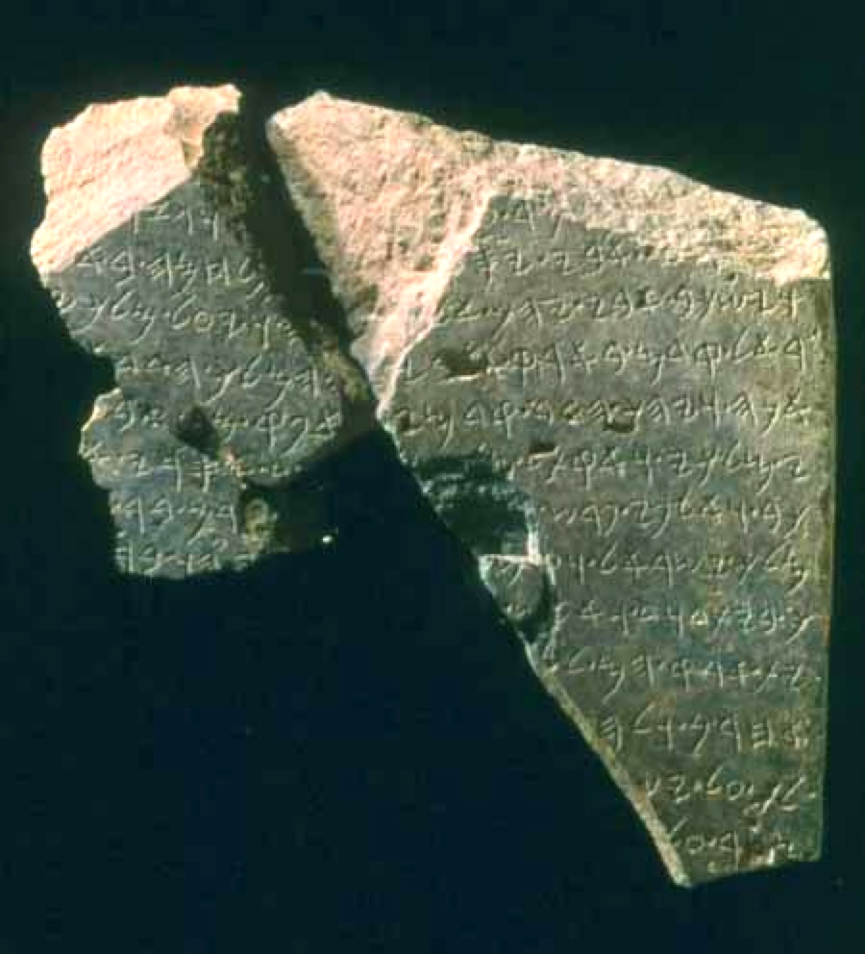

Slide 39
David inscription from Dan
… my father went up…
… and my father died, he went to [his fate… Is-]rael formerly in my father’s land…
I [fought against Israel?] and Hadad went in front of me…
… my king. And I slew of [them X footmen, Y cha-]
riots and two thousand horsemen…
the king of Israel. And [I] slew [… the kin-]
g of the House of David. And I put…
their land…
other… [… ru-]
led over Is[rael…]
siege upon… - Avraham Biran, “An Aramaic Stele Fragment from
Tel Dan,” The Israel Exploration Journal 43 (1993) 90

Slide 40
The Hittites
Genesis 10:15; 15:20; 23:3, 5, 7, 10, 16, 18, 20; 25:9-10; 26:34; 27:46; 36:2; 49:29-30, 32; 50:13; Exodus 3:8, 17; 13:5; 23:23, 28; 33:2; 34:11; Numbers 13:29; Deuteronomy 7:1; 20:17, Joshua 1:4; 3:10, 9:1; 11:3; 24:11; Judges 1:26; Judges 3:5; 1 Samuel 26:6; 2 Samuel 11:3, 6, 17, 21, 24; 12:9-10; 23:39; 1 Kings 9:20; 10:29; 11:1; 15:5; 2 Kings 7:6; 1 Chronicles 1:13; 11:41; 2 Chronicles 1:17; 8:7; Ezra 9:1; Nehemiah 9:8; Ezekiel 16:3, 45.

Slide 41
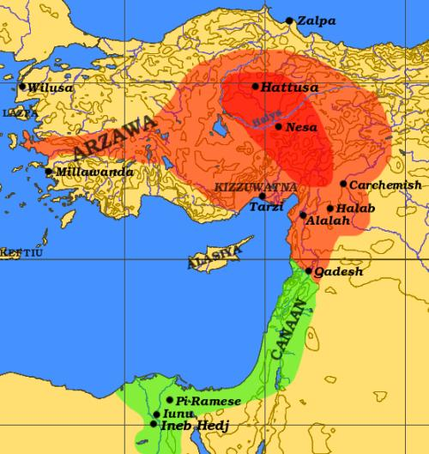
The Hittite Empire

Slide 42

Ph.D. in Hittite Studies
Hittite Language Study

Slide 43
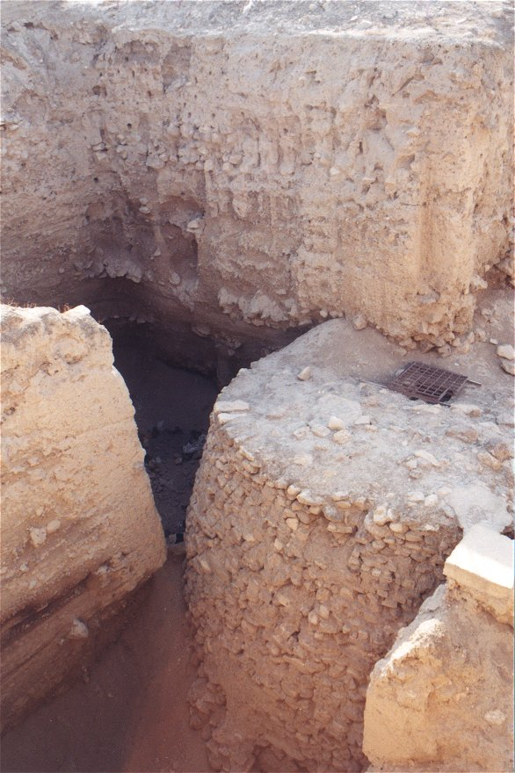
Jericho

Slide 44
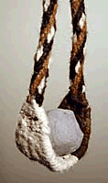

Slide 45
400 m
Gold-ball sized

Slide 46
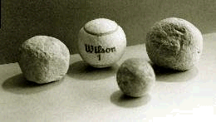
Slingstones, c. 250g

Slide 47
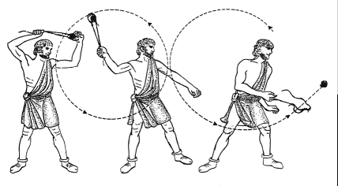
400 m
Gold-ball sized

Slide 48
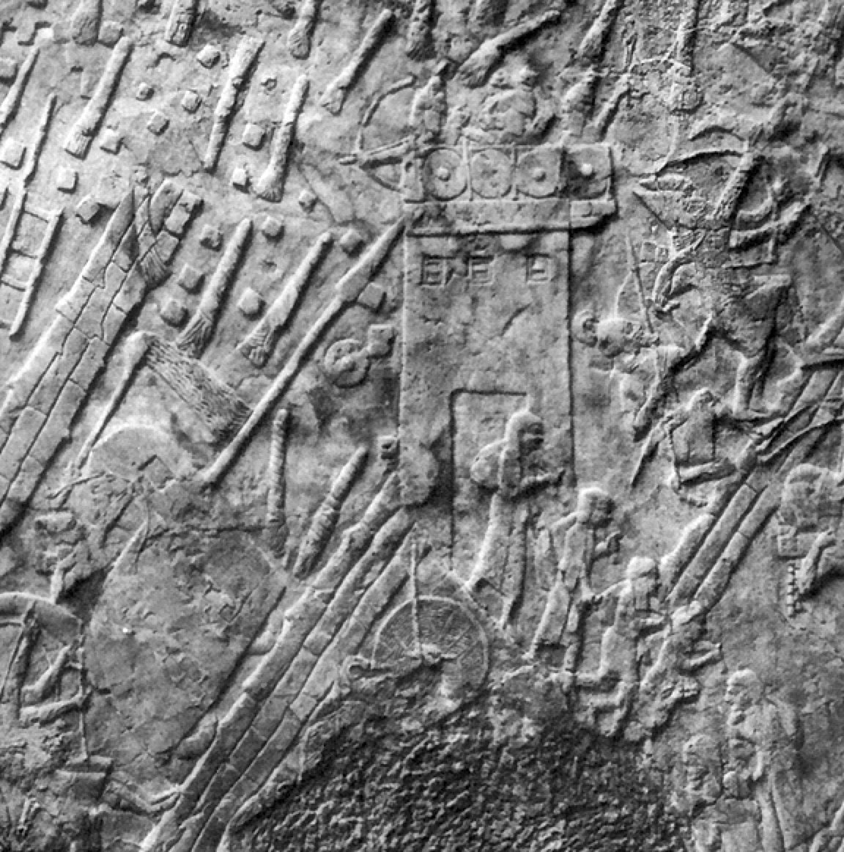
Lachish, 701 BC

Slide 49
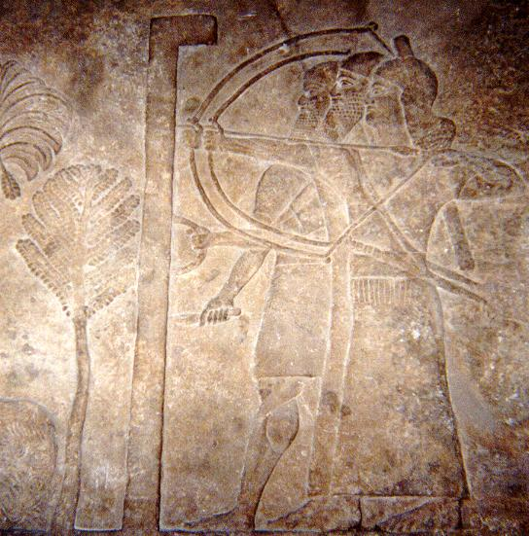
Lachish, 701 BC

Slide 50
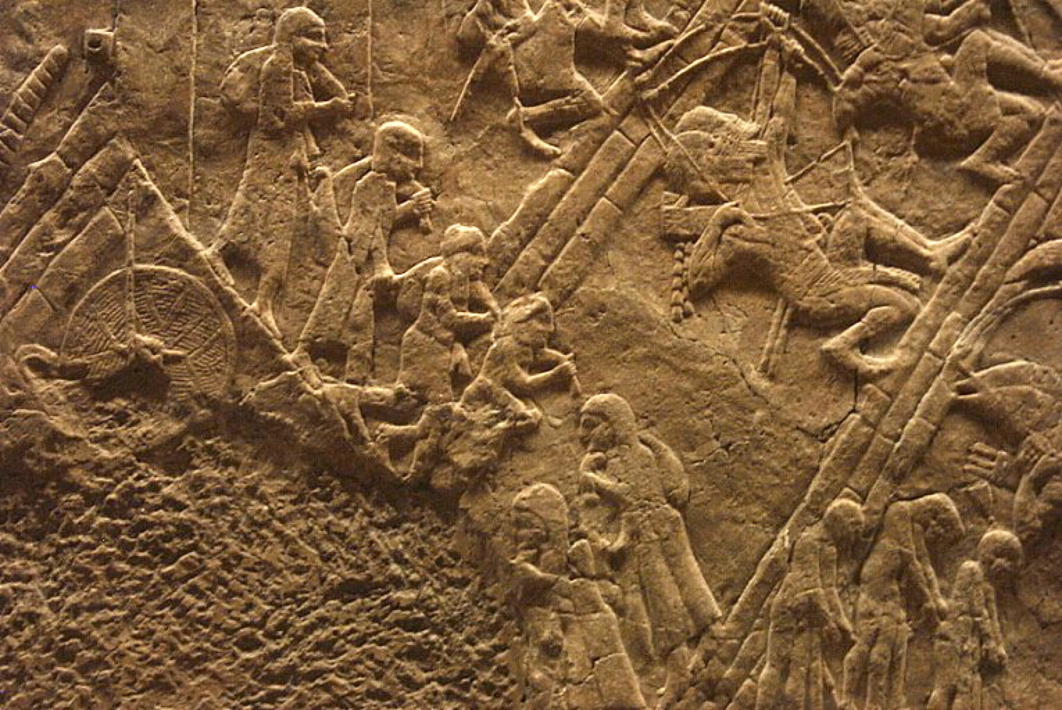

Slide 51
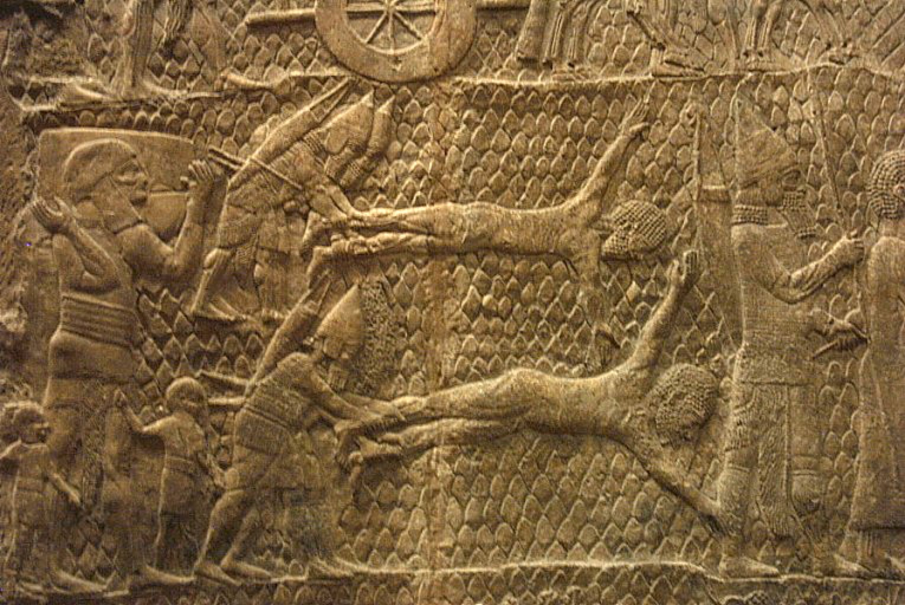

Slide 52
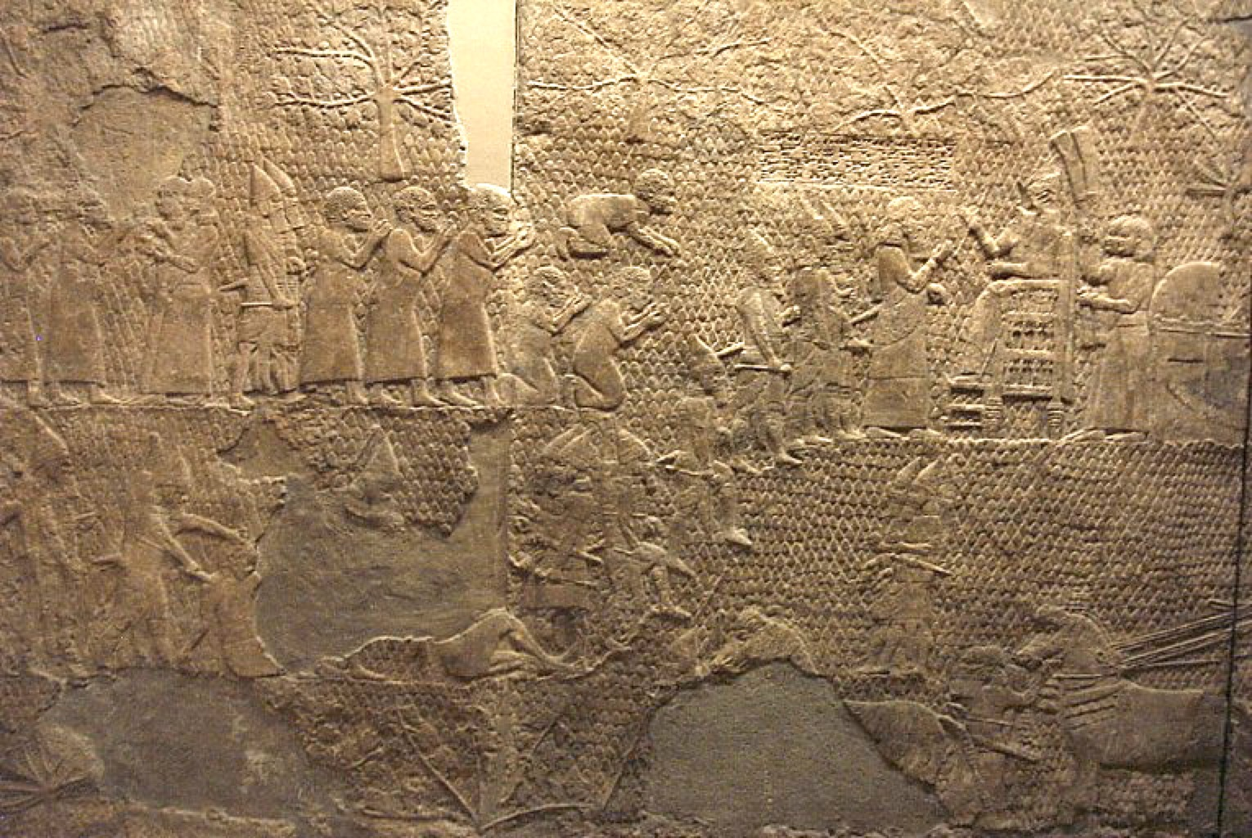

Slide 53
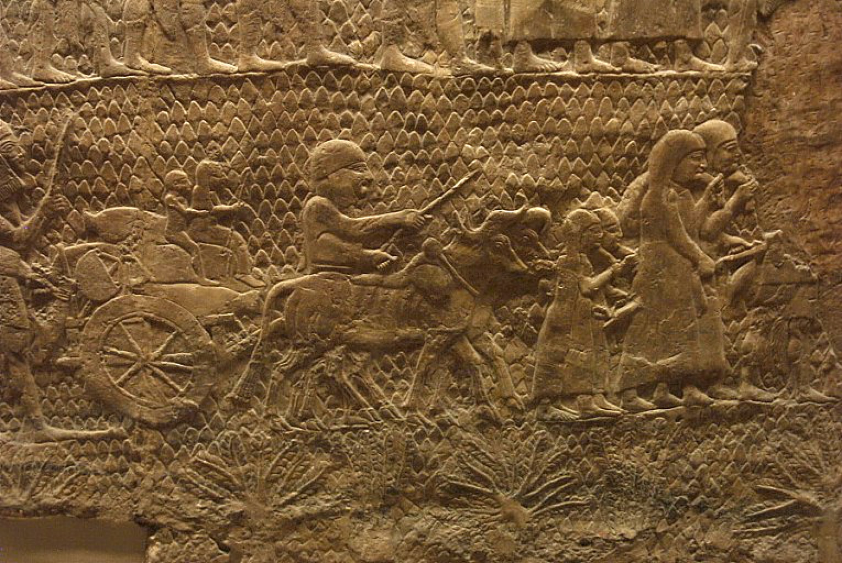

Slide 54
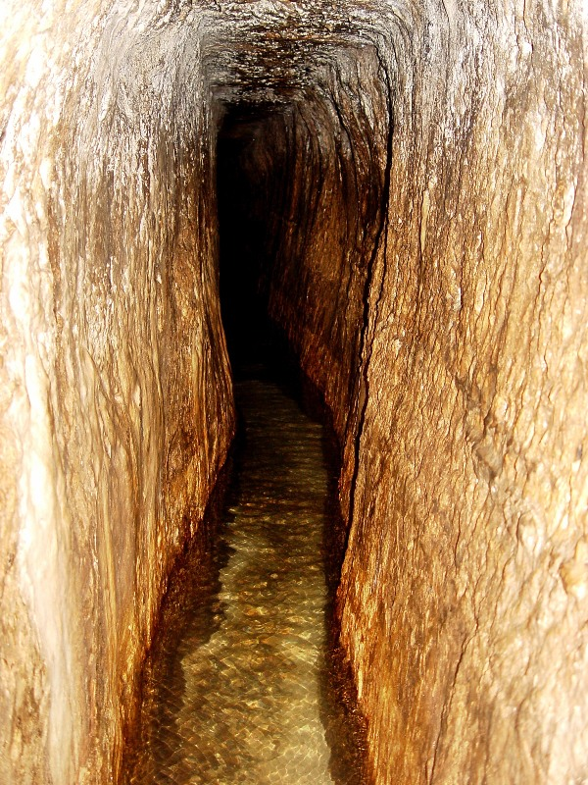
Hezekiah’s Tunnel
(c.701 BC)
2 Kings 20:20
(Discovered 1880)
“… And this was the account of the breakthrough. While the laborers were still working with their picks, each toward the other, and while there were still three cubits to be broken through, the voice of each was heard calling to the other, because there was a crack in the rock from south to north. And at the moment of the breakthrough, the laborers struck each toward the other, pick against pick. Then the water flowed from the spring to the pool for 1200 cubits. And the height of the rock above the heads of the laborers was 100 cubits.”

Slide 55
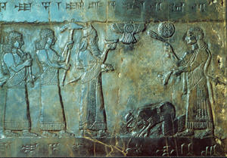
The Black Obelisk of Shalmaneser III

Slide 56
Taylor Prism (Annals of Sennacherib)‏
2 Kings and Isaiah (8th C):
“Then it happened that night that the angel of the Lord went out and struck 185,000 in the camp of the Assyrians…”
Herodotus (484-425 BC):
“Egyptian god sent field mice to eat Assyrian bowstrings, quivers, shield handles…”
Sennacherib (before 681 BC):
“As for Hezekiah, the Judean who did not submit to my yoke, I surrounded and conquered 46 of his strong-walled towns and innumerable small settlements around them by means of earth ramps and siege engines and attack by infantry men… He himself I shut up in Jerusalem, his royal city, like a bird in a cage…”

Slide 57
Hezekiah Tribute Inscription

Slide 58
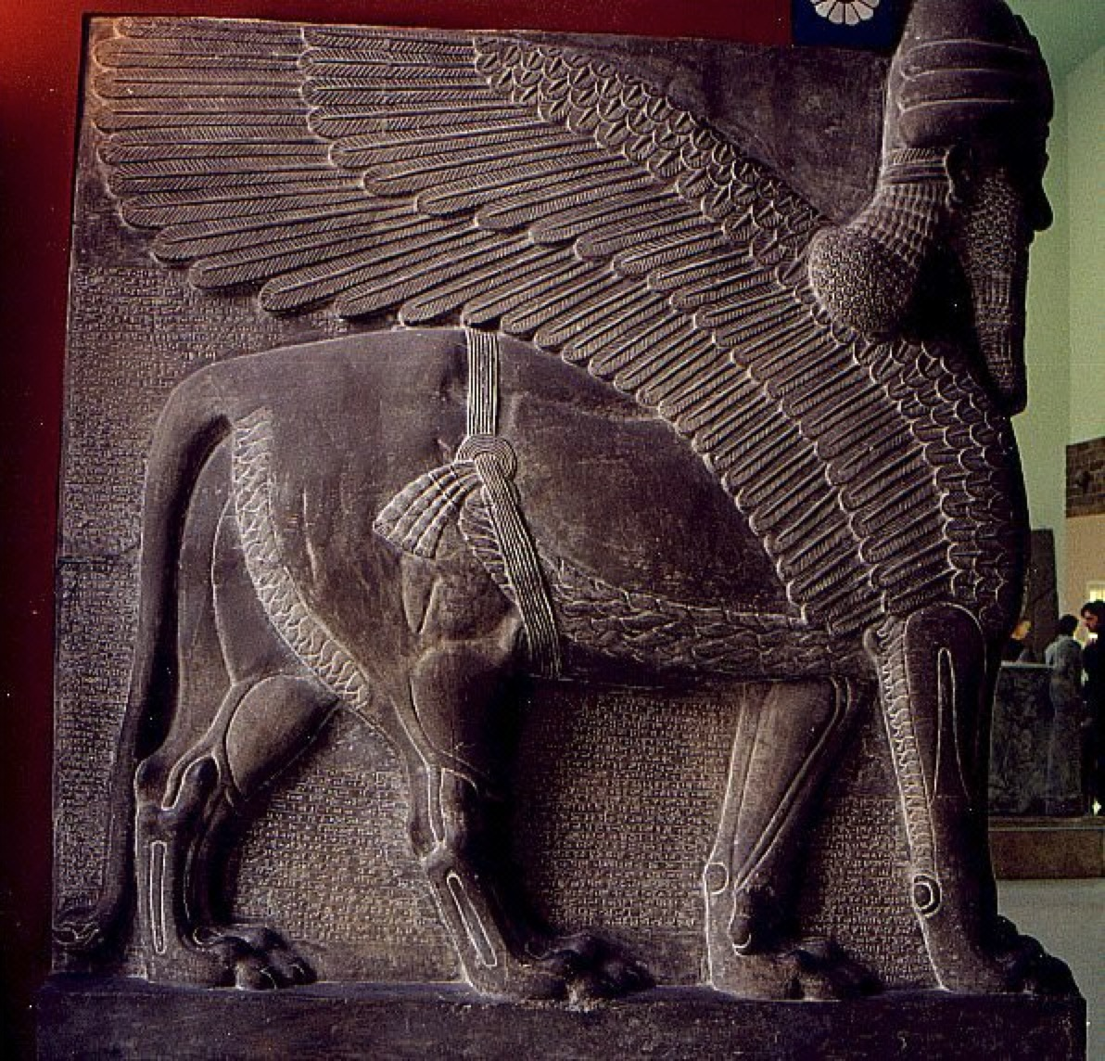

Slide 59
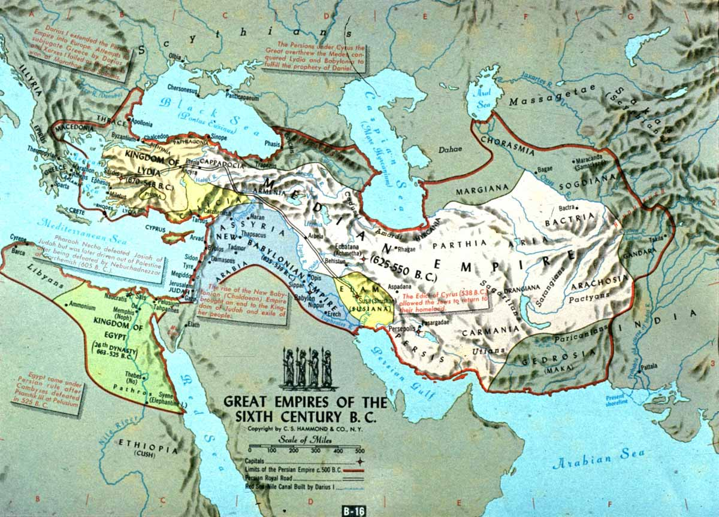

Slide 60
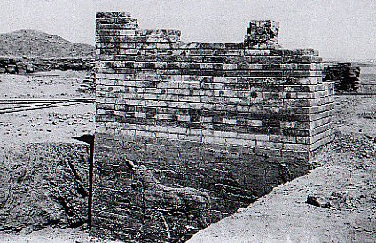

Slide 61
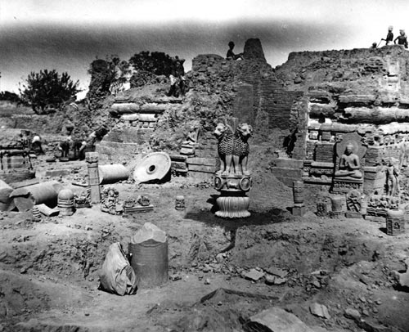
Notes:
61

Slide 62
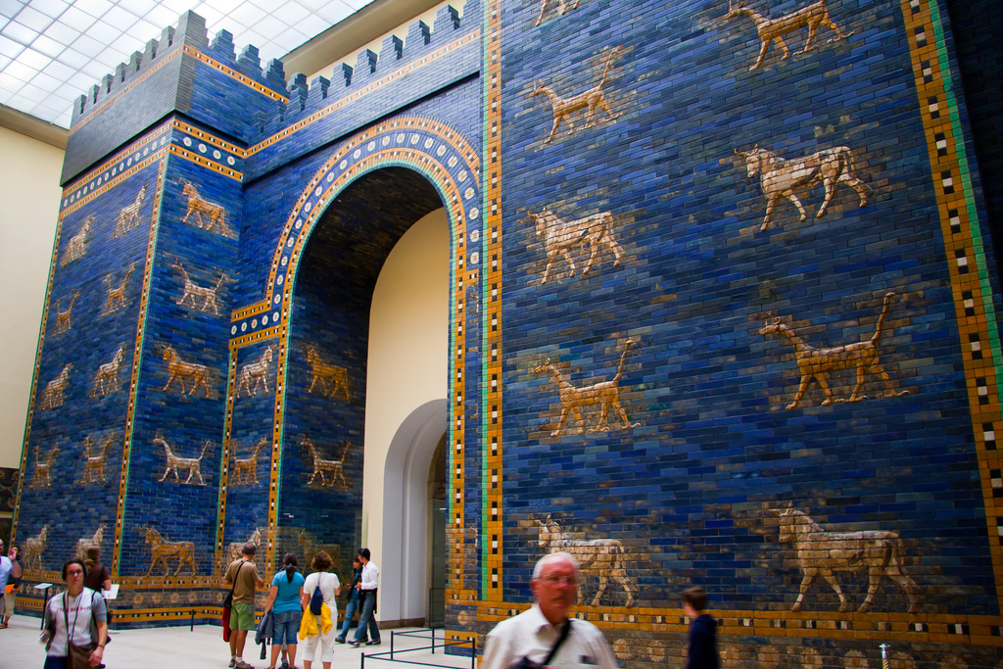
Ishtar Gate, Babylon

Slide 63
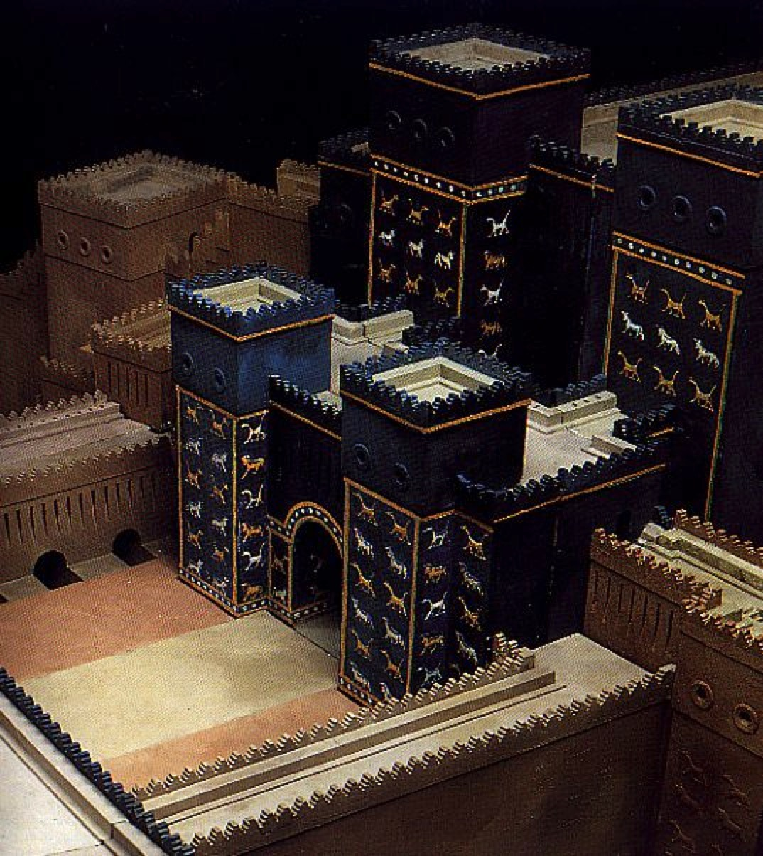

Slide 64


Slide 65
From Ishtar Gate, Babylon:
Jehoiachin—“Yaukin, king of the land of Jahud” (2 Kgs 25:27)‏
From Elephantine, Egypt:
Hanani (Nehemiah’s brother, Neh 7:2)‏
Johanan (High priest, Neh 12:22)‏
Sanballat
Other:
Balaam—6th C. BC Aramaic inscription
Menahem—Tiglath Pileser III’s boast
Bullae – Gemariah, Ishmael, Baruch

Slide 66
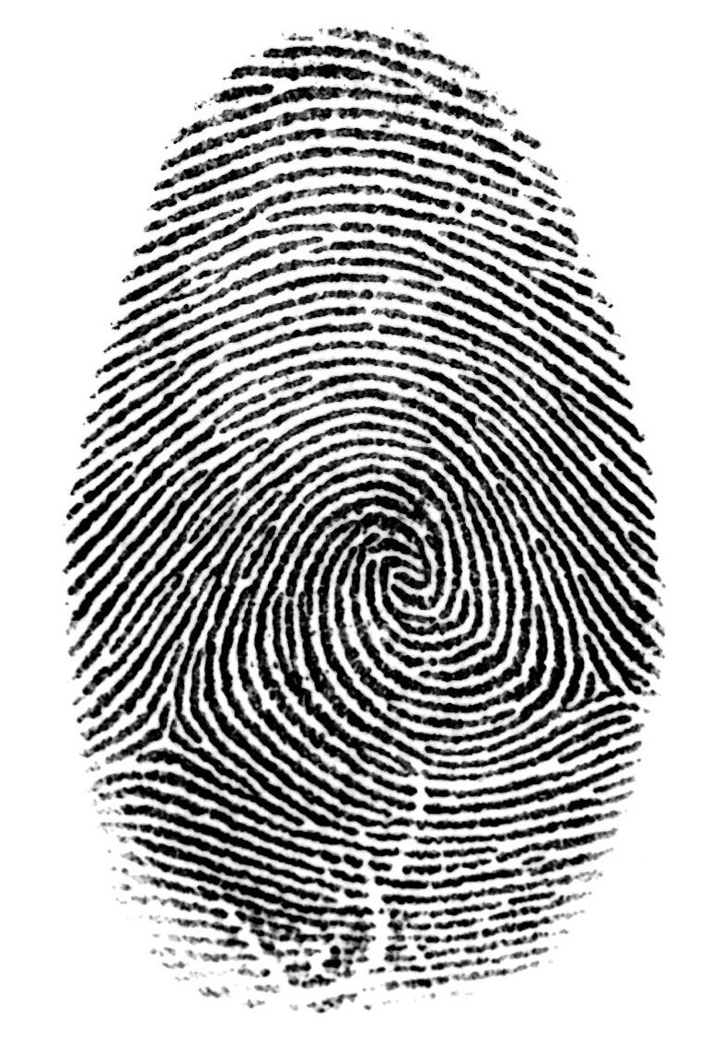
Baruch’s fingerprint

Slide 67
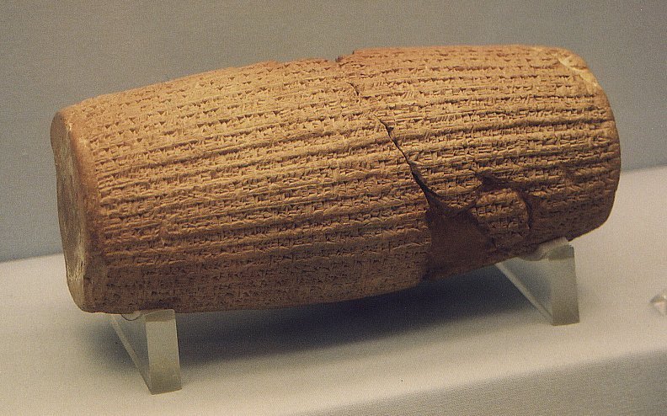

Slide 68
Other archaeological evidence (OT)‏
Item(s) No. Date BC Significance
HEZEKIAH’S SEAL 1 727-698 Evidence of Judean king
Discovered 1999
NEW D.S.S. 2 2nd C. There’s more to come!
Disc./pub. 2000, 2006
BAB. CHRONICLE 4 7th-6th C. Fall of Nineveh, Jerusalem
Kgs, Chron, Jer, Dan
CYRUS CYLINDER 1 6th C. Return from Exile
Chron, Ezra

Slide 69
Other archaeological evidence (OT)‏
Item(s) No. Date BC Significance
EBLA TABLETS 15,000 23rd C. Semitic language
Gen 10-1, 14, 19 Eber, Sodom & Gomorrah
MARI TABLETS 20,000 18th C. Nahor, Patriarchal
Gen 11, 12-50, 15 customs, cutting covenant
NUZI TABLETS 1000s 15th C. Servant heir, birthright
Gen 15-16, 25, 31 sale, household idols
RAS SHAMRA TABLETS 1000s 15th C. Canaanite religious
Judg, Kgs, Chron immorality
AMARNA LETTERS 300 14th C. Invading “Hapiru”
Joshua

Slide 70
Campaign into Israel by Pharaoh Shishak (1 Kgs 14:25-26), recorded on the walls of the Temple of Amun in Thebes, Egypt.
Revolt of Moab against Israel (2 Kgs 1:1; 3:4-27), recorded on the Mesha Inscription.
Fall of Samaria (2 Kgs 17:3-6, 24; 18:9-11) to Sargon II, king of Assyria, as recorded on his palace walls.
Defeat of Ashdod by Sargon II (Isa 20:1), as recorded on his palace walls.
Siege of Lachish by Sennacherib (2 Kgs 18:14, 17), as recorded on the Lachish reliefs.
Assassination of Sennacherib by his own sons (2 Kgs 19:37), as recorded in the annals of his son Esarhaddon.

Slide 71
Fall of Nineveh as predicted by the prophets Nahum and Zephaniah (2:13-15), recorded on the Tablet of Nabopolasar.
Captivity of Jehoiachin, king of Judah, in Babylon (2 Kings 24:15-16), as recorded on the Babylonian Ration Records.
Fall of Babylon to the Medes and Persians (Dan 5:30-31), as recorded on the Cyrus Cylinder.
Freeing of captives in Babylon by Cyrus the Great (Ezr a1:1-4; 6:3-4), as recorded on the Cyrus Cylinder.
New Testament
The existence of Jesus Christ as recorded by Josephus, Suetonius, Thallus, Pliny the Younger, the Talmud, and Lucian.
Forcing Jews to leave Rome during the reign of Claudius (A.D. 41-54) (Acts 18:2), as recorded by Suetonius.

Slide 72
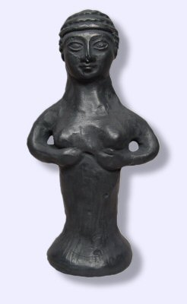
> 1000 ancient idols (figurines) found in Israel

Slide 73


Slide 74


THE DEAD SEA SCROLLS

Slide 75
Conclusions
Archeological discoveries bring the Bible to life, helping us envision the true events that took place in ancient times and places.
Prejudice against the biblical record has often been shown to be unjustified.
The manuscript record attests to the accuracy of the O.T., esp. the Dead Sea Scrolls.
As a large number of discoveries have been made only in recent decades, there’s probably much more to be found!

Slide 76

Unearthing the Truth
PART II: NEW TESTAMENT

Slide 77
Top finds: New Testament
Excavations at Caesarea Maritima, Caesarea Philippi, Capernaum, Bethsaida, Beth Shan (Scythopolis), Ephesus, Pergamum, Rome, and Jerusalem; Caiaphas ossuary; Gallio Inscription; Erastus Pavement; skeletal remains of crucified man; first century tombs; synagogue at Capernaum; Soreg Inscription; Pilate Stone; Pool of Siloam; Alexamenos Graffito; references to Jesus and primitive church in Josephus, Suetonius, Tacitus, Thallus, Pliny the Younger, the Talmud, Lucian, and other writings.

Slide 78


Slide 79


Slide 80




Slide 81

Capernaum

Slide 82


Slide 83

Bethsaida, 1989
Notes:
83

Slide 84

Pool of Siloam?
John 9

Slide 85

Pool of Siloam
John 9

Slide 86

Pool of Siloam (2004)

Slide 87

Gethsemane

Slide 88


Slide 90

Caesarea Maritima

Slide 91


Slide 92


Slide 93

Pontius Pilatus

Slide 94

Pilate inscription

Slide 95


Slide 96

Caiaphas Ossuary (bone box)

Slide 97

Yehosef bar Qayafa
(6 skeletons)‏

Slide 98
Caiaphas Ossuary

Slide 99

James Ossuary

Slide 100


Slide 102

Yohanan ben Ha’galgol

Slide 103

Ep. Barn., 9:7; 12:2
Lucian, Tr. Ct. Vow., 12.4-13
Matt 27:37; Luke 23:38; John 19:19; [Mark 15:26]

Slide 104


Slide 106
Ep. Barn., 9:7; 12:2
Lucian, Tr. Ct. Vow., 12.4-13
Matt 27:37; Luke 23:38; John 19:19; [Mark 15:26]

Slide 107


Slide 108

Philip’s tomb (Hierapolis)

Slide 109

High priest’s bell?

Slide 110

Notes:
110

Slide 111


Slide 112

Soreg Inscription
Greek, East Jerusalem
Warning sign to Gentiles, 19 BC-AD 70
(Acts 21:27-31)‏

Slide 113
NO FOREIGNER
IS TO GO BEYOND THE BALUSTRADE
AND THE PLAZA OF THE TEMPLE ZONE.
WHOEVER IS CAUGHT DOING SO
WILL HAVE HIMSELF TO BLAME
FOR HIS ENSUING DEATH.

Slide 114

ARCH OF TITUS

Slide 115


Slide 116

Masada
(fell 73 AD)

Slide 117


Herod the Great

Slide 118


2008
Herodion

Slide 119

Herod’s tomb (4 BC), Herodion

Slide 120


2008
Herodion

Slide 121


Slide 122

Ephesus

Slide 123
Some 27 people named in the New Testament are known from other records, with six likenesses surviving (four of them Roman emperors).

Slide 124
Some 27 people named in the New Testament are known from other records, with six likenesses surviving (four of them Roman emperors).
Over 50 persons named in the Old Testament are known outside the Bible, and we have likenesses of 12 of them.

Slide 125

Puteoli graffito, discovered 1959
Guest house, 2nd C
Flaying & crucifixion at nearby Cumae

Slide 126

2nd 3rd C,
British Museum
Again, feet nailed separately
Tau cross

Slide 127


Slide 128
5% of Israel excavated?
Italy—25%?
How about Asia Minor?
Egypt? Syria? Iraq? Iran?

Slide 129

Archaeology
illuminates and
confirms the Bible.

Slide 130
Use this information, but remember the goal:

Slide 131
Use this information, but remember the goal:
Transformation, not information

Slide 132
Transformation, not information
Self: Deepen own walk with God
Others: share the good news

Slide 133
BIBLICAL ARCHAEOLOGY
Unearthing the Truth
Dr. D. A. Jacoby, Atlanta
São Paulo, 14 May 2017

