Slide 1
Science & Faith:
Enemies or Allies?

Slide 2
Science & Faith: Enemies or Allies? São Paulo 15 May 2017
Douglas Jacoby, M.T.S., D.Min.
IBTM, Atlanta

Slide 3
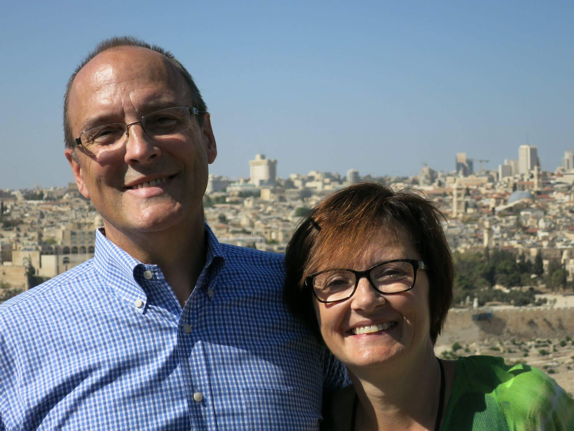

Slide 4
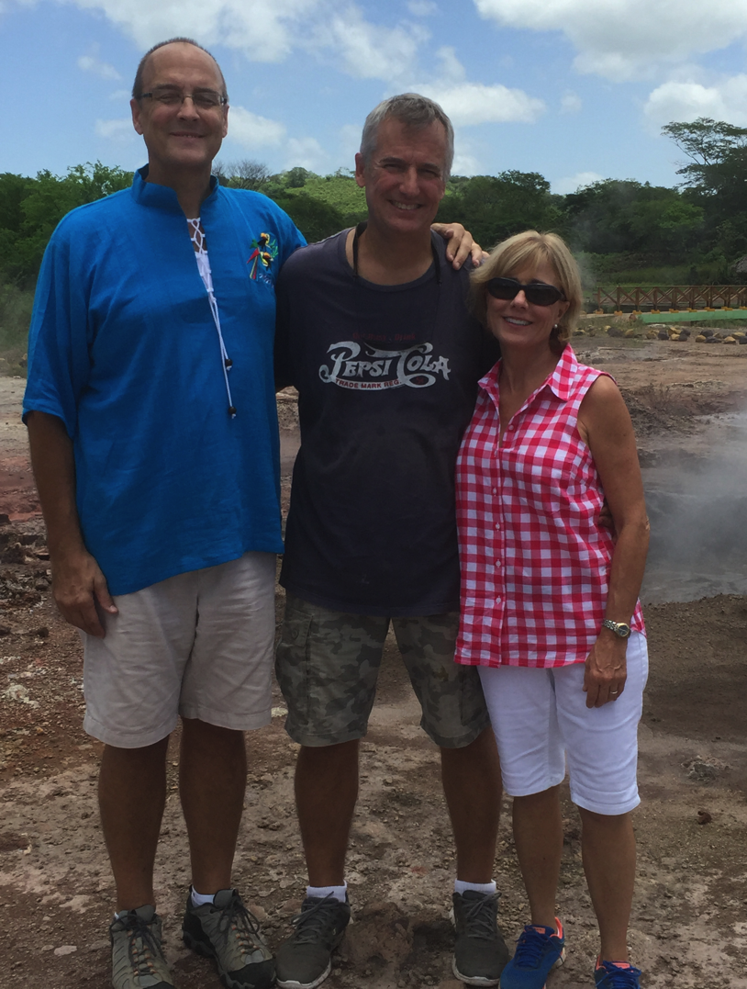
file:///.file/id=6571367.18663323

Slide 5
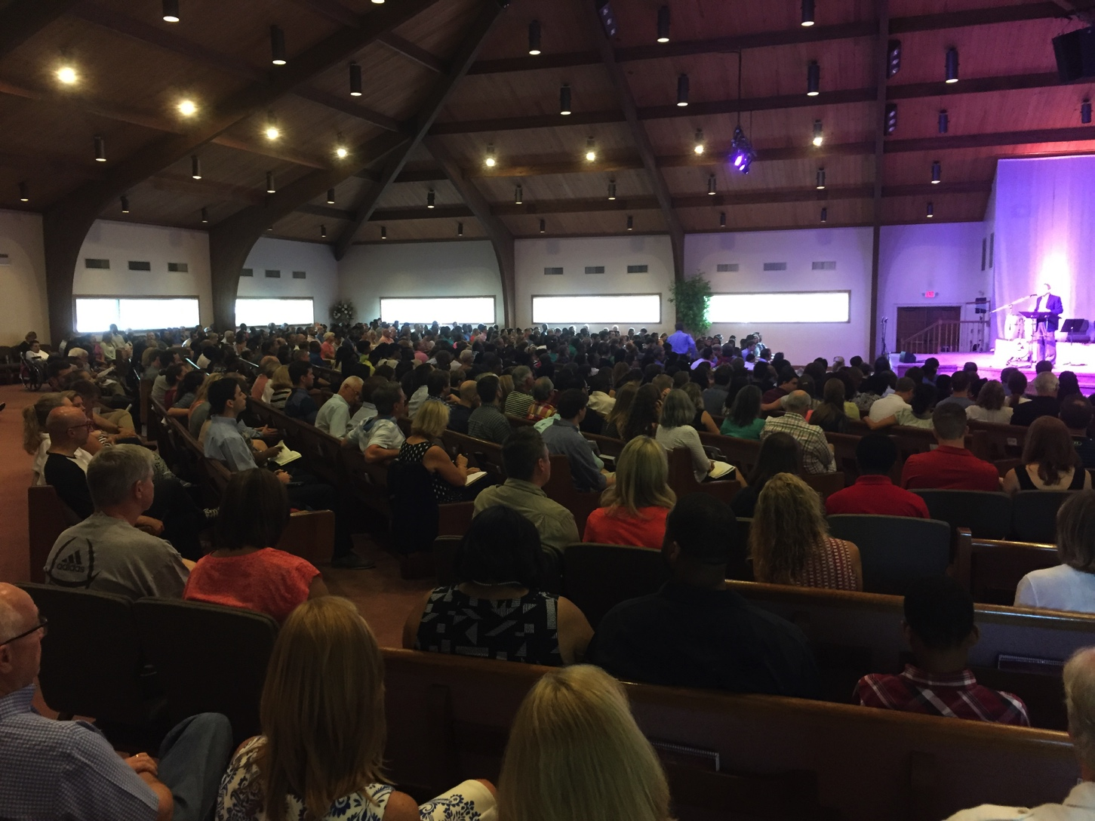

Slide 6
think about faith!

Slide 10
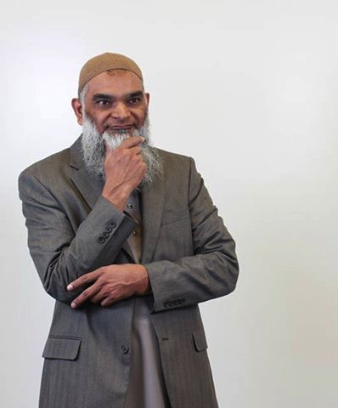
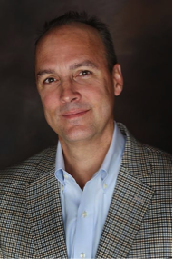
Debate with Sheikh Shabir Ally
Toronto, 27 Feb 2017
“Violence, the Bible, & the Qur’an”

Slide 11
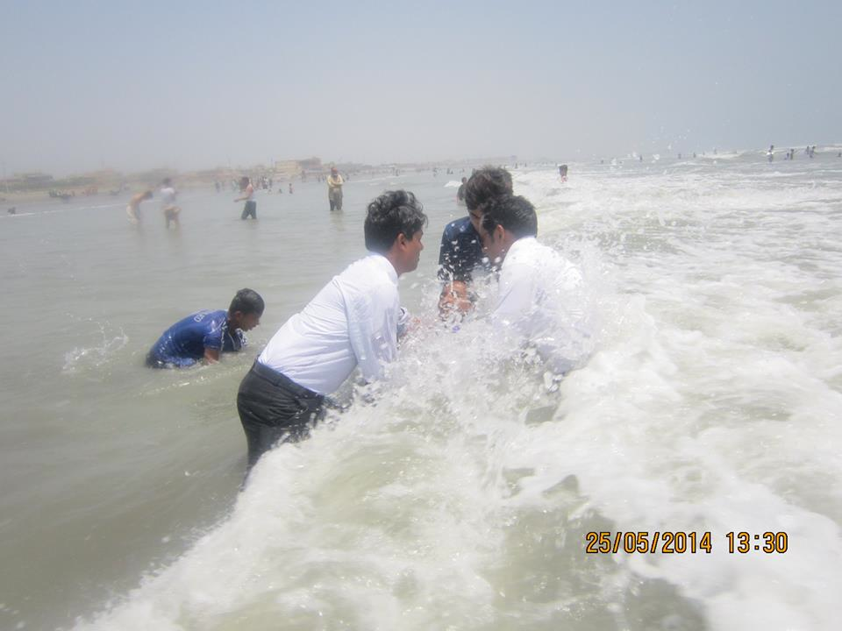

Slide 12
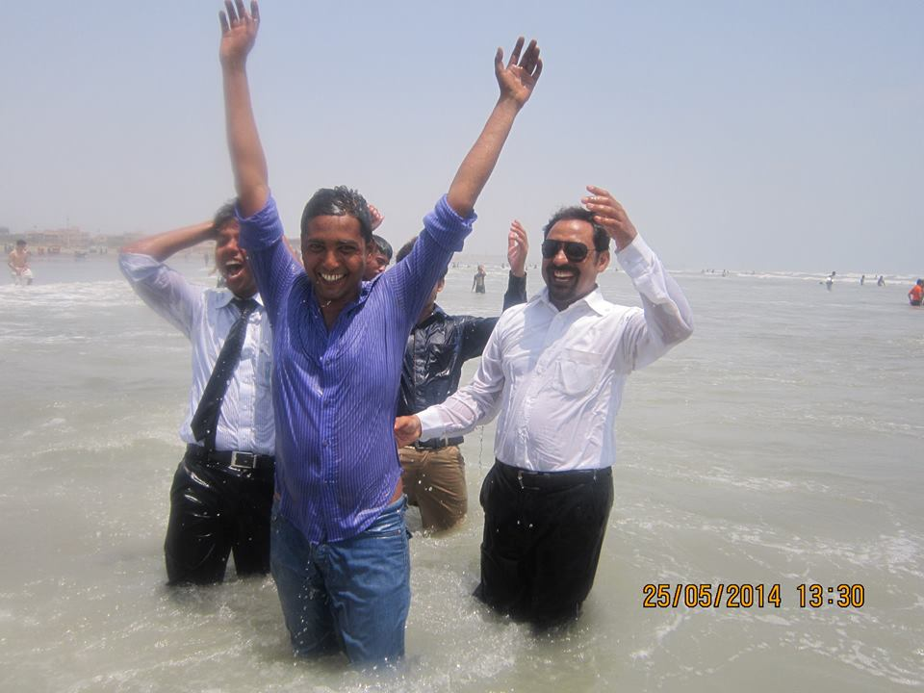

Slide 13
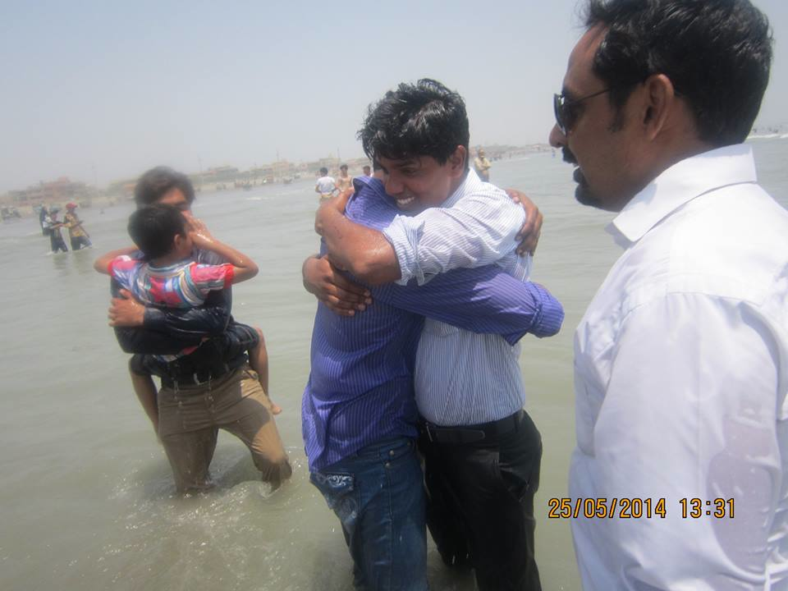

Slide 14
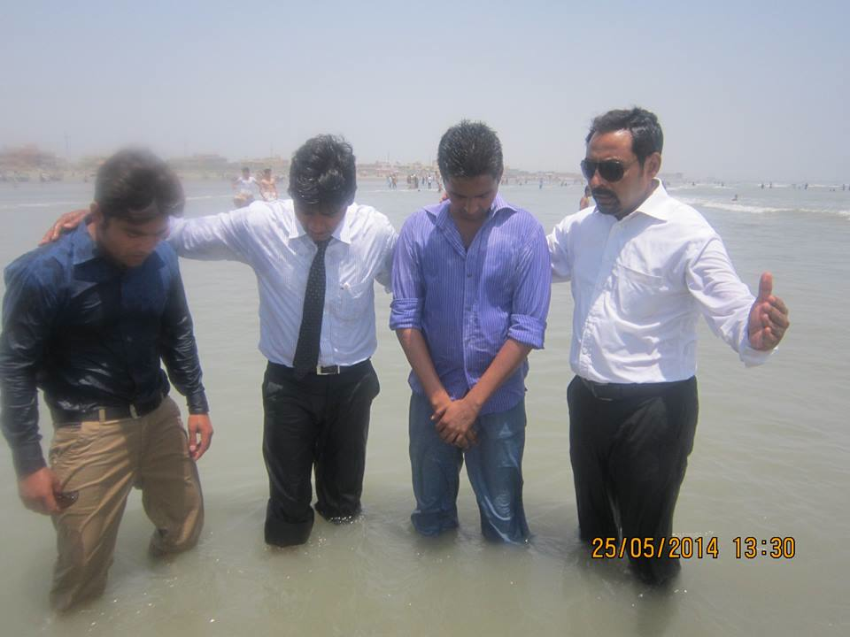

Slide 15
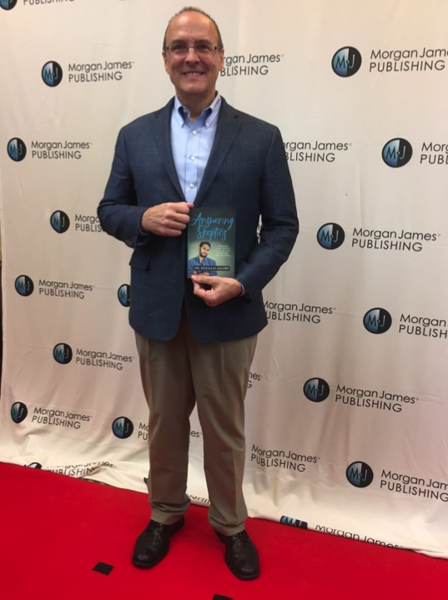

Slide 19
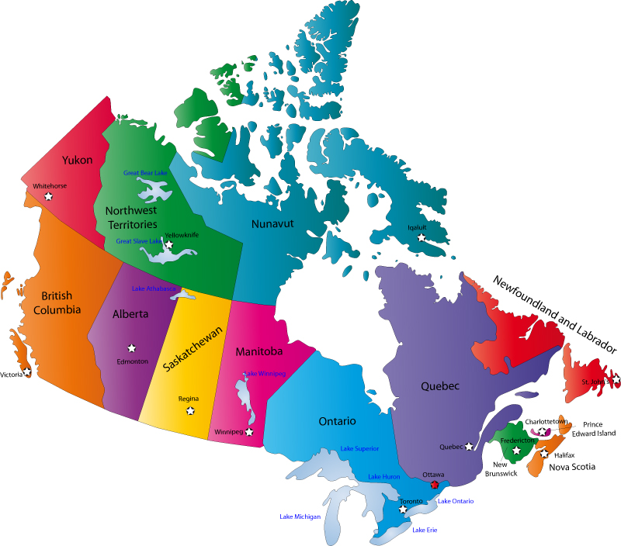

Slide 20
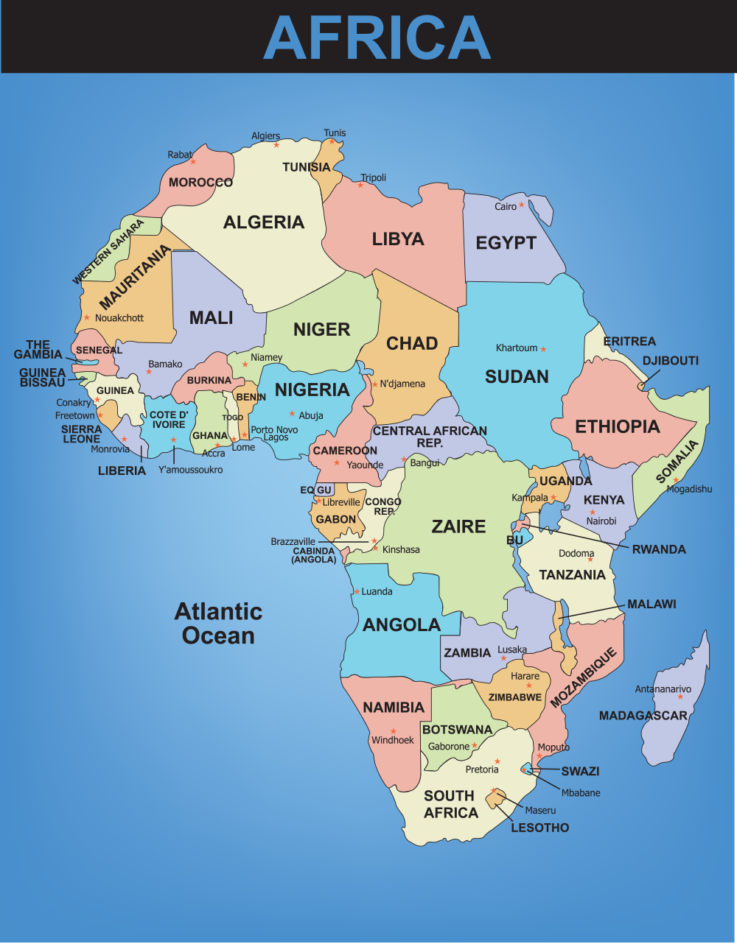
APRIL: * Orlando (Unboxed + sermons) * Ghana (Accra & Kumasi) JUNE: * Lusaka (Zambia) * South Africa (Johannesburg & Durban)

Slide 21
file:///.file/id=6571367.18663323

Slide 22
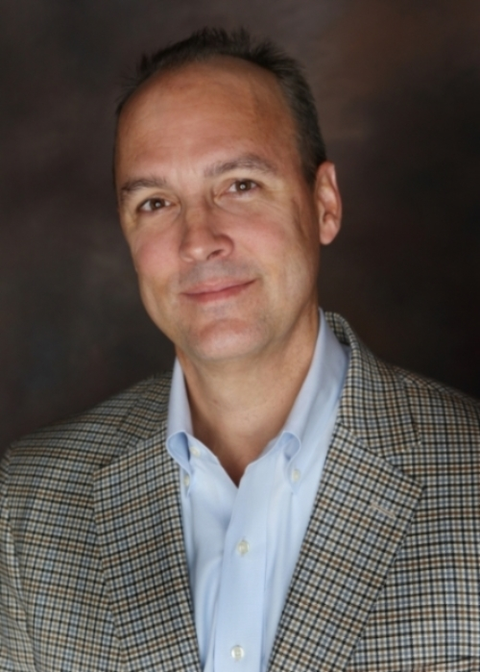
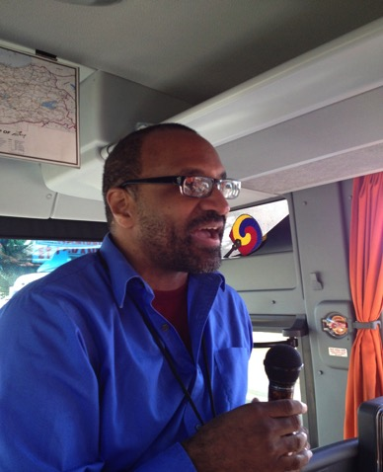
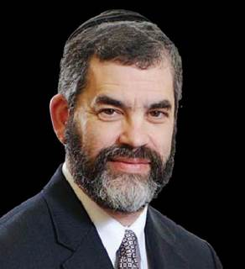
AIM / ASOM Athens Institute

Slide 23
International Bible Teaching Ministry Free. Weekly newsletter Sign up at website. www.DouglasJacoby.com

Slide 24
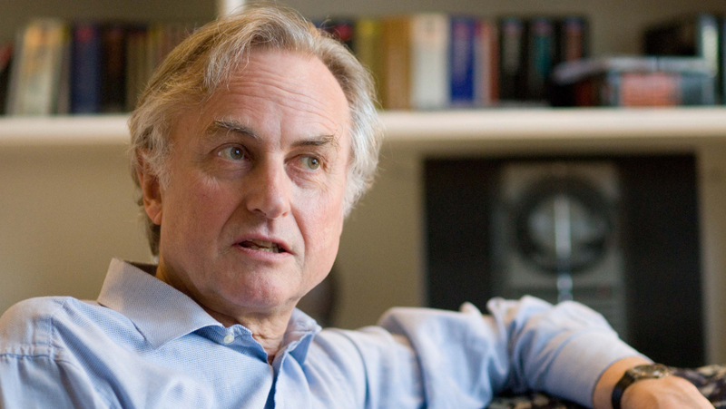
“If you have faith, it is [probably] the same faith as your parents and grandparents had… by far the most important variable determining your religion is the accident of birth… Faith is the great cop-out, the great excuse to evade the need to think and evaluate the evidence.” —Richard Dawkins

Slide 25
Use your head! 1. Lord modified the Greatest Command. Why? 2. Faith is relational * Bible is a book of relationship > rules * God does not smother us! 3. Faith is a response to evidence.

Slide 26
Love the Lord your God with all your heart and with all your soul and with all your mind and with all your strength. — Deut 6:5 Love the Lord your God with all your heart and with all your soul and with all your mind and with all your strength. — Mark 12:30 Matt 22:27 + Luke 10:27

Slide 27
Love the Lord your God with all your heart and with all your soul and with all your mind and with all your strength. — Deut 6:5 Love the Lord your God with all your heart and with all your soul and with all your mind and with all your strength. — Mark 12:30 Matt 22:27 + Luke 10:27

Slide 28
Love the Lord your God with all your heart and with all your soul and with all your mind and with all your strength. — Deut 6:5 Love the Lord your God with all your heart and with all your soul and with all your mind and with all your strength. — Mark 12:30

Slide 29
Love the Lord your God with all your heart and with all your soul and with all your mind and with all your strength. — Deut 6:5 Love the Lord your God with all your heart and with all your soul and with all your mind and with all your strength. — Mark 12:30 Matt 22:27 + Luke 10:27

Slide 30
“Faith is believing
`what you know ain’t so.”
– Mark Twain, Following the Equator, 1897

Slide 31
Hebrews 11:1
Now faith is being sure of what we hope for and certain of what we do not see.

Slide 32
Use your head! 1. Lord modified the Greatest Command. Why? 2. Faith is relational. * Bible is a book of relationship > rules * God does not smother us! 3. Faith is a response to evidence.

Slide 33
Use your head! 1. Lord modified the Greatest Command. Why? 2. Faith is relational. * Bible is a book of relationship > rules * God does not smother us! 3. Faith is a response to evidence.

Slide 34
Use your head! 1. Lord modified the Greatest Command. Why? 2. Faith is relational. * Bible is a book of relationship > rules * God does not smother us! 3. Biblical faith is also a response to evidence.

Slide 35
1. use your head! Faith needn’t be irrational!

Slide 36
1. use your head! Faith needn’t be irrational!

Slide 37
2. realize the nature of the Bible

Slide 38
■ Relational  Torah = instruction, guidance  To bring us to God  Isn’t a math text /science book  Resonates with and makes sense of life  Was copied adequately; the message was preserved well.  It’s practical—it works!

Slide 39
■ Relational  Torah = instruction, guidance  To bring us to God  Isn’t a math text /science book  Resonates with and makes sense of life  Was copied adequately; the message was preserved well.  It’s practical—it works!

Slide 40
■ Relational  Torah = instruction, guidance  To bring us to God  Isn’t a math text /science book  Resonates with and makes sense of life  Was copied adequately; the message was preserved well.  It’s practical—it works!

Slide 41
■ Relational  Torah = instruction, guidance  To bring us to God  Isn’t a math text /science book  Resonates with and makes sense of life  Was copied adequately; the message was preserved well.  It’s practical—it works!

Slide 42
Accommodated speech

Slide 43
Accommodated speech

Slide 44
Accommodated speech

Slide 45
Potter Surgeon Gardener Tailor

Slide 46
Potter Surgeon Gardener Tailor

Slide 47
Potter Surgeon Gardener Tailor

Slide 48
Potter Surgeon Gardener Tailor

Slide 49
3. there’s more than one way to tell a story.

Slide 50
Multiple creation accounts : Genesis 1:1-2:3 Genesis 2:4-25 Proverbs 8:22-31 PO

Slide 51
Multiple creation accounts : Genesis 1:1-2:3 Genesis 2:4-25 Proverbs 8:22-31 PO

Slide 52
Multiple creation accounts : Genesis 1:1-2:3 Genesis 2:4-25 Proverbs 8:22-31 PO

Slide 53
22 “The Lord possessed me at the beginning of his way, before His works of old. 23 “From everlasting I was established, from the beginning, from the earliest times of the earth. 24 “when there were no depths I was brought forth, when there were no springs abounding with water. 25 “Before the mountains were settled, before the hills I was brought forth; 26 while he had not yet made the earth and the fields, nor the first dust of the world. 27 “When he established the heavens, I was there, When he inscribed a circle on the face of the deep, 28 when he made firm the skies above, when the springs of the deep became fixed, 29 when He set for the sea its boundary so that the water would not transgress his command, when He marked out the foundations of the earth; 30 Then I was beside him, as a master workman; and I was daily his delight, rejoicing always before him, 31 rejoicing in the world, his earth, and having my delight in the sons of men.

Slide 54
Multiple creation accounts : Genesis 1:1-2:3 Genesis 2:4-25 Proverbs 8:22-31 Ezekiel 28:12-15 PO

Slide 55
Multiple creation accounts : Genesis 1:1-2:3 Genesis 2:4-25 Proverbs 8:22-31 Ezekiel 28:12-15 PO

Slide 56
Ezek 28:12 “Son of man, take up a lamentation over the king of Tyre and say to him, ‘Thus says the Lord God, “You had the seal of perfection, full of wisdom and perfect in beauty. 13 “You were in Eden, the garden of God; every precious stone was your covering: the ruby, the topaz and the diamond; the beryl, the onyx and the jasper; the lapis lazuli, the turquoise and the emerald; and the gold, the workmanship of your settings and sockets, was in you. On the day that you were created they were prepared. 14 “You were the anointed cherub who covers, and I placed you there. You were on the holy mountain of God; you walked in the midst of the stones of fire. 15 “You were blameless in your ways from the day you were created until unrighteousness was found in you.

Slide 57
Multiple creation accounts : Genesis 1:1-2:3 Genesis 2:4-25 Proverbs 8:22-31 Ezekiel 28:12-15 John 1:1-3

Slide 58
Multiple creation accounts : Genesis 1:1-2:3 Genesis 2:4-25 Proverbs 8:22-31 Ezekiel 28:12-15 John 1:1-33P 1 In the beginning was the Word, and the Word was with God, and the Word was God. 2 He was in the beginning with God. 3 All things came into being through Him, and apart from Him nothing came into being that has come into being.

Slide 59
Multiple creation accounts : Genesis 1:1-2:3 Genesis 2:4-25 Proverbs 8:22-31 Ezekiel 28:12-15 John 1:1-3P 1 In the beginning was the Word, and the Word was with God, and the Word was God. 2 He was in the beginning with God. 3 All things came into being through him, and apart from him nothing came into being that has come into being.

Slide 60
Multiple creation accounts : Genesis 1:1-2:3 Genesis 2:4-25 Proverbs 8:22-31 Ezekiel 28:12-15 John 1:1-3 At least 5 “creation stories.” Can you find more?

Slide 62
3. there’s more than one way to tell a story.

Slide 63
4. science and faith are complementary.

Slide 64
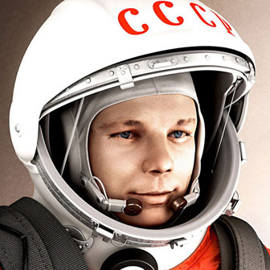

Slide 65
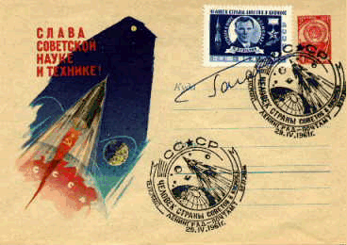
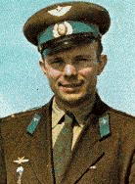
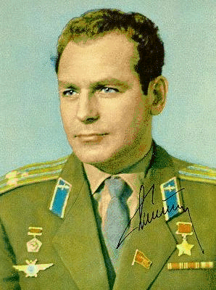
“I did not see ‘God’ anywhere in the heavens!”

Slide 66
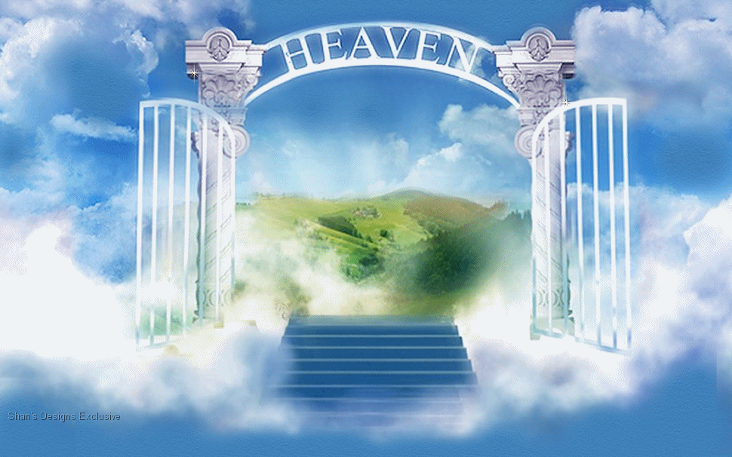

Slide 68
The astronomer Arthur Eddington once told a parable about a fisherman who used a net with a three-inch mesh. After a lifetime of fishing he concluded there were no fish shorter than three inches.
Eddington’s moral is that just as one’s fishing net determines what one catches, so it is with conceptual nets: what we find in the ocean of reality depends on the conceptual net we bring to our investigation.

Slide 69
The astronomer Arthur Eddington once told a parable about a fisherman who used a net with a three-inch mesh. After a lifetime of fishing he concluded there were no fish shorter than three inches.
Eddington’s moral is that just as one’s fishing net determines what one catches, so it is with conceptual nets: what we find in the ocean of reality depends on the conceptual net we bring to our investigation.

Slide 70
Science
Scientism

Slide 71
Science
Scientism

Slide 72
Much in our world is real even though it can’t be scientifically proven: Justice, Honor, Love, Good, evil Beauty Numbers Science Logic .

Slide 73
Much in our world is real even though it can’t be scientifically proven: Justice, Honor, Love, Good, evil Beauty Numbers, Science, Logic .

Slide 74
Complementary,
not competing

Slide 75
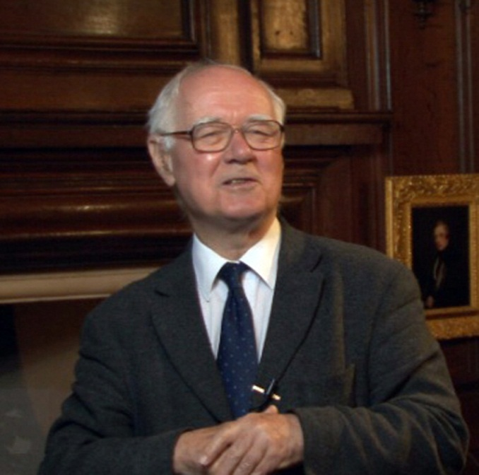
John Polkinghorne

Slide 76
Notes:
Credit: Polkinghorne

Slide 77
Burning gas is raising the temperature of the water.
Scientific.
But is this only explanation?
I want a cup of tea.
Personal.
WHY IS THE KETTLE BOILING?

Slide 78
Burning gas is raising the temperature of the water.
Scientific.
But is this only explanation?
I want a cup of tea.
Personal.
WHY IS THE KETTLE BOILING?

Slide 79
Burning gas is raising the temperature of the water.
Scientific explanation
But is this only explanation?
I want a cup of tea.
Personal.
WHY IS THE KETTLE BOILING?

Slide 80
Burning gas is raising the temperature of the water.
Scientific explanation
But is this only explanation?
I want a cup of tea.
Personal.
WHY IS THE KETTLE BOILING?

Slide 81
Burning gas is raising the temperature of the water.
Scientific explanation
But is this only explanation?
I want a cup of tea.
Personal.
WHY IS THE KETTLE BOILING?

Slide 82
Burning gas is raising the temperature of the water.
Scientific explanation
But is this only explanation?
I want a cup of tea.
Personal.
WHY IS THE KETTLE BOILING?

Slide 83
Burning gas is raising the temperature of the water.
Scientific explanation
But is this only explanation?
I want a cup of tea.
Personal.
BOTH EXPLANATIONS ARE TRUE!

Slide 84
¹The heavens declare the glory of God; the skies proclaim the work of his hands… ⁴Their voice goes out into all the earth, their words to the ends of the world.
In the heavens he has pitched a tent for the sun, ⁵which is like a bridegroom coming forth from his pavilion, like a champion rejoicing to run his course. ⁶It rises at one end of the heavens and makes its circuit to the other; nothing is hidden from its heat.
⁷The law of the LORD is perfect, reviving the soul. The statutes of the LORD are trustworthy, making wise the simple…
Psalm 19

Slide 85
¹The heavens declare the glory of God; the skies proclaim the work of his hands… ⁴Their voice goes out into all the earth, their words to the ends of the world.
In the heavens he has pitched a tent for the sun, ⁵which is like a bridegroom coming forth from his pavilion, like a champion rejoicing to run his course. ⁶It rises at one end of the heavens and makes its circuit to the other; nothing is hidden from its heat.
⁷The law of the LORD is perfect, reviving the soul. The statutes of the LORD are trustworthy, making wise the simple…
I.e., God’s “Book of Works” (Nature) and his “Book of Words” (Scripture)

Slide 86
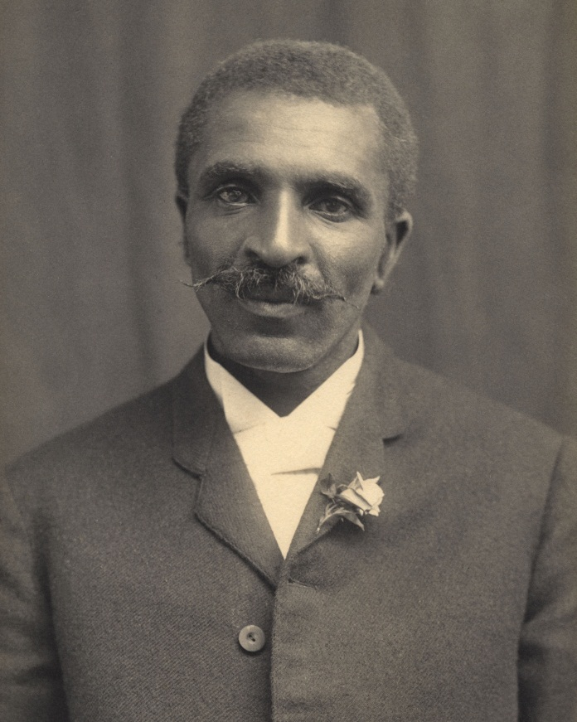
George Washington Carver

Slide 87
Foundations of modern science
Agassiz—Ichthyology Simpson—Gynecology
Babbage—Computers Mendel—Genetics
Boyle—Chemistry Ramsay—Isotropic chemistry
Faraday—Magnetism Pascal—Hydrostatics
Steno—Stratigraphy Lister—Antiseptic surgery
Kepler—Astronomy Maxwell—Electrodynamics
Pasteur—Bacteriology Kelvin—Thermodynamics
Newton—Physics

Slide 88
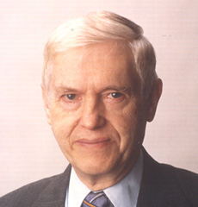
Owen Gingerich (Harvard), Author of God’s Universe (2006)
“… The universe has been created with intention and purpose…this belief does not interfere with the scientific enterprise.”
“A common-sense and satisfying interpretation of our world suggests the designing hand of a superintelligence.”

Slide 89
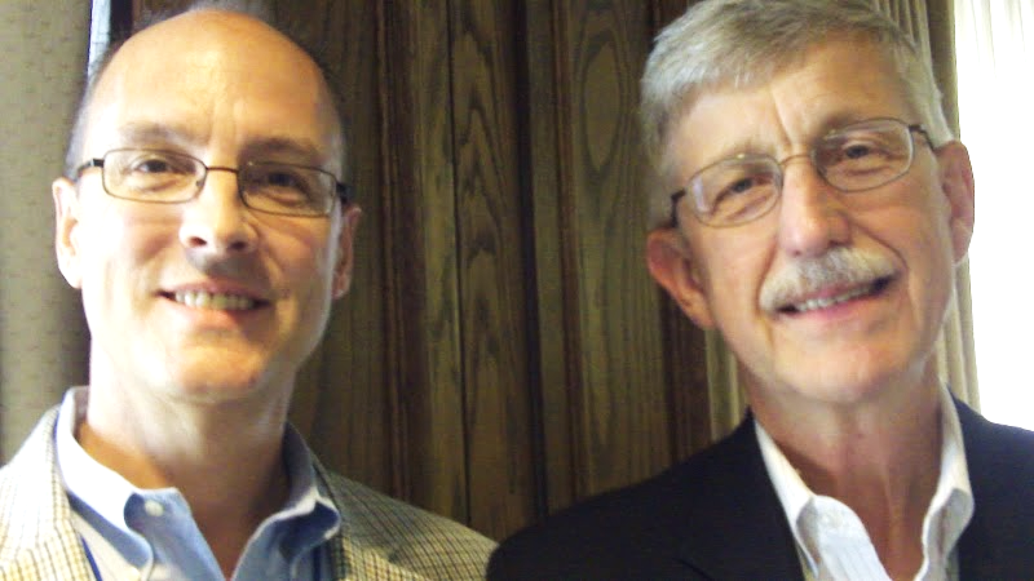
Francis Collins Director, National Institutes of Health Bethesda, Maryland, USA

Slide 91
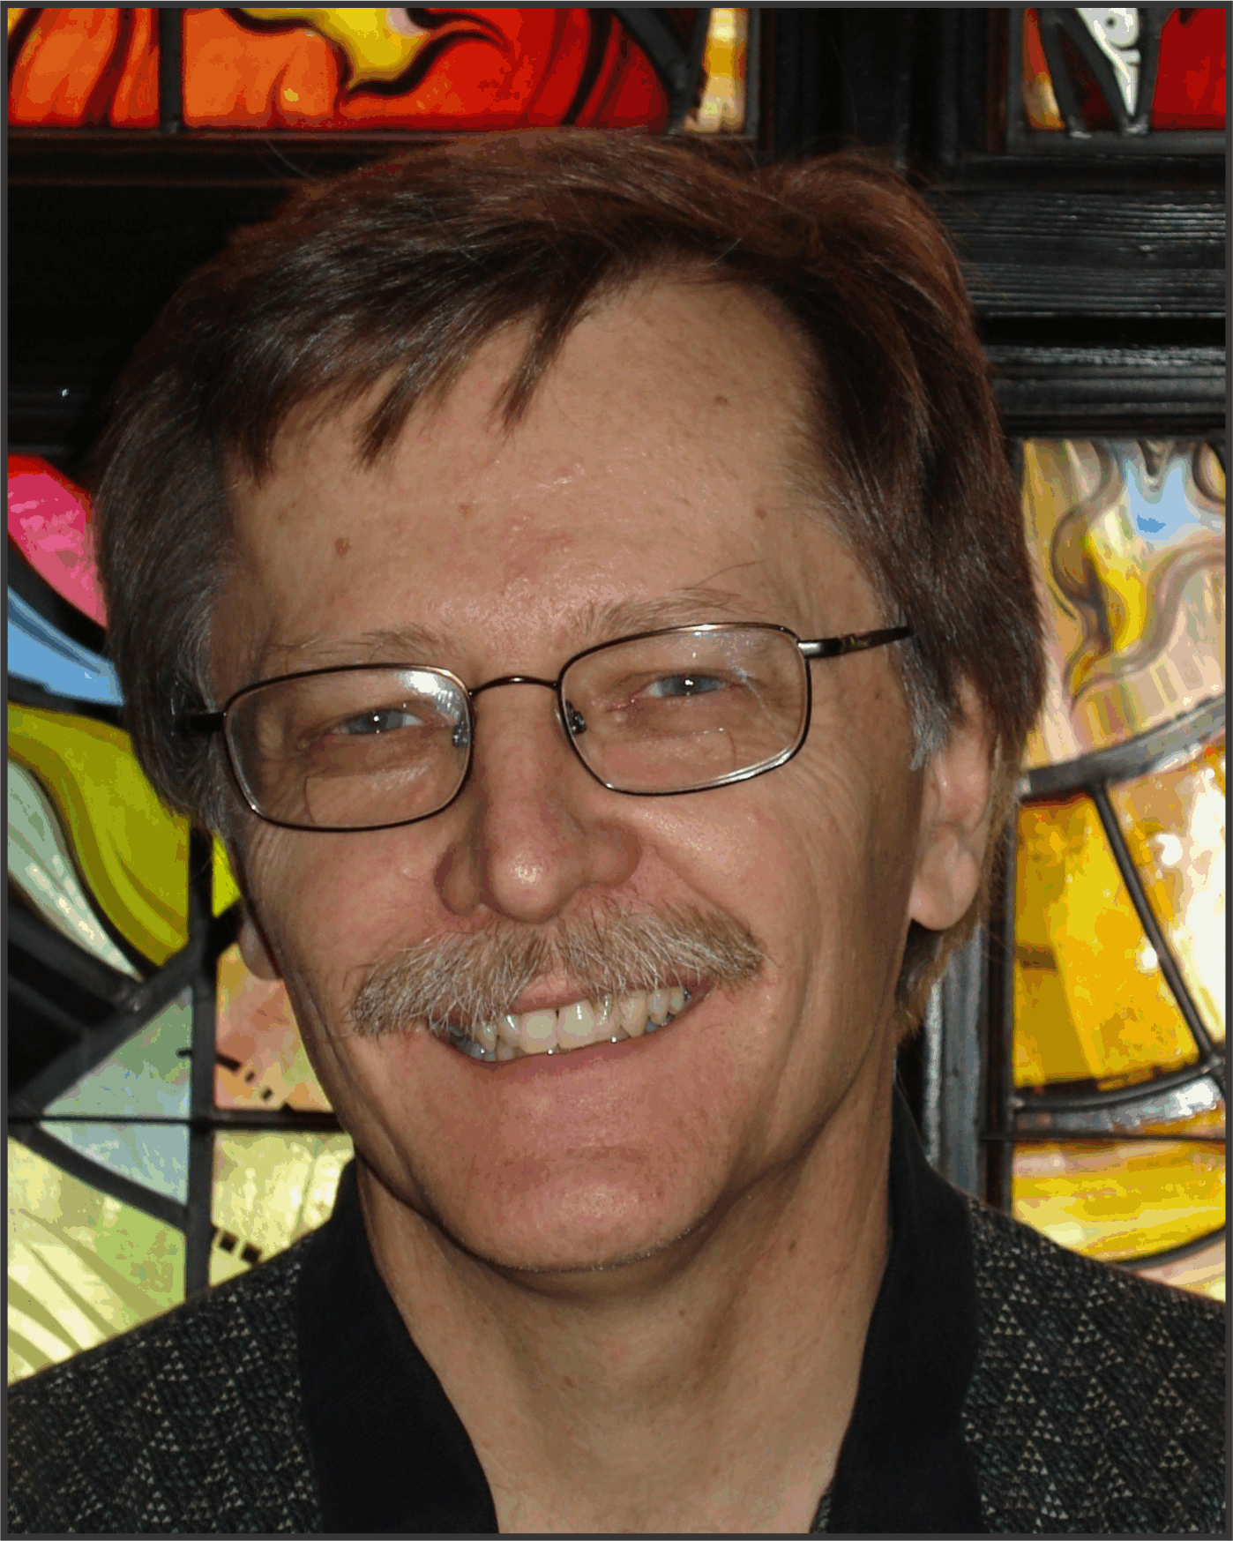
Denis Lamoureux

Slide 92
Denis Lamoureux All lectures available online (free)

Slide 93
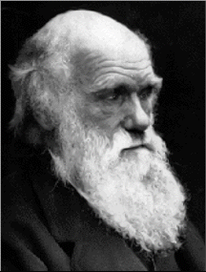
“There is grandeur in this view of life, with its several powers, having been originally breathed by the Creator, into a few forms or into one; and that, whilst this planet has gone cycling on according to the fixed law of gravity, from so simple a beginning endless forms most beautiful have been, and are being, evolved.”
— Charles Darwin, Origin of Species, editions 1860+

Slide 94
4. science and faith are complementary.

Slide 95
5. god has left us with sufficient evidence.

Slide 96
Areas
Existence of God
Character of God
Atheism
Atheists
Agnosticism

Slide 97
Areas
Truth of Bible
Text (transmission) of Bible
Dead Sea Scrolls
Applicability of Bible
Perceived contradictions
Archaeology

Slide 98
Areas
Life & Teaching of Christ
Legend—Liar—Lunatic—Lord
Messianic Prophecy
The Resurrection
Jesus Among other “gods”

Slide 99
Areas
Science & Faith
Big Bang Cosmology
Evolution
Genesis 1-11
Astronomy

Slide 100
Areas
Other Paths to God?
Islam
Hinduism, Buddhism, & New Age
“Tolerance” & “Judging”
Those Who Have Never Heard?

Slide 101
Areas
Philosophy & Philosophers
Doubt
The Problem of Suffering
The Meaning of Life
Life, Death, & Beyond
Morality & Ethics

Slide 102
5. god has left us with sufficient evidence.

Slide 103
6. if this is true, i need to respond.

Slide 104
John 7:14-17
Jesus went up to the temple courts and began to teach. Then the Jewish leaders were astonished and said, “How does this man know so much when he has never had formal instruction?” So Jesus replied, “My teaching is not from me, but from the one who sent me. If anyone wants to do God’s will, he will know about my teaching, whether it is from God or whether I speak from my own authority.

Slide 105
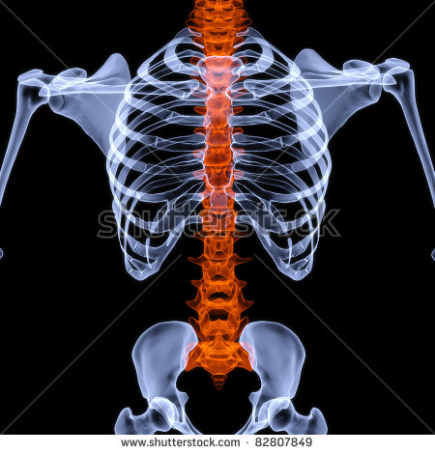

Slide 106
John 7:14-17
Jesus went up to the temple courts and began to teach. Then the Jewish leaders were astonished and said, “How does this man know so much when he has never had formal instruction?” So Jesus replied, “My teaching is not from me, but from the one who sent me. If anyone wants to do God’s will, he will know about my teaching, whether it is from God or whether I speak from my own authority.

Slide 107
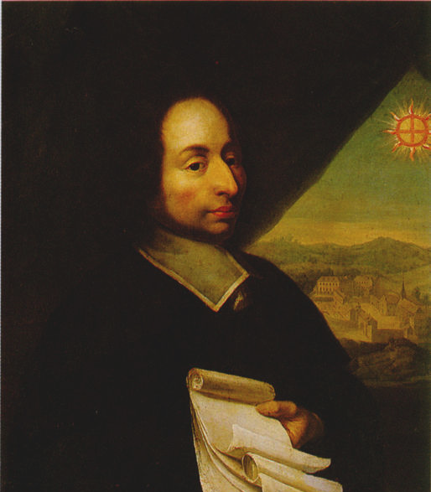
Evidence suffisante
Il a voulu se rendre parfaitement connaissable à ceux-là, et ainsi voulant paraître à découvert à ceux qui le cherchent de tout leur coeur, et caché à ceux qui le fuient de tout leur coeur il a tempéré sa connaissance, en sorte qu'il a donné des marques de soi visibles à ceux qui le cherchent et non à ceux qui ne le cherchent pas. Il y a assez de lumière pour ceux qui ne désirent que de voir, et assez d'obscurité pour ceux qui ont une disposition contraire.
– Blaise Pascal, Pensées

Slide 108
Sufficient evidence
[God] so regulates the knowledge of himself that he has given some signs of himself, visible to those who seek him and not to those who seek him not. There is enough obscurity for those who have a contrary disposition.
– Blaise Pascal, Pensées

Slide 109
For believers
^{1 Pet 3:13-16}

Slide 110
For believers
For who is going to harm you if you are devoted to what is good? But in fact, if you happen to suffer for doing what is right, you are blessed. But do not be terrified of them or be shaken. But set Christ apart as Lord in your hearts and always be ready to give an answer to anyone who asks about the hope you possess. Yet do it with courtesy and respect, keeping a good conscience, so that those who slander your good conduct in Christ may be put to shame when they accuse you.

Slide 111
For believers
For who is going to harm you if you are devoted to what is good? But in fact, if you happen to suffer for doing what is right, you are blessed. But do not be terrified of them or be shaken. But set Christ apart as Lord in your hearts and always be ready to give an answer to anyone who asks about the hope you possess. Yet do it with courtesy and respect, keeping a good conscience, so that those who slander your good conduct in Christ may be put to shame when they accuse you.

Slide 112
For believers
For who is going to harm you if you are devoted to what is good? But in fact, if you happen to suffer for doing what is right, you are blessed. But do not be terrified of them or be shaken. But set Christ apart as Lord in your hearts and always be ready to give an answer to anyone who asks about the hope you possess. Yet do it with courtesy and respect, keeping a good conscience, so that those who slander your good conduct in Christ may be put to shame when they accuse you.

Slide 113
For believers
For who is going to harm you if you are devoted to what is good? But in fact, if you happen to suffer for doing what is right, you are blessed. But do not be terrified of them or be shaken. But set Christ apart as Lord in your hearts and always be ready to give an answer to anyone who asks about the hope you possess. Yet do it with courtesy and respect, keeping a good conscience, so that those who slander your good conduct in Christ may be put to shame when they accuse you.

Slide 114
For believers
Engage!

Slide 115
1. use your head 2. realize the nature of the Bible 3. there’s more than one way to tell a story 4. science & faith are complementary 5. god has left us with sufficient evidence 6. if this is true, i need to respond

Slide 116
It’s not complicated. Woof-woof!

Slide 117
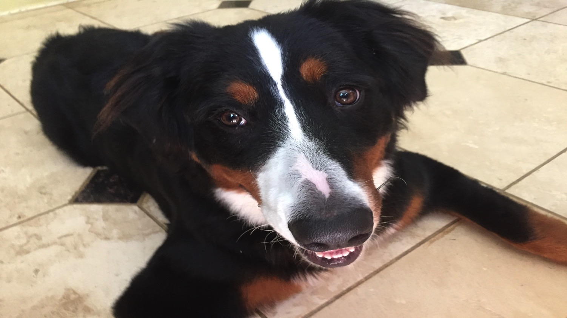

Slide 118
Makes sense to me. I’m a believer. Life’s good.

Slide 119
It’s not complicated.

Slide 121
Just do it!

Slide 122
WOOF

Slide 123
Just do it!

Slide 124
International Bible Teaching Ministry Free. Weekly newsletter Sign up at website. www.DouglasJacoby.com

Slide 125
From Facts to Faith

